Slide 2
Faculty Panel
Joshua S. Jacobs, MD
Medical Director of Clinical Research
Allergy & Asthma Medical Group
Walnut Creek, California
William R. Lumry, MD
Clinical Professor
Department of Internal Medicine/Allergy
University of Texas
Southwestern Medical School
Private Practice
Dallas, Texas
Michael E. Manning, MD, FACAAI
President and Medical Director
Medical Research of Arizona
Allergy, Asthma & Immunology Associates, Ltd.
Scottsdale, Arizona
Marc A. Riedl, MD, MS
Professor of Medicine
Clinical Director of
US HAEA Angioedema Center
Fellowship Program Director
Division of Rheumatology, Allergy,
and Immunology
University of California, San Diego
La Jolla, California

Slide 3

Current Management of Hereditary Angioedema: Considerations to Optimize Individualized Care
Disclosures of Financial Relationships
Michael E. Manning, MD, FACAAI, Moderator
  Consultant/Advisor: CSL Behring, Pharming, Shire,
  Contracted Research: AstraZeneca, CSL Behring, Dyax, GlaxoSmithKline,
  Regeneron, Shire
  Speaker: Circassia, CSL Behring, Genentech, Pharming, Shire, Teva
Joshua S. Jacobs, MD
  Consultant/Advisor: CSL Behring, Pharming, Regeneron, Shire, Teva
  Contracted Research: CSL Behring, Genentech, Regeneron, Sanofi, Shire, Teva
  Speaker: Shire, Teva

Slide 4
Current Management of Hereditary Angioedema: Considerations to Optimize Individualized Care
Disclosures of Financial Relationships
William R. Lumry, MD
  Consultant: Biocryst, CSL Behring, Genentech, Pharming, Shire
  Contracted Research: Bio Products Lab, Circassia, CSL Behring, Genentech, Kedrion, Shire, Teva, Therapure
  Speaker: AstraZeneca, CSL Behring, Greer, Meda, Pharming, Shire
Marc A. Riedl, MD, MS
  Consultant/Advisor: Biocryst, CSL Behring, Dyax, Pharming, Shire
  Contracted Research: Biocryst, CSL Behring, Dyax, Pharming, Shire
  Speaker: CSL Behring, Dyax, Pharming, Salix, Shire, Valeant

Slide 5
Current Management of Hereditary Angioedema: Considerations to Optimize Individualized Care
Learning Objectives
Differentiate key signs and symptoms of HAE from other common conditions and review the diagnostic tests in HAE
Review the kallikrein-bradykinin system in HAE attacks
Discuss the role of bradykinin receptors in HAE attacks and potential pathophysiologic explanations for multi-site attacks
Identify key considerations in development of individualized treatment plans for patients with HAE

Slide 6
Agenda
Welcome and Introductions
Michael E. Manning, MD
HAE Overview
Michael E. Manning, MD
Case Study I – Accurate Diagnosis of HAE
Joshua S. Jacobs, MD
Case Study II – Acute Management of HAE
Marc A. Riedl, MD, MS
Case Study III – Considerations for Prophylaxis in HAE
William R. Lumry, MD
Questions and Discussion
Adjourn

Slide 7
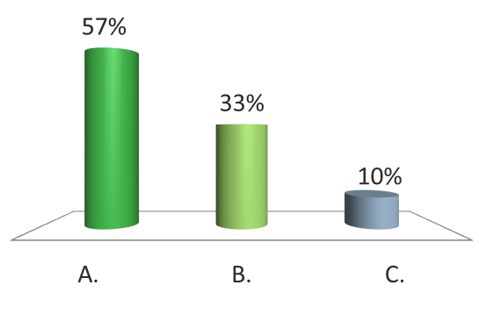

Pretest Audience Response Question
1
A 22-year-old female patient with a family history of HAE presents to your office with a complaint of symptoms of HAE. She describes 2 attacks over the past 6 months that included peripheral angioedema and moderate abdominal pain. Peripheral edema affects approximately 96% of patients with HAE while abdominal attacks occur in what percentage of patients with HAE?
73
83
93

Slide 8
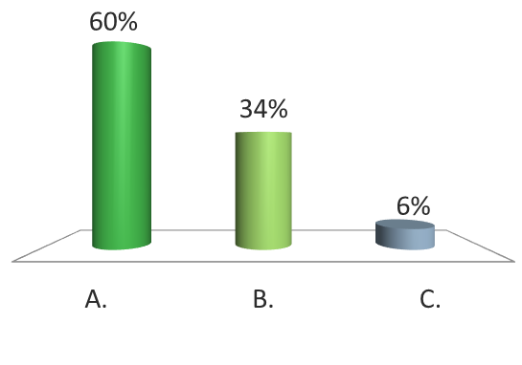
Pretest Audience Response Question
2
The patient’s history reveals that she first developed symptoms consistent with HAE approximately 3-4 years ago. The onset of symptoms for the majority of patients with HAE occurs at what age?
0-20 years old
21-30 years old
>30 years old

Slide 9
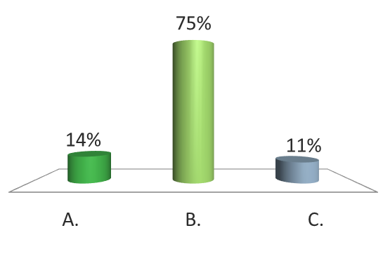
Pretest Audience Response Question
3
To confirm the diagnosis of HAE in this patient, complement testing is completed. The patient’s results indicate a normal to high C1-INH level, low C1-INH function, and a low C4 level. Her C3 and C1q levels are also normal. The appropriate diagnosis for this patient is which of the following?
HAE Type I
HAE Type II
HAE with normal C1-INH

Slide 10
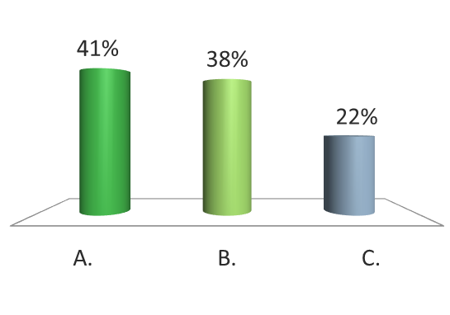
Pretest Audience Response Question
4
A recent paper by Hofman et al presented an activation model that assumes a systemic fluid-phase activation of the contact system leading to HAE attacks. This pathogenic model implicates which of the following as an explanation for the systemic activation process resulting in local attacks and why angioedema can occur at multiple sites during an attack?
Initial bradykinin (BK) formation
Activation of BK receptor 2
Activation of BK receptor 1

Slide 11
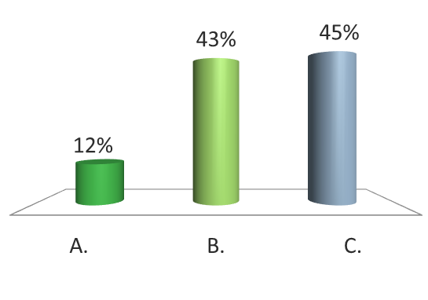
Pretest Audience Response Question
5
Ray is a 22-year-old patient who was diagnosed with HAE Type 1 at 16-years-old. His treatment plan for management of acute attacks has been administration of C1-INH at his local emergency department. Ray has recently graduated from college and is interested in self-administration of therapy for acute attacks. A 2015 paper by Wang et al indicated the greatest barrier to choosing self-administered therapy (occurring in 32% of patients) was which of the following?
Performance
Expense
Learning correct technique

Slide 12
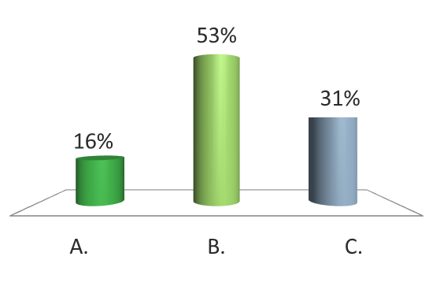
Pretest Audience Response Question
6
Ray’s treatment plan is revised for at home administration of treatment for acute attacks. Education is provided and an HAE action plan is put in place. Early treatment of the acute attack is stressed, as a 2013 paper by Maurer et al indicated that the average duration of an acute attack treated within the first 2 hours after onset was 7.2 hours vs a duration of approximately how many hours for an attack treated >2 hours after onset?
10 hours
20 hours
30 hours

Slide 13
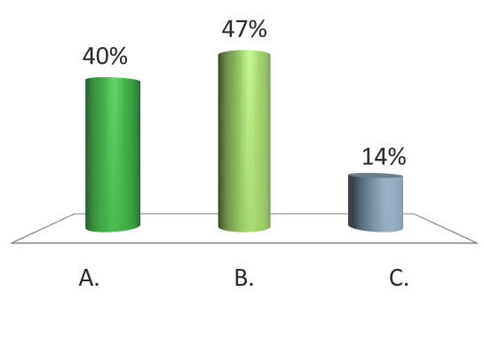
Pretest Audience Response Question
7
Allison is a 29-year-old female who presents to your office following treatment in the ED for an acute attack of HAE. She was diagnosed with HAE at 24-years-old. Her current treatment regimen for acute attacks is self-administered icatibant. Her attack frequency has increased over the past 2 years. When considering prophylactic therapy, an attack frequency of which of the following may indicate a need for prophylactic therapy?
≥1 attack per month
≥2 attacks per month
≥3 attacks per month

Slide 14
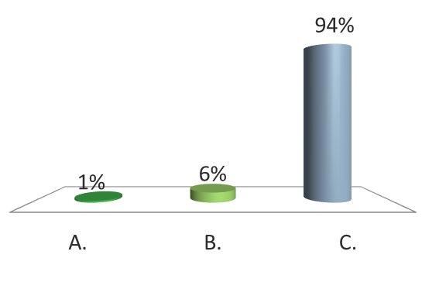
Pretest Audience Response Question
8
Allison is open to prophylactic therapy. She explains that she would prefer to be able to administer therapy at home and she and her husband are considering having children. The most appropriate therapy for Allison is which of the following?
Androgens
Tranexamic acid
C1-INH

Slide 15
HAE Overview
Michael E. Manning, MD

Slide 16
Hereditary Angioedema
A rare autosomal genetic disorder affecting an estimated 1:10,000 to 1:50,000 patients
Positive family history in ~75% of cases
Angioedema often severe
Attacks unpredictable
  Increase over 24 hours
  Resolve over 2 to 4 days
Unresponsive to treatment with antihistamines, corticosteroids,
and epinephrine
Associated with considerable morbidity and mortality
Notes:
Slide 16
Abdominal attacks cause significant morbidity. The barium enema on the left shows evidence of spiculation and thickening of intestinal folds, whereas the intraluminal images from a swallowed camera show how edematous the bowel can become.
Abdominal attacks can cause severe abdominal pain, nausea, and vomiting. Bowel sounds are often diminished or even silent, but guarding and rebound tenderness may be elicited on physical examination. Third-spacing of fluid can cause clinically significant hypotension. In many cases, patients with HAE have undergone unnecessary surgery because the severity of their symptoms mimicked that of a surgical abdomen.

Slide 17
HAE Burden of Disease
Disease Burden
Decreased Physical Health
Decreased Mental Health
Greater Depression
Impaired Productivity
Treatment Costs (2008)
$14,000 - $96,000 per patient

Slide 18
Causes of Angioedema
Allergies: foods, drugs, insect stings/bites
Radiocontrast media
ASA and other NSAIDs
Autoimmune
ACE inhibitor-induced
C1 inhibitor deficiency
  Hereditary: Types I, II
  Acquired
Hereditary with normal C1-INH
Idiopathic
  Histamine-induced/Mast cell-mediated
  Bradykinin-induced
ACE, angiotensin-converting enzyme; ASA, acetylsalicylic acid; C1-INH, C1 inhibitor; NSAID, nonsteroidal anti-inflammatory drug.
Agostoni A. J Allergy Clin Immunol. 2004;114:S51-S131.
Cichon S. Am J Hum Genet. 2006;79:1098-1104.

Slide 19
HAE Attacks
Caused by the extravasation of plasma into the deeper cutaneous or mucosal layers due to bradykinin release
Manifest as swelling of the skin, abdominal pain, and/or potentially life-threatening upper airway obstruction
Are recurrent and unpredictable
May be frequent and/or severe, but are highly variable between patients and within families
Nzeako UC, et al. Arch Intern Med. 2001;161:2417-2429.
Agostoni A, et al. J Allergy Clin Immunol. 2004;114:S51-S131.
Bork K, et al. Mayo Clin Proc. 2000;75:349-354.

Slide 20
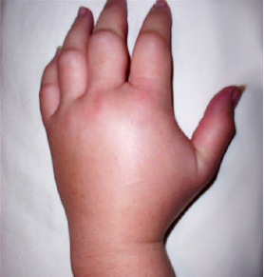
HAE Extremity Attacks
Peripheral angioedema
Affects 96% of patients
Functionally disabling
  Hands: difficulty holding,
  typing, use of phone
  Feet: impedes walking, standing
Interferes with school
Rarely results in hospitalization
Frank MM, et al. Ann Intern Med. 1976;82:580-593.
Frank MM. Immunol Allergy Clin North Am. 2006;26:653-668.
Notes:
20
Extremity attacks may be overlooked by physicians as insignificant, but they frequently lead to functional and occupational disability; hands and feet can be affected, interfering with patients’ abilities to drive, type, talk on the phone, walk and stand. Not surprisingly, acute attacks of HAE in the extremities can significantly interfere with work and school, although they rarely result in hospitalization.
References:
Frank MM, Gelfand JA, Atkinson JP. Hereditary angioedema: the clinical syndrome and its management. Annals Int Med. 1976;84:580-593.
Frank MM. Hereditary angioedema: the clinical syndrome and its management in the United States. Immunol Allergy Clin North Am. 2006;26:653-668.

Slide 21
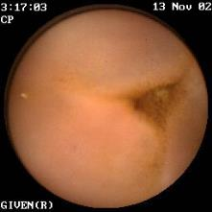
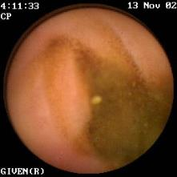
Abdominal Attacks
Bowel Edema
Occur in 93% of patients with HAE
Mild to severe colicky pain
Vomiting common; constipation/diarrhea may occur
Functional intestinal obstruction
Fluid loss may lead to hemoconcentration and hypovolemic shock
Protuberant abdomen, tenderness, and rebound possible
Symptoms mimic surgical emergencies, resulting in misdiagnosis and unnecessary surgery
Edematous
Ileum
After
Treatment
Frank MM, et al. Ann Intern Med. 1976;84:580-593.
Agostoni A, et al. J Allergy Clin Immunol. 2004;114:S51-S131.
Frank MM. Immunol Allergy Clin North Am. 2006;26:653-668.
Agostoni A, Cicardi M. Medicine. 1992;71:206-215.
Pictures courtesy of Dr. Marco Cicardi.
Notes:
Although HAE afflicts few individuals, the symptoms are often severe and may require intensive intervention.
34% of misdiagnosed patients have unnecessary surgery (appendectomy, exploratory laparoctomy, or both). Frequently these attacks lead to hospitalization.
Lack of clinical familiarly is problematic in treating abdominal attacks in patients with HAE.
Agostoni A, Cicardi M. Medicine. 1992;71:206-215.
Annotation
Frank 1976, 581 A
Agostoni 2004 S55 A
Frank 2006, 653-654 B
Agostoni 2004 S55 B
Agostoni 1992, 210 A
Annotation
Agostoni 1992, 210 A
Agostoni 1992, 210 B

Slide 22
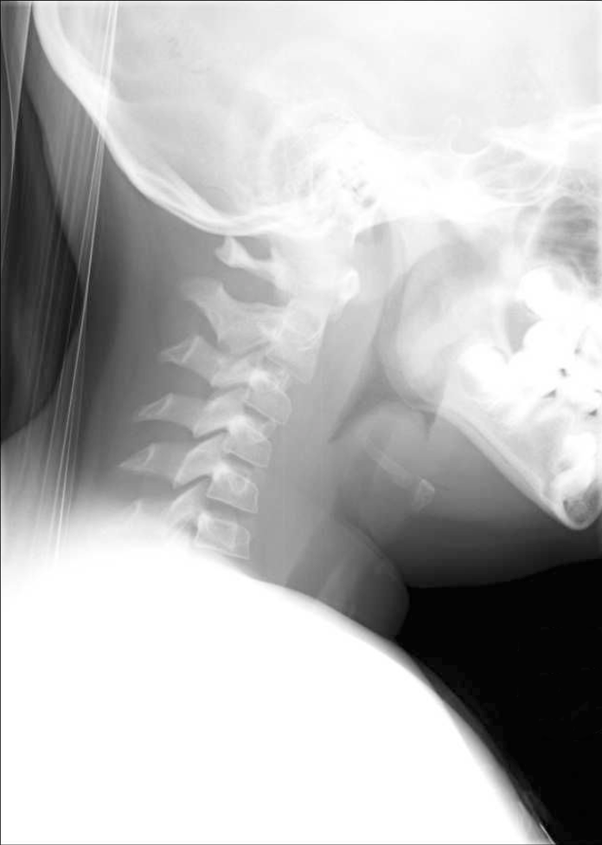
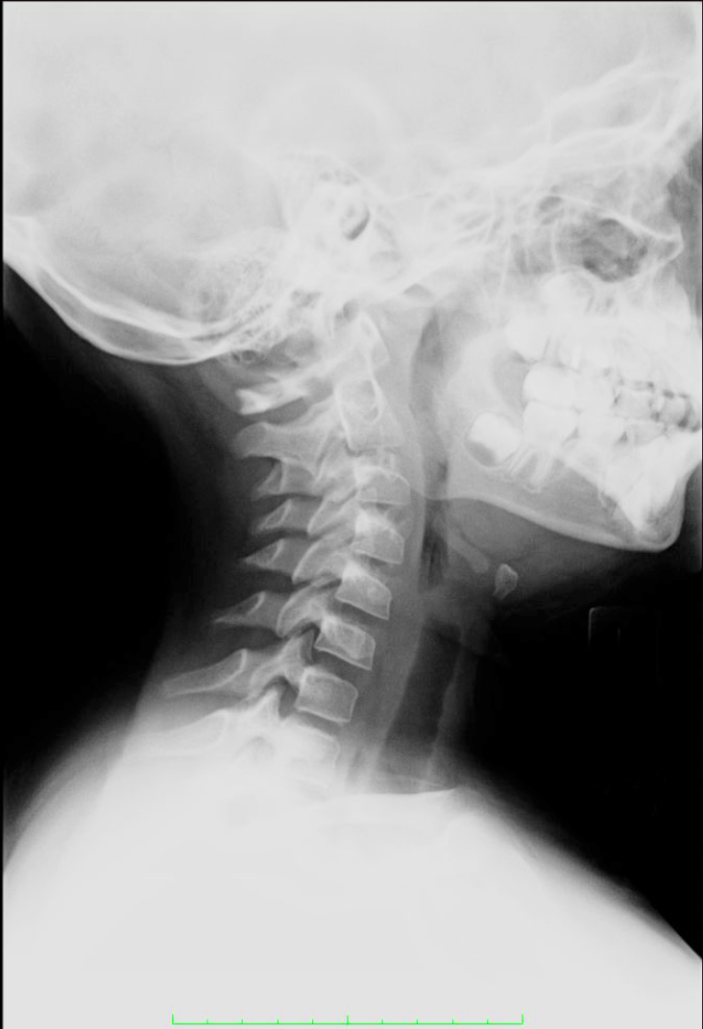
HAE Laryngeal Attacks
Occur in ~50% of patients during their lifetime
Require airway management to prevent asphyxiation
Are of particular concern in children, given the heightened risk for asphyxiation associated with a smaller airway
Bork K, et al. Arch Intern Med. 2003;163:1229-1235.
Bork K, et al. Mayo Clin Proc. 2000;75:349-354.
Bork K, et al. Arch Intern Med. 2001;161:714-718.
Radiographs courtesy of William Lumry, MD.
Notes:
Acute oropharyngeal/laryngeal attacks may occur in up to 50% of patients with HAE.¹ This potentially life-threatening event requires careful monitoring and airway management with intubation or tracheotomy is necessary in some cases. In a retrospective survey of 58 HAE patients, the incidence of asphyxiation in untreated laryngeal attacks was as high as 40%, underscoring the severity of this event.²
References:
Bork K, HardtJ, SchicketanzKH, Ressel N. Clinical studies of sudden upper airway obstruction in patients with hereditary angioedemadue to C1 esterase inhibitor deficiency. Arch Intern Med. 2003;163:1229-1235.
Bork K, Siedlecki K, Bosch S, Schopf RE, Kreuz W. Asphyxiation by laryngeal edema in patients with hereditary angioedema. Mayo Clin Proc. 2000;75:349-354.
22

Slide 23
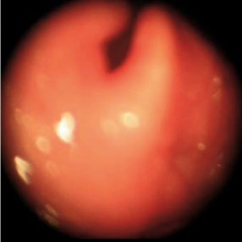
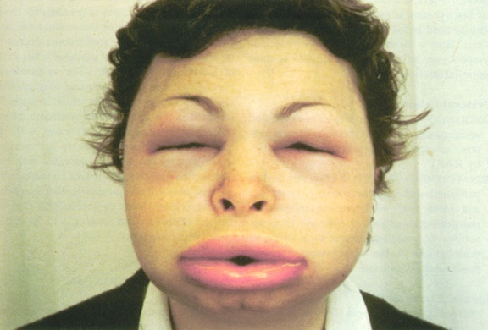
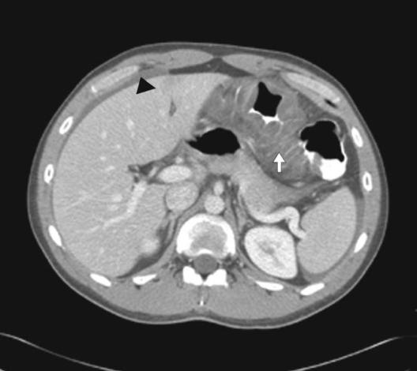
Recognition of Clinical Symptoms

Slide 24
Onset of Symptoms Occurs Early in the First 2 Decades in Majority of Cases
15
10
Number of Patients
5
0
0
10
20
30
40
Age at Onset (Years)
Frank MM, et al. Ann Intern Med. 1976;84:580-593; Nzeako UC, et al. Arch Intern Med. 2001;161:2417-2429; Farkas H, et al. Pediatr Allergy Immunol. 2002;13:153-161; Agostoni A, et al. J Allergy Clin Immunol. 2004;114:S51-131; Frank MM. Curr Opin Pediatr. 2005;17:686-689; Bork K, et al. Am J Med. 2006;119:267-274; Bygum A. Br J Dermatol. 2009;161(5):1153-1158; Farkas H. Allergy Asthma Clin Immunol. 2010;6:18; Nielsen EW, et al. Pediatr Res. 1994;35(2):184-187.
Notes:
In ~50% of HAE patients, the symptoms first occur during childhood, usually between 4 and 11 years of age
Although some patients can suffer attacks in the first year after birth
Early onset of symptoms may mean more severe course of HAE
Symptoms and frequency of attacks increase during periods of intense physiological development, such as between age 3 and 6 years and at the onset of puberty
Frank MM, et al. Ann Intern Med. 1976;84:580-593; Nzeako UC, et al. Arch Intern Med. 2001;161:2417-2429; Farkas H, et al. Pediatr Allergy Immunol. 2002;13:153-161; Agostoni A, et al. J Allergy Clin Immunol. 2004;114:S51-131; Frank MM. Curr Opin Pediatr. 2005;17:686-689; Bork K, et al. Am J Med. 2006;119:267-274;
Bygum A. Br J Dermatol. 2009;161(5):1153-1158; Farkas H. Allergy Asthma Clin Immunol. 2010;6:18. Nielsen EW, et al. Pediatr Res. 1994;35(2):184-187.

Slide 25
Anatomical Location of HAE Symptoms
221 patients with HAE
5,736 patient-years of observation
131,110 angioedema attacks
Per-patient Analysis
Per-episode Analysis
100%
50%
48%
97%
54%
22%
9%
8%
5%
3.6%
5%
4%
4%
4%
2%
Bork K, et al. Am J Med. 2006;119:267-274.

Slide 26
Airway Angioedema
Age at time of death from asphyxiation in 70 patients with HAE-C1-INH
182 families: 728 patients
Death from asphyxiation:
  7/527 (1.3%) in diagnosed
  patients
  63/201 (31%) in undiagnosed patients
Bork K, et al. J Allergy Clin Immunol. 2012;130:627-629.

Slide 27
Unmet Needs in HAE
Understanding of the underlying pathways
Improving HAE symptom recognition and accurate diagnosis
Strategies to implement appropriate acute and prophylactic treatments
To treat at home or not to treat at home?
Creating an HAE action plan/ensuring attack preparedness

Slide 28
Accurate Diagnosis of HAE
Joshua S. Jacobs, MD

Slide 29
Pathways Underlying HAE

Slide 30
Function of C1-INH
Trace FXIIa or trace activity
in native FXII
Prekallikrein
FXII
FXIIa
Surface
HK
HK
Kallikrein
HK
Bradykinin
FXII
FXIIa
FXIIf
Surface
Autodigestion
Kallikrein
= Inhibited by C1-INH
C1
¯
C₄ & C₂
Digestion
C1
FXII, factor XII; HK, high-molecular-weight kininogen.
Notes:
Slide 30
C1-INH inhibits all active enzymes of the bradykinin-forming cascade. It inhibits all functions of factor XIIa (factor XII autoactivation and conversion of prekallikrein to kallikrein). C1-INH inhibits kallikrein as well as blocks the feedback activation of factor XII (bold arrow) and the cleavage of HMW-kininogen to generate bradykinin. A second cleavage by kallikrein converts factor XIIa (80 Kd) to factor XIIf (fragment of 30 Kd) and factor XIIf activates the C1r subcomponent of complement C1. The C1 then digests and activates its substrates C4 and C2. Both factor XIIf and activated C1 are inhibited by C1-INH. Although C4 is low in asymptomatic patients, the formation of factor XIIf and its activation of C1r during an attack of swelling is the likely reason C4 levels then approach zero and C2 is depleted.

Slide 31
Bradykinin is the Mediator of Angioedema in HAE
Triggers
Injury, inflammation, negatively charged surfaces and macromolecules, gC1qR, some aggregated proteins
Contact (Kinin) Activation
PK
Surface
HK
FXII
FXIIa
Intrinsic Coagulation
Surface
HK
FXIIf
HK
Autodigestion
Kallikrein
Kallikrein
FXI
FXIa
Complement
Bradykinin
–
Digestion of C4 and C2
C1
C1
Thrombin
Fibrin
–
C1r → C1r
C1s → C1s
Angioedema
–
FXI, factor XI; PK, prekallikrein.
Kaplan AP, et al. Clin Rev Allergy Immunol. 2016;51:207-215.
Notes:
Diagram of reactions leading to bradykinin formation and complement activation upon addition of a surface known to catalyze auto-activation of FXII. The kallikrein “feedback” is that a small amount of kallikrein evolves; it cleaves factor XII to yield factor XIIa (first) and then cleaves factor XIIa to factor XIIf.

Slide 32
Systemic Contact Activation Leads to Local Angioedema
Minor trauma? Not necessarily at site of attack?
Initial contact activation
Low C1-INH
Dissemination of contact activation throughout the circulation
Elevated BK
Cleaved HK
Prodromal symptoms
Initial BK
Desensitization of B2R
No hypotension
Cytokines, endotoxins, kinins
Angioedema where B1R is present
From 0 up to 5 locations
On initial triggering by BK, B2R becomes functionally inactive because of desensitization. BK levels are preferentially degraded by CPN or CPM into desArg9-BK, which induces angioedema at sites where B1R is expressed.
BK, bradykinin; B1R, bradykinin receptor 1; B2R, bradykinin receptor 2; CPN, carboxypeptidase N; CPM, carboxypeptidase M.
Hofman ZL, et al. J Allergy Clin Immunol. 2016;138:359-366.
Notes:
Hereditary angioedema (HAE) caused by a deficiency of
functional C1-inhibitor (C1INH) becomes clinically manifest as
attacks of angioedema. C1INH is the main inhibitor of the
contact system. Poor control of a local activation process of this
system at the site of the attack is believed to lead to the
formation of bradykinin (BK), which increases local
vasopermeability and mediates angioedema on interaction with
BK receptor 2 on the endothelium. However, several
observations in patients with HAE are difficult to explain from a
pathogenic model claiming a local activation process at the site
of the angioedema attack. Therefore we postulate an alternative
model for angioedema attacks in patients with HAE, which
assumes a systemic, fluid-phase activation of the contact system
to generate BK and its breakdown products. Interaction of these
peptides with endothelial receptors that are locally expressed in
the affected tissues rather than with receptors constitutively
expressed by the endothelium throughout the whole body
explains that such a systemic activation process results in local
manifestations of an attack. In particular, BK receptor 1, which
is induced on the endothelium by inflammatory stimuli, such as
kinins and cytokines, meets the specifications of the involved
receptor. The pathogenic model discussed here also provides an
explanation for why angioedema can occur at multiple sites
during an attack and why HAE attacks respond well to modest
increases of circulating C1INH activity levels because inhibition
of fluid-phase Factor XIIa and kallikrein requires lower C1INH
levels than inhibition of activator-bound factors. (J Allergy Clin
Immunol 2016;138:359-66.)

Slide 33
Discussion
How does our understanding of the pathways underlying HAE guide treatment?

Slide 34
Major Types of Angioedema
 | Mast-cell Mediated or Allergic | Bradykinin-mediated or Nonallergic
Onset | Minutes to hours | Hours
Urticaria | + | —
Pruritus | + | —
Pain/burning | — | May be present
Response to antihistamine | + | —
Response to steroids | + | —
Notes:
Slide 34
Take home point: remember the main 2 underlying mediators of angioedema and the clues to differentiating these.

Slide 35
Diagnostic Algorithm for Angioedema
Not a C1-INH
deficiency
C4
Normal
Low
C1 inhibitor antigen
Normal
Low
C1 inhibitor function
C1q antigen
Low
Normal
Normal
Low
Type II HAE
Idiopathic
Type I HAE
Acq C1-INH Def
Acq, acquired; Def, deficiency.

Slide 36
Evaluating for Angioedema
Skin
  Episodic
    Photographs valuable
  Non-pitting
  Localized
  Involves skin or mucosa
  Relatively rapid onset: minutes to hours
  Frequently asymmetric distribution
  Distribution not in dependent areas
  Differential diagnosis: granulomatous cheilitis (Melkersson-Rosenthal), SVC syndrome, lymphedema, capillary leak syndrome (Clarkson),
  autoinflammatory syndromes, contact dermatitis, cellulitis
SVC, superior vena cava.

Slide 37
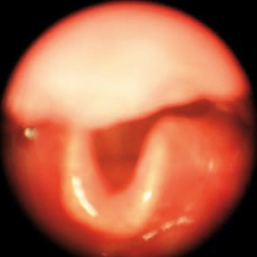
Evaluating for Angioedema (Cont’d)
Airway symptoms, “throat closing/choking” challenging to evaluate
  VCD
  Tracheomalacia
  Exercise-induced asthma
Recurrent abdominal pain: consider other potential causes
With
Symptoms
Normal
VCD, vocal cord dysfunction.

Slide 38
Additional Questions and History
Any history of urticaria, angioedema, skin or airway swelling?
Treatment received and efficacy of that treatment?
Any family history of similar issues?
Exacerbating factors?

Slide 39
Case Study #1: Chris, 12-year-old Male
Chris presents to your office with a complaint of recurrent abdominal pain
Previously diagnosed with inflammatory bowel disease by internist and has been referred to you following gastroenterology consult
Description of complaint:
  Abdominal pain lasting between a few hours to 2-3 days
  Pain and duration have increased in intensity recently
  Most recent attack accompanied by nausea and vomiting with
  mild diarrhea

Slide 40
Chris, 12-year-old Male: History
No notable medical history prior to recent abdominal pain
Family history of irritable bowel syndrome (grandfather
and aunt)
Recently relocated to your area and started in a new school 6 months ago

Slide 41
Chris, 12-year-old Male: Physical Exam and Previous Test Results
Vital signs are normal
Exam reveals:
  Normal abdomen
  No organomegaly or masses
Previous test results found normal:
  WBC counts
  Amylase, lipase, metabolic panel, and C-reactive protein
  Stool analysis
  Urine analysis
  Abdominal ultrasound
  Fecal calprotectin
  Upper and lower endoscopies
WBC, white blood cell.

Slide 42
Differential Diagnosis of Abdominal Pain
Biliary disease
Acute pancreatitis
Dyspepsia
Hiatus hernia
Pneumonia
Myocardial infarction
Splenic abscess or infarction
Appendicitis
Diverticular disease
Kidney stones
Bladder distension
Pelvic pain
Mesenteric ischemia and infarction
Ruptured aneurysm
Peritonitis
Intestinal obstruction
Sickle cell disease
Women
  Pelvic inflammatory disease
  Adnexal pathology
  Endometriosis
  Ectopic pregnancy
  Endometritis
  Leiomyomas
Celiac artery compression syndrome
Painful rib syndrome
Wandering spleen syndrome
Abdominal wall pain
Abdominal migraine
Mesenteric lymphadenitis
Eosinophilic gastroenteritis
Epiploic appendagitis
Abdominal compartment syndrome
Fitz-Hugh-Curtis syndrome
Familial Mediterranean fever

Slide 43
HAE Abdominal Attacks
80
70
60
50
40
30
20
10
0
No. of Attacks
(Prospective Part)
153 patients reporting abdominal HAE attacks: 169 prospective; 33,671 retrospective
Bork K. Am J Gastroenterol. 2006;101:619-627.

Slide 44
Phases and Time Course of Typical HAE
Abdominal Attack
Phases
0
1
2
3
4
8
6
4
2
0
Mean pain score
Pain Score
Day 1
Day 2
Day 3 Day 4
Time (Days)
Time (Hours)
0 10 20 30 40 50 60 70 80 90
Phase 0: Pre-phase
Phase 1: Early abdominal phase
Phase 2: Crescendo phase
Phase 3: Maximum phase
Phase 4: Decrescendo phase
Bork K. Am J Gastroenterol. 2006;101:619-627.

Slide 45
Clinical Pearl: Testing
C4 level is an excellent screening test for HAE
  Readily available in most hospitals and clinical labs
  No special handling of blood specimen (serum red-top tube)
  95% of time will be low between attacks in patients with HAE
  >99.5% of time will be low during an attack
  Borderline-low results should be repeated if clinical suspicion high for HAE
  Can be confirmed with C1-INH antigenic or functional assay
  Inexpensive
Notes:
45

Slide 46
C4 Levels in HAE Due to C1-INH Deficiency
1,000,000
100,000
10,000
<500
Normals
Mean ± 2 SD
C4 Units per mL Serum
SD, standard deviation.
Frank MM, et al. Ann Intern Med. 1976;84:580-593.

Slide 47
C1-INH Functional Assay Differences
150
100
50
0
Chromogenic Assay
% fC1-INH
P H
140
120
100
80
60
40
20
0
On-site individual lab-determined reference value
Complex ELISA Assay (Quidel)
% fC1-INH
Manufacturer-recommended “normal” reference value
ELISA, enzyme-linked immunosorbent assay; fC1-INH, functional C1-INH; H, healthy; P, patients.
P H
Wagenaar-Bos IG, et al. J Immunol Methods. 2008;338:14-20, with permission.
Confirmed HAE Healthy
Notes:
It is important to understand specific potential pitfalls to current commercial C1INH functional lab testing in the US. The “off-the-shelf” assay kit offered by many large commercial laboratories is the Quidel ELISA assay. A recent study by a European consortium determined that the manufacturer recommended normal values for C1-INH function may lead to falsely “normal” levels in a proportion of patients previously confirmed to have HAE by lab testing using other methods. Thus, the sensitivity of this specific assay may be compromised potentially leading to missed diagnoses. The sensitivity may be improved by local labs performing their own standard testing and determining a more appropriate normal reference range, as demonstrated by the dashed line in Figure B. In Europe and other parts of the world, the chromogenic C1-INH functional assay is the preferred method for diagnostic testing due to the reliable and reproducible results. This assay is currently available in the US through National Jewish Laboratories in Denver.
Reference:
Wagenaar-Bos IG, Drouet C, Aygören-Pursun E, et al. Functional C1-inhibitor diagnostics in hereditary angioedema: assay evaluation and recommendations. J Immunol Methods. 2008;338:14-20.

Slide 48
Comparison of C1-INH Functional Assays
93% agreement between chromogenic and ELISA assays
Chromogenic:
  45/45 C1-INH-deficient patients low (<74%): 100% sensitivity
  29/30 Normal patients normal (≥74%): 97% specificity
ELISA:
  10/45 C1-INH-deficient patients with equivocal (41% to 67%) results
  2/45 C1-INH-deficient patients with normal (>67%) results
  33/45 C1-INH-deficient patients with low (<41%) results: 73% sensitivity
  30/30 Normal patients with normal results: 100% specificity
Sensitivity of baseline C4 in detecting C1-INH deficiency: 86%
Li H, et al. J Allergy Clin Immunol Pract. 2015;3:200-205.

Slide 49
Chris, 12-year-old Male: Laboratory Results
CBC, amylase, lipase, CMP, and CRP normal
Complement testing
  C4: low
  C1-INH quantitative: normal
  C1-INH functional: low
  C1q: normal
CBC, complete blood cell count; CMP, comprehensive metabolic profile; CRP, C-reactive protein.

Slide 50
Clinical Pearl: Complement Testing in Recurrent Angioedema
Type | C1-INH Level | C1-INH Function | C4 Level | C3 Level | C1q Level
HAE Type I | Low | Low | Low | Normal | Normal
HAE Type II | Normal-high | Low | Low | Normal | Normal
Acquired C1-INH I/II | Low | Low | Low | Low-normal | Low
HAE with normal C1-INH | Normal | Normal | Normal | Normal | Normal
ACE inhibitor-associated angioedema | Normal | Normal | Normal | Normal | Normal
Idiopathic angioedema | Normal | Normal | Normal | Normal | Normal
Zuraw BL, et al. J Allergy Clin Immunol. 2013;131:1491-1493.

Slide 51
Chris, 12-year-old Male: Diagnosis
Type | C1-INH Level | C1-INH Function | C4 Level | C3 Level | C1q Level
HAE Type I | Low | Low | Low | Normal | Normal
HAE Type II | Normal-high | Low | Low | Normal | Normal
HAE with normal C1-INH | Normal | Normal | Normal | Normal | Normal
Acquired C1I-NH I/II | Low | Low | Low | Low-normal | Low
ACE inhibitor-associated angioedema | Normal | Normal | Normal | Normal | Normal
Idiopathic angioedema | Normal | Normal | Normal | Normal | Normal
Zuraw BL, et al. J Allergy Clin Immunol. 2013;131:1491-1493.

Slide 52
Diagnosis of HAE with Normal C1-INH
Patient with recurrent angioedema
without concomitant urticaria
AND
Normal C1-INH function and C4
AND
Lack of response to high-dose antihistamines
AND
Either
fXII mutation
OR
Family history of angioedema
Zuraw B. Asthma Allergy Proc. 2012;33:S145-S156.

Slide 53
Importance of Correct Diagnosis
Familial implications of angioedema conditions
Uneasy lies the head that wears a “genetic crown”
Informed and appropriate counseling
Preventing unnecessary anxiety and guilt for patients

Slide 54
Faculty Discussion
Testing of family members
Age dependency
Potential triggers or precipitating events in HAE

Slide 55
Acute Therapies and Maximizing Treatment Effectiveness
Marc A. Riedl, MD, MS

Slide 56
Recommended Components of HAE Management
Develop a management plan:
- Involvement of an expert clinician
- Extensive patient education
- Consider all treatment options
- Coordination of care
- Treatment logistics
On-demand treatment:
- Available for all patients
- Arrange in advance
- Treat early in an attack
- All attack locations eligible
- Assess efficacy on ongoing basis
Prophylactic treatment:
- Short term: dependent on stress
- Long term: no rigid criteria
- Decision must be individualized
- Use lowest effective dose
- Avoid use of indwelling ports
Monitoring plan:
- Monitor attack frequency and severity
- Adjust medications accordingly
- Find best on-demand treatment
- Monitor adverse events
- Continuous patient education
2013;1(5):458-467.
Zuraw B, et al. J Allergy Clin Immunol.

Slide 57
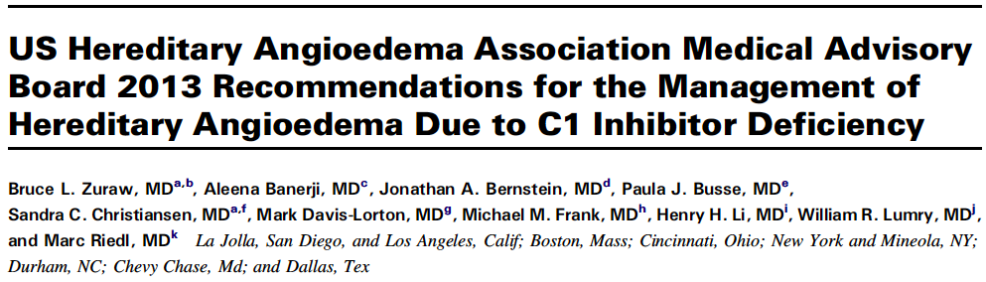
Benefits of HAE Expert Physician Involvement
Referral centers or networks
Collaborative care with other physicians
Optimal patient education regarding condition and treatment options
Iterative process to adjust/adapt treatment plan over time

Slide 58
Three Treatment Strategies for HAE-C1-INH
Required for ALL patients
HAE-C1-INH
Used as needed for individual patients
On-demand
Short-term
prophylaxis
Long-term
prophylaxis
To rapidly stop an existing attack before the patient experiences M&M
To prevent an attack when the patient will be exposed to a known stimulus
To decrease the frequency and severity of ongoing attacks
M&M, morbidity and mortality; QOL, quality of life.
Treatment for HAE must be individualized to provide optimal care and normalize QOL.
Tourangeau LM, et al. Curr Allergy Asthma Rep. 2011;11(5):345-351.
Notes:
58
On-demand: Resolve angioedema symptoms as quickly as possible during an attack
Short-term prophylaxis: Reduce the likelihood of swelling in response to anticipated events known to precipitate an attack
Long-term prophylaxis: Decrease the number and severity of angioedema attacks

Slide 59
Recommendations for Treatment of Acute Attacks of HAE
All patients with HAE should have acute therapy available for treating an attack:
  C1-INH inhibitor (plasma-derived or recombinant)
  Ecallantide (Kalbitor)
  Icatibant (Firazyr)
Patients should have at least 2 doses of an on-demand therapy at home and be trained in self-administration whenever possible
Early treatment of attacks beneficial to reduce morbidity and complications
All attacks are eligible for treatment as soon as they are recognized
Hospital evaluation is recommended for laryngeal involvement
Cicardi M, et al. Allergy. 2012;67(2):147-157; Craig T, et al. World Allergy Organ J. 2012;5(12):182-199; Lang D, et al. Ann Allergy Asthma Immunol. 2012;109(6):395-402; Betschel, et al. Allergy Asthma Clin Immunol. 2014;10:50; Zuraw B, et al. J Allergy Clin Immunol Pract. 2013;1(5):458-467.

Slide 60
Case Study #2: Jason, 22-year-old Male
Jason presents to your office following a recent acute HAE attack
History:
  Diagnosed with Type I HAE at 18 years old
  Family history of fatal laryngeal attacks due to HAE
  Has experienced 2 to 3 attacks per year since diagnosis
Treatment history:
  Following diagnosis received C1-INH therapy for acute attacks administered in ED
  Switched to self-administered icatibant on demand when he started college (current therapy)
ED, emergency department.

Slide 61
Jason, 22-year-old Male: Recent History
Two most recent attacks have required ED visits
  First attack presented with laryngeal swelling
  Second attack, he experienced relapse of symptoms 30 hours after symptom relief from treatment
Recently graduated from college and began working
Expresses desire to review his treatment plan

Slide 62
Comparison of Acute Treatments
Agent | Age | Route | Dose | Safety | Home/ Self-Use | AAE* | HAE w/nl C1-INH* | ACE*
pdC1-INH | All ages | IV | 20 U/kg | Infectious (?) | Y/Y | +/- | +/- | -
Ecallantide | Adolescent | SC | 30 mg | Allergy | Y/N | + | + | +
Icatibant | 18 | SC | 30 mg | Local pain | Y/Y | + | + | +
rhC1-INH | Adolescent | IV | 50 U/kg | Allergy | Y/Y | +/- | ? | -
pdC1-INH* | All ages | IV | 1000 U | Infectious (?) | Y/Y | +/- | +/- | -
FFP* | All ages | IV | 2 U (10 mL/Kg) | Infectious worsening allergic | N/N | ? | ? | ?
*Not FDA-approved indications.
AAE, acquired angioedema; FDA, US Food and Drug Administration; FFP, fresh frozen plasma; IV, intravenous; N, no; nl, normal; pdC1-INH, plasma-derived C1 inhibitor; rhC1-INH, recombinant human C1 inhibitor; SC, subcutaneous; w/, with; Y, yes.

Slide 63
Current Acute HAE Therapies
Factor XII
Factor XIIa
C1-INH
Ecallantide
Prekallikrein
Kallikrein
C1-INH
High-molecular-weight kininogen
Bradykinin
Icatibant
Bradykinin type 2 receptor
Angioedema
Adapted from Chen M, et al. Immunol Allergy Clin North Am. 2017.

Slide 64
Comparison of HAE Acute Therapies
Drug | Study Participants, N | Primary End Point | Primary Outcome Measurement Tool | Treatment Effect for Primary Outcome vs Placebo/Control | Statistical Outcome for Primary End Point vs Placebo/Control | Adverse Events Reported in >5% of Drug-Treated Study Participants | Regulatory Status
Pasteurized pd C1-INH (Berinert) | 125 | Time to onset of symptom relief | Patient’s response to periodic standard question | 0.5 h (20 U/kg) vs 1.2 h (10 U/kg) vs 1.5 h (placebo) | 20 U/kg: P=.0025; 10 U/kg: P=.2731 | HAE, headache, abdominal pain, nausea, muscle spasms, pain | Approved for acute HAE treatment in United States and European Union.
Nanofiltered pd C1-INH (Cinryze) | 68 | Time to onset of unequivocal relief (3 consecutive reports of improvement) at defining site | Patient response to periodic symptom severity question | 2 h (1,000 U) vs >4 h (placebo) | 1,000 U: P=.02 | Sinusitis | Not currently approved for acute HAE treatment; approved for long-term prophylactic HAE treatment in United States (separate prophylactic study)
Recombinant C1-INH (Ruconest) | 70 | Time to beginning of symptom relief (VAS score decrease ≥20 mm for 2 consecutive reports) | Periodic patient-reported VAS score | 66 min (100 U/kg) vs 122 min (50 U/kg) vs 495 min (placebo) | 100 U/kg: P<.001; 50 U/kg: P=.013 | Headache | Approved for acute HAE treatment in United States and European Union.
Ecallantide (Kalbitor) | 71 (96 additional in EDEMA 4 phase 3 study [39], not detailed here) | TOS at 4 h post-treatment | Patient-reported TOS (composite score; + 100 [significant improvement] to –100 [significant worsening]) | TOS + 50 (30 mg) vs TOS 0 (placebo) | P=.004 | Headache, HAE, diarrhea, pyrexia, nasopharyngitis, tachycardia, nasal congestion | Approved for acute HAE treatment in United States
Icatibant (Firazyr) | 56 (FAST-1); 74 (FAST-2) (88 additional in FAST-3 phase 3 study [40], not detailed here) | Time to clinically significant symptom relief of index symptoms (≥30% decrease in VAS score for 3 consecutive measurements) | Periodic patient-reported VAS score | FAST-1: 2.5 h (30 mg) vs 4.6 h (placebo); FAST-2: 2 h (30 mg) vs 12 h (tranexamic acid, 3 g/d for 2 d) | FAST-1: P=.14; FAST-2: P<.001 | Injection site reactions | Approved for acute HAE treatment in United States and European Union.
EDEMA, Evaluation of the DX-88 Effect in Mitigating Angioedema Subcutaneous Treatment (study); FAST, For Angioedema Subcutaneous Treatment (trial); TOS, treatment outcome score; VAS, visual analogue scale.
Riedl MA. Curr Allergy Asthma Rep. 2011;11:300-308.

Slide 65
Berinert Registry Data: Location of
C1-INH Infusions
Attack Treatment
(11,720 infusions)
Prophylaxis
(3,089 infusions)
296 subjects with prospective data: 2 thrombotic events (DVT – indwelling port; MI – 8 months after last C1-INH infusion)
DVT, deep vein thrombosis; MI, myocardial infarction.
Riedl MA. Curr Allergy Asthma Rep. 2011;11:300-308.

Slide 66
C1-INH Use in Pregnancy
Berinert Registry data: 11 pregnancies in 10 subjects who used pdC1-INH for HAE treatment
261 doses during pregnancy
8 pregnancies concluded in the birth of a healthy baby
Remaining 3 pregnancies:
  1 voluntarily terminated at 9 weeks of gestation
  1 ended as a first-trimester spontaneous abortion 1 week after the subject's most recent pdC1-INH infusion; considered unrelated to C1-INH treatment
  1 occurred in a subject who exited the registry approximately 2 months before her due date, with no further follow-up
As assessed for 30 days after each pdnfC1-INH infusion, there were no AEs that were considered related to pdnfC1-INH therapy
AE, adverse event; pdnfC1-INH, plasma-derived nanofiltered C1 inhibitor.
Fox J. Allergy Asthma Proc. 2017;38(3):216-221.

Slide 67
C1-INH Use in Children and the Elderly
Berinert registry: 18 children, 275 infusions
  77% of infusions completed in non-health care setting
  3 AEs in 3 children (toothache, nasopharyngitis,
  ankle fracture)
  None considered related to pdC1-INH
Adults 65 or older: 27 subjects, 1,701 infusions
  95% of infusions completed in non-health care setting
  19 AEs in 8 subjects – 2 severe (prostatectomy and
  GI bleeding)
  None considered related to pdC1-INH
GI, gastrointestinal.
Busse P, et al. J Allergy Clin Immunol Pract. 2017;4:1142.
Bygum A, et al. Drugs Aging. 2016;33:819-827.

Slide 68
Ecallantide
Unique HAE Patients
N = 297
SC: n=230 IV: n=67
MSCS=mean symptom
complex score
Patients with HSR
N = 32
SC: n=20 IV: n=12
(n=42)
(n=67)
MSCS at 4 hours
Improvement in Mean
(n=35)
(n=47)
(n=67)
(n=34)
P= .041
P= .010
P= .001
Ecallantide
Placebo
Meets NIAID Criteria
for Anaphylaxis
N = 13
SC: n=8 IV: n=5
Does Not Meet NIAID Criteria
for Anaphylaxis
N = 19
SC: n=10; IV: n=7; SC&IV: n=2*
P= .045
P= .003
P= .001
(n=67)
TOS=treatment
outcome score
TOS at 4 hours
(n=35)
Improvement in Mean
(n=67)
(n=34)
EDEMA3
EDEMA4
Integrated Analysis†
HSR, hypersensitivity reaction; NIAID, National Institute of Allergy and Infectious Disease.
Sheffer A, et al. J Allergy Clin Immunol. 2011;128:153-159. Craig TJ, et al. J Allergy Clin Immunol Pract. 2015;3:206-212.

Slide 69
Home-based Treatment with Ecallantide
HCP administration required due to 3% to 4% rate of anaphylaxis seen in clinical trials
158 patients enrolled in home nursing acute treatment program
Most likely time for patient calls: 6:00 am – 5:00 pm
Average time to relief onset was 43.5 minutes
One dose sufficient to treat the majority of attacks; second dose was needed in 23.6% of patients
HCP, health care provider.
Tachdjian R, et al. Allergy Asthma Proc. 2015;36:151-159.

Slide 70
Icatibant Study in Children and Adolescents
0.9
0.8
0.7
0.6
0.5
0.4
0.3
0.2
0.1
0.0
Pubertal status
Overall
Children
Adolescents
Composite Investigator-assessed
Symptom Score
0 1 2 3 4 5 6 7 8
Time From Icatibant Administration (Hours)
No. of patients
Children 11 11 11 11 11
Adolescents 11 11 11 11 11 2
Overall 22 22 22 22 22 2
Farkas H, et al. J Allergy Clin Immunol Pract. 2017. [epub ahead of print]

Slide 71
Icatibant in Children and Adolescents
Summary of TEAEs Occurring in ≥2 Patients, by System Organ Class (Safety Population)*
 | Children (n=11) |  | Adolescents (n=21) |  | Overall (n=32)
TEAE | Patients | Events | Patients | Events | Patients | Events
Any adverse event | 2 (18.2) | 9 | 7 (33.3) | 23 | 9 (28.1) | 32
Gastrointestinal | 0 | 0 | 3 (14.3) | 9 | 3 (9.4) | 9
Nervous system | 1 (9.1) | 2 | 2 (9.5) | 2 | 3 (9.4) | 4
General disorders/administration site conditions | 0 | 0 | 2 (9.5) | 2 | 2 (6.3) | 2
Infections/infestations | 1 (9.1) | 1 | 1 (4.8) | 1 | 2 (6.3) | 2
Musculoskeletal/connective tissue disorders | 1 (9.1) | 1 | 1 (4.8) | 1 | 2 (6.3) | 2
Respiratory, thoracic, and mediastinal | 1 (9.1) | 2 | 1 (4.8) | 1 | 2 (6.3) | 3
Values are n (%).
*Two TEAEs occurring in 1 adolescent were considered possibly related to icatibant: dry mouth and fatigue.
TEAE, treatment-emergent adverse event.
Farkas H, et al. J Allergy Clin Immunol Pract. 2017. [epub ahead of print]

Slide 72
Icatibant Outcomes Study
 | Icatibant-Treated Patients (n=557)
 | Number of Events Related to Icatibant Use (%) | Number of Patients Experiencing Icatibant-Related Events (%)
Any event | 43 (100.0) | 17 (3.1)
Drug ineffective | 6 (14.0) | 5 (0.9)
Injection site erythema | 6 (14.0) | 1 (0.2)
Blood pressure decreased | 4 (9.3) | 1 (0.2)
Hyperemia | 4 (9.3) | 3 (0.5)
Pain | 3 (7.0) | 2 (0.4)
Gastritis | 2 (4.7) | 1 (0.2)
Application site pain | 1 (2.3) | 1 (0.2)
Chest discomfort | 1 (2.3) | 1 (0.2)
Cholelithiasis | 1 (2.3) | 1 (0.2)
Depression | 1 (2.3) | 1 (0.2)
Dizziness | 1 (2.3) | 1 (0.2)
Epigastric discomfort | 1 (2.3) | 1 (0.2)
Feeling hot | 1 (2.3) | 1 (0.2)
Headache | 1 (2.3) | 1 (0.2)
Herpes zoster | 1 (2.3) | 1 (0.2)
Infusion site pain | 1 (2.3) | 1 (0.2)
Injection site pain | 1 (2.3) | 1 (0.2)
Injection site urticaria | 1 (2.3) | 1 (0.2)
Nausea | 1 (2.3) | 1 (0.2)
Noncardiac chest pain | 1 (2.3) | 1 (0.2)
Therapeutic product ineffective | 1 (2.3) | 1 (0.2)
Postherpetic neuralgia | 1 (2.3) | 1 (0.2)
Reflux esophagitis | 1 (2.3) | 1 (0.2)
Weight decreased | 1 (2.3) | 1 (0.2)
 | Icatibant-Treated Patients (n=557)
 | Number of Events (%) | Number of Patients (%)
Any event | 43 (100.0) | 59 (10.6)
Abdominal pain | 8 (5.6) | 7 (1.3)
Angioedema | 4 (2.8) | 4 (0.7)
Diarrhea | 4 (2.8) | 2 (0.4)
Peripheral edema | 4 (2.8) | 2 (0.4)
Abdominal distension | 3 (2.1) | 3 (0.5)
Face swelling | 3 (2.1) | 3 (0.5)
Laryngeal edema | 3 (2.1) | 3 (0.5)
Abdominal hernia | 2 (1.4) | 2 (0.4)
Abdominal pain (upper) | 2 (1.4) | 2 (0.4)
Colonic polyp | 2 (1.4) | 1 (0.2)
Cough | 2 (1.4) | 2 (0.4)
Dyspnea | 2 (1.4) | 2 (0.4)
Hematochezia | 2 (1.4) | 1 (0.2)
Hereditary angioedema | 2 (1.4) | 2 (0.4)
Legionella infection | 2 (1.4) | 1 (0.2)
Local administration site swelling | 2 (1.4) | 2 (0.4)
Myelodysplastic syndrome | 2 (1.4) | 1 (0.2)
Pyrexia | 2 (1.4) | 2 (0.4)
Respiratory failure | 2 (1.4) | 1 (0.2)
Suicide attempt | 2 (1.4) | 2 (0.4)
Three SAEs (drug inefficacy, gastritis,
reflux esophagitis) in 2 patients considered possibly or probably related to icatibant
SAEs, serious adverse events.
Zanichelli A, et al. Allergy. 2017;72:994-998.

Slide 73
Recombinant Human C1-INH – Sustained Response
Lack of hereditary angioedema attack recurrence or new hereditary angioedema attack onset within 72 hours of rhC1-INH treatment
Bernstein JA, et al. Ann Allergy Asthma Immunol. 2017;118:452-455.

Slide 74
Recombinant Human C1-INH for Upper Airway
HAE Attacks
Pooled analysis of 3 clinical trials: 683 HAE attacks 45 with upper airway involvement treated with rhC1-INH
Median time to the beginning of symptom relief: 67 minutes (95% confidence interval, 60–120 minutes)
91% achieved the beginning of relief within 4 hours of
rhC1-INH treatment
All attacks resolved without the need for any additional medication
No patients required intubation or tracheostomy
Riedl M, et al. Allergy Asthma Proc. 2017;38:462-466.

Slide 75
Future Acute HAE Treatment
ZENITH-1: a Clinical Trial to Evaluate BCX7353 (oral kallikrein inhibitor) as an Acute Treatment of Hereditary Angioedema Attacks
  Single-dose liquid formulation
  Phase 2 trial ongoing in Europe

Slide 76

Optimizing Acute Treatment Plans
Your patient has a prescription for an acute HAE medication.
Now what?
“I’m writing you a prescription. Do you want a longer life with less quality or vice versa?”

Slide 77
Access to On-Demand Medication
Hours
0 2 4 6 8 10 12 14 16 18 20 22 24
300
250
200
150
100
70
60
50
40
30
20
10
0
1
0.9
0.8
0.7
0.6
0.5
0.4
0.3
0.2
0.1
0
Median Time (h)
pdC1-INH (total duration)
Icatibant (total duration)
Tran. acid (total duration)
pdC1-INH (post-treatment)
Untreated (total duration)
Icatibant (post-treatment)
pdC1-INH
Icatibant
No treatment
Tranexamic acid
Number of attacks responding at different time points within the first 24 hours from the onset of attack
Zanichelli A, et al. Allergy. 2015;70:1553-1558.
Notes:
227 patients, over 4000 attacks, 5 year period

Slide 78
Access to Medication
2
1
0
-1
-2
-3
Psych/Emot
Daily symptoms
Suffocation
Children
Side effects
Change in Burden of Illness After
Introduction of On-Demand Treatments
None Minimal Mild Moderate Severe
Initial Severity
Emot, emotional; Psych, psychological.
Christiansen SC, et al. Allergy Asthma Proc. 2015;36:145-150.

Slide 79
Access to Medication
P<.00005
P=.0001
OP, outpatient.
Riedl MA, et al. J Allergy Clin Immunol Pract. 2014;3:220-227.
Riedl MA, et al. J Allergy Clin Immunol Pract. 2014;3:220-227.

Slide 80
Early Treatment Reduces Attack Burden
*
*
*
<1
≥1
<2
≥2
<5
≥5
Analysis of 436 attacks from 136 subjects; duration of attack by interval to treatment
*P<.001.
Maurer M, et al. PLoS One. 2013;8(2):e53773.

Slide 81
Icatibant Self-administration
15
12
9
6
3
*
†
30
27
24
21
18
15
12
9
6
3
Hours
Hours
HCP (n=29) Self (n=50)
HCP (n=29) Self (n=49)
Time in minutes from attack onset to (A) treatment and (B) complete symptom resolution was significantly shorter for self-administration compared to HCP administration. Data presented as mean with standard deviation.
*P < .0001; †P < .01.
Otani IM, et al. J Allergy Clin Immunol Pract. 2017;5(2):442-447.

Slide 82
C1-INH Home Therapy
Disease burden and treatment outcomes before and after switching to home therapy
Summary of costs related to the management of C1-INH-HAE before and after the switch to home therapy with pdC1-INH
 | Before Home Therapy | After Home Therapy
Hospitalizationsª, n | 16.8 ± 19.2 | 2.1 ± 3.9^{b}
Time to therapy administration, h | 3.2 ± 5.8 | 1.9 ± 5.7
Time to symptom improvement, min | 84 ± 1.1 | 54 ± 0.5
Time to symptom resolution, h | 12.8 ± 12.9 | 10.8 ± 12.9
Missed work/school days, n | 20.3 ± 23.9 | 7.1 ± 15.5^{c}
All data are means ± SD. ªIncluding visits to the ED and hospital admissions. ^{b}P value (χ² test) = 0.003. ^{c}P value (χ² test) = 0.037.
 | Before Home Therapy |  | After Home Therapy |  | Δ
Resource | Study Population (n=17) | Per Patient | Study Population (n=17) | Per Patient | Study Population (n=17) | Per Patient | Savings, %
Medical resources
pdC1-INH concentrate | 481,805.00 | 28,341.47 | 449,499.00 | 26,441.12 | 32,306.00 | 1,900.35 | 6.7
ED visits | 8,201.73 | 482.45 | 1,375.66 | 80.92 | 6,826.07 | 401.53 | 83.2
Hospital admissions | 8,252.00 | 485.41 | 0 | 0 | 8,252.00 | 485.41 | 100.0
Total | 498,258.73 | 29,309.34 | 450,874.66 | 26,522.04 | 47,384.07 | 2,787.30 | 9.5
Missed work/school days | 11,026.25 | 648.60 | 1,514.04 | 89.06 | 9,512.21 | 559.54 | 86.3
Travel expenses | 894.72 | 52.63 | 171.10 | 10.06 | 723.62 | 42.57 | 80.9
Total | 510,179.69 | 30,010.57 | 452,559.80 | 26,621.16 | 57,619.89 | 3,389.41 | 11.3
Costs are in euros and were estimated for Italy from the payer (Italian National Healthcare System) and societal perspectives.
Petraroli A, et al. Int Arch Allergy Immunol. 2015;166:259-266.
Notes:
17 patients

Slide 83
Improvements in Quality of Life with C1-INH IRT
Retrospective phase
Prospective phase
60
55
50
45
40
35
30
25
20
15
10
5
0
☺
☺
10
9
8
7
6
5
4
3
2
1
0
Total Score
Item Scale
☹
☹
Family/Home Social Occupation Life General Condition
Responsibility Activities Support Condition During
Activity Attacks
Life Activity Items Total of the
6 items
IRT, individual replacement therapy.
Kreuz et al. Transfusion. 2009;49:1987-1995.

Slide 84
Self-administration Barriers
Greatest barrier to choosing self-administered therapy
Performance | 19 (32.20%)
Expense | 13 (22.03%)
Learning the technique | 12 (20.32%)
Safety | 10 (16.95%)
Sterility | 5 (8.47%)
Numbers represent response frequencies (N=59 responses)
Greatest worry about self-administering therapy
Not being able to treat myself when I need it | 35 (59.32%)
Getting air into a vein | 12 (20.34%)
Infection | 6 (10.17%)
Death | 5 (8.47%)
Bleeding | 1 (1.69%)
Wang A, et al. Ann Allergy Asthma Immunol. 2015;115:120-125.

Slide 85
Barriers to Optimal Treatment of HAE Attacks
Lack of access to medication
  Appropriate prescription provided
  Cost/coverage of medication
  Logistics of refills
Medication administration
  Lack of self-administration planning or education
  Uninformed ED care
  Patient not knowing when to use medication
Adverse events
Failing to recognize danger of airway events
Notes:
The issues of concern regarding HAE medicines are listed here. They include cost of medication and administration, route of administration, adverse events and location of care.
References:
Aberer W, Hoffmann T, Wiednig M, et al. A study of the self-administration of icatibant for acute attacks of hereditary angioedema (HAE). Ann of Allergy Asthma and Immunol. 2010; 105(5): A92 #P236
Dagen C, Craig TJ. Treatment of hereditary angioedema: items that need to be addressed in practice parameter. Allergy Asthma Clin Immunol. 2010;6(1): 11.

Slide 86
Patient Education
Provide patients with education on:
  Signs and symptoms of attacks
  Risks of attacks
  Attack triggers
  Family counseling
  Information about all therapies
  Self-administration
Both patients and healthcare providers need an
action plan in place before an attack.

Slide 87
Bork Laryngeal Edema Data
182 Families: 728 patients
Death from asphyxiation:
  7/527 (1.3%) in diagnosed patients
  63/201 (31%) in undiagnosed patients
Age at time of death from asphyxiation in 70 patients with HAE-C1-INH
81.6%
15.1%
3.3
%
Phase 1: 3.7 ± 3.2 hours; range, 0-11 hours
Phase 2: 41 ± 49 minutes; range, 2 minutes to 4 hours
Phase 3: 8.9 ± 5.1 minutes; range, 2-20 minutes
Mean durations of the 3 phases of fatal laryngeal attacks in 36 patients with HAE-C1-INH
Bork et al. J Allergy Clin Immunol. 2012;130:629-637.

Slide 88
Anticipating and Managing Triggers
Physical Trauma
- Incidental
- Iatrogenic
Infections
- Helicobacter pylori?
- Viral?
Known or Suspected
Triggers
Medications
- Estrogens
- ACE inhibitors
Emotional Stress
- HANE
- Holidays
HANE, hereditary angioneurotic edema.
Zuraw B, et al. J Allergy Clin Immunol Pract. 2013;1:458.

Slide 89
Optimizing Non-pharmacologic Treatment
0.5
0.4
0.3
0.2
0.1
0
Control
0.5
0.4
0.3
0.2
0.1
0
IL-1
PK
HK+PK
HK+ PK+FXII
Management of Trigger Factors
  Stress: Physical or Mental
  Iatrogenic Trauma: Surgical or Dental Procedures
  Infection
  Medications: Estrogen and ACE-I
Kallikrein Activity
(Absorbance, OD at 405 mm)
Kallikrein Activity
(Absorbance, OD at 405 mm)
PK
HK+PK
HK+ PK+FXII
0 30 60 90 120 150 180
Time (Minutes)
0 30 60 90 120 150 180
Time (Minutes)
0.5
0.4
0.3
0.2
0.1
0
4
3.5
3
2.5
2
1.5
1
0.5
0
0.5
0.4
0.3
0.2
0.1
0
TNF-α
Estradiol
*
*
Concentration
(ng/mL)
*
*
*
0
1
5
10
20
30
Kallikrein Activity
(Absorbance, OD at 405 mm)
*
*
*
Hsp90 (ng/mL)
*
Kallikrein Activity
(Absorbance, OD at 405 mm)
*
*
PK
HK+PK
HK+ PK+FXII
PK
HK+PK
HK+ PK+FXII
*
*
Interleukin 1 beta TNF alpha Estradiol
0 30 60 90 120 150 180
Time (Minutes)
0 30 60 90 120 150 180
Time (Minutes)
Joseph K. J Allergy Clin Immunol. 2017;140(1):170-176.
Notes:
.

Slide 90
Health Care Provider Education
Area(s) of HAE Knowledge in the ED Needing Improvement | ED Group (n=105) | 2009+ Group (N=87)
 | n (%) | n (%)
A – HAE itself (diagnosis) | 50 (48) | 44 (51)
B – Understanding about effective medications | 62 (59) | 51 (59)
C – Appreciation of serious nature of HAE attacks | 47 (45) | 40 (46)
D – Nothing, current knowledge of HAE in ED is sufficient | 1 (1) | 0 (0)
Otani IM, et al. J Allergy Clin Immunol Pract. 2017;5:128-134.

Slide 91
Patient Perspective of ED Management of HAE
ED management of HAE has been hindered by misdiagnosis and limited treatment options
Recent survey of 105 patients with HAE:
  99% indicated understanding of HAE in ED needed improvement
  Areas that needed improvement included recognition of HAE as a diagnosis (48%), appreciation of HAE as a serious disease (45%), and medication management (59%)
Among 68 patients whose plan was to receive home therapy, 26 required ED care because of inability to receive therapy at home
Having a treatment plan was associated with a higher likelihood of receiving HAE therapy in the ED vs corticosteroids, epinephrine, etc
Otani IM, et al. J Allergy Clin Immunol Pract. 2017;5:128-134.

Slide 92


Slide 93
Written Action Plans
Provide guidance on navigating the health care system
Treatment plan should include:
  Pre-placement of therapies
  When to treat
  Who will administer therapies
  Monitoring of prescriptions
  Method to obtain refill
Travel planning
Emergency card
Zuraw B, et al. J Allergy Clin Immunol Pract. 2013;1:458.

Slide 94
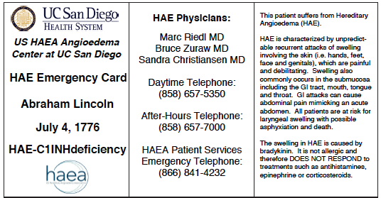
Emergency Treatment Plan – Cards or Letters
US HAEA Angioedema Center at UC San Diego HAE Emergency Card Abraham Lincoln July 4, 1776 HAE-C1 INH deficiency | HAE Physicians: Marc Riedel, MD Bruce Zuraw, MD Sandra Christiansen, MD Daytime Telephone: (858) 657-5350 After-Hours Telephone: (858) 657-7000 HAEA Patient Services Emergency Telephone: (866) 841-4232 | This patient suffers from Hereditary Angioedema (HAE). HAE is characterized by unpredictable recurrent attacks of swelling involving the skin (ie, hands, feet, face and genitals), which are painful and debilitating. Swelling also commonly occurs in the submucosa including he GI tract, mouth, tongue and throat, GI attacks can cause abdominal pain mimicking an acute abdomen. All patients are at risk for laryngeal swelling with possible asphyxiation and death. The swelling in HAE is caused by bradykinin. It is not allergic and therefore DOES NOT RESPOND to treatments such as antihistamines, epinephrine or corticosteroids.
Treatment of Attacks Effective emergency treatment should be given as soon as possible to arrest the attack. There are several effective therapies available, including: C1 inhibitor concentrate by IV injection: 20 U/kg (Berinert), or 1000 U (Cinryze), or 50 U/kg (Ruconest) [max 4200 U] Icatibant (SC injection) 30 mg in 3 mL (Firazyr) Ecallantide (SC injection) 30 mg, 3×1 mL (Kalbitor) | Laryngeal Attacks Because of the risk of asphyxiation during a laryngeal attack and because the effective medicines can take 30 to 60 minutes to begin to work, physicians should be prepared to emergently intubate the patient or perform a cricothyrotomy. Signs of impending airway obstruction include stridor, inability to swallow, and change in the voice. The airway may be significantly distorted and these procedures should be performed by an expert. | Additional Information Online: www.haea.org Zuraw BL, et al. US Hereditary Angioedema Association Medical Advisory Board 2013 recommendations for the management of hereditary angioedema due to C1 inhibitor deficiency. J Allergy Clin Immunol Pract. 2013;1:458. Mollman JJ, et al. A consensus parameter for the evaluation and management of angioedema in the emergency department. Acad Emerg Med. 2014;21:469.

Slide 95

Between Appointments
Tracking of HAE symptoms and medication used (calendar, smartphone app, etc)
Patient to notify HCP if:
  Difficulties getting or using medication
  Treatment seems ineffective
  Side effects occur
  Dental or surgical procedures are necessary
Advise patient on family testing
“How can I trust your information when you’re using such outdated technology?”

Slide 96




Thank You

Slide 97
Faculty Discussion
Frequency with which acute treatment plan should
be reviewed
Considerations for at-home administration of acute therapy
Attack duration, location, and symptom relapse

Slide 98
Consideration for Prophylaxis in HAE
William Lumry, MD

Slide 99
Case Study #3: Allison, 29-year-old Female
Allison presents to your office following treatment in the ED for an acute attack of HAE
Diagnosed with Type I HAE at 24 years old
Family history of HAE (mother and grandmother)
Physical exam is unremarkable with normal vital signs
Previous laboratory results:
  C4 level: 6 mg/dL (normal: 13-75 mg/dL)
  C1-INH quantitative: 8 mg/dL (normal: 16-33 mg/dL)
  C1-INH functional level: 44% (normal: >67%)
  C1q level: 18 mg/dL (normal: 12-22 mg/dL)

Slide 100
Allison, 29-year-old Female: Recent History
Current acute treatment plan of self-administered icatibant
Previous course of short-term prophylaxis with C1-INH for dental procedure
Description of recent attack:
  Multi-site attack that included laryngeal and extremity swelling
  Icatibant treatment resulted in reduced swelling but 8 hours passed before complete symptom resolution
  Second attack in past month
Attack frequency has increased over past 2 years

Slide 101
Considerations when Selecting
Prophylactic Therapy
Consideration Criteria | Prophylactic Therapy
Frequency of attacks | ≥1 per month
Rapid progression of attacks | Yes
Timely access to care | No
History of laryngeal attacks | Yes
Emergency visit to physician/hospital | ≥3 per year
Intubation due to HAE | Yes
Hospitalized due to HAE | ≥1 per year
ICU admission due to HAE | Yes
Missed days of school or work | ≥10 per year
Impacts lifestyle (vacation, family, sports) | Yes
Analgesic dependency | Yes
ICU, intensive care unit.
Lunn M, et al. J Blood Med. 2010;1:163-170.
Craig T, et al. Ann Allergy Immunol. 2009;102:366-372.

Slide 102
Allison, 29-year-old Female
Consideration Criteria | Prophylactic Therapy
Frequency of attacks | 1-2 per month
Rapid progression of attacks | No
Timely access to care | Yes
History of laryngeal attacks | Yes
Emergency visit to physician/hospital | 1 in past year
Intubation due to HAE | No
Hospitalized due to HAE | No
ICU admission due to HAE | No
Missed days of school or work | 9 in past year
Impacts lifestyle (vacation, family, sports) | Significant impact
Analgesic dependency | No

Slide 103
Comparison of Prophylactic Treatments
Agent | Age | Route | Dose
pdC1-INH | Adolescent | IV | 1000IU-2500IU every 3-4 days
Danazol | ≥16 years | PO | 200 mg daily
Tranexamic acid* | All ages | PO | 0.5-1.5 g bid
pdC1-INH | Adolescent | SC | 60 IU/kg every 3-4 days
*Not FDA approved.
bid, twice a day; PO, by mouth.

Slide 104
Short-term Prophylaxis
Agent | Age | Route | Dose | Timing | HAE w/nl C1-INH
pdC1-INH | All ages | IV | 1000-2000 U (20 U/kg) | 1-6 hours prior to event | ?
Danazol | ≥16 years | PO | 200 mg 3 x daily (6-10 mg/kg/day) | 5-7 days prior, 2 days post | ?
FFP | All ages | IV | 2 U (10 mL/kg) | 1-6 hours prior to event | ?
On-demand therapy should be available at all times post procedure.
An HAE-specific therapy is preferred.
Zuraw BL, et al. J Allergy Clin Immunol Pract. 2013;1:458-467.
Joint Task Force on Practice Parameters. J Allergy Clin Immunol. 2013;131:1491-1493.

Slide 105
Efficacy and Effective Therapeutic Dose of Danazol
 | Total Courses | Attack-Free Courses | Attacks
Danazol | 42 | 41 | 1
Placebo | 46 | 3 | 43
Total | 88 | 44 | 44
Danazol Dose | % With Clinical Response
600 mg | 95
400 mg | 88
300 mg | 58
200 mg | 11
Frank MM. Immunol Allergy Clin N Am. 2006;26:653-668.

Slide 106
Side Effects of Danazol Therapy
Side Effect | % With Clinical Response
Abnormal LFTs | 9
Hematuria | 9
Myopathy | 21
Myalgias, cramps | 17
Elevated CPK | 11
Headache | 7
Abnormal menses requiring treatment | 5
Decreased libido | 5
Hair loss | 7
Anxiety reactions | 18
CPK, creatine phosphokinase; LFT, liver function test.
Frank MM. Immunol Allergy Clin North Am. 2006;26:653-668.

Slide 107
Alkylated Androgens
Recent reevaluation of alkylated androgen use
  650 subjects; 3 groups
    Never users of alkylated androgens (n=126)
    Previous users (n=180)
    Current users (n=344)
  Confirmed decrease in attack frequency and severity (83% reduction)
  Improved outcomes (decrease in ED visits, hospitalizations, narcotic use, and negative impact on QOL)
Zuraw BL, et al. J Allergy Clin Immunol Pract. 2016;4:948-955.

Slide 108
Alkylated Androgens: Side Effects
Important findings
  No relationship between AA dose and efficacy
  No relationship between AA dose and ED use, hospitalization, or attack severity
  Strong correlation between AA dose and side effects including mental health measures (anxiety, depression, sadness, aggressiveness), weight gain, headache, and hypertension
  Duration of treatment associated with ↑ LFTs, HTN, and HA
AA, 17-a-alkylated androgens; HA, headache; HTN, hypertension.
Zuraw BL, et al. J Allergy Clin Immunol Pract. 2016;4:948-955.

Slide 109
Intravenous pd-nf-C1-INH Prophylaxis
Associated with Lower HAE Attack Rate
Average normalized
attack rate: 12.73 vs 6.26,
placebo vs pd-nf-C1-INH
Average difference
in attack rates: 6.47 (P<.001)
25
20
15
Normalized Attack Rate (Number)
10
5
0
Placebo
pd-nf-C1-INH
Zuraw B, et al. N Engl J Med. 2010;363:513-522.
Notes:
109
Depicted here is the normalized HAE attack rate during the C1-INH-nanofiltered prophylaxis trial. The attack rates are shown for each of the 22 subjects during the 12-week period when either placebo or nanofiltered C1-INHibitor was being administered. Each pair of connected points represents the attack rates for a single subject during the two periods. The black horizontal lines indicate mean attack rates for the two treatments, which were 6.3 and 12.7 for the C1-INHibitor group and the placebo group, respectively.
Reference:
Zuraw B, Busse PJ, White M, et al. Nanofiltered C1 inhibitor concentrate for treatment of hereditary angioedema. N Engl J Med. 2010;363:513-522.

Slide 110
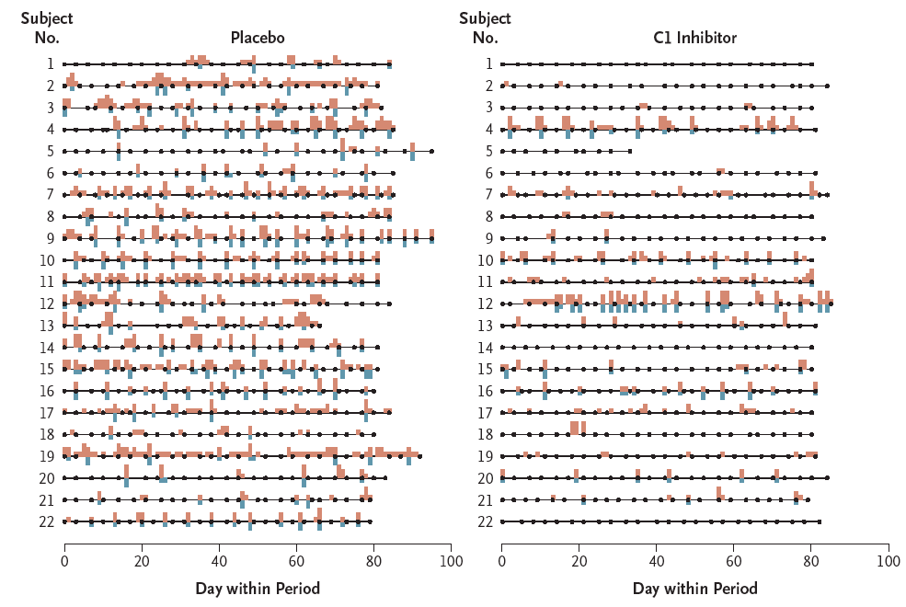
Intravenous nf-C1-INH Prophylaxis
Associated with Lower HAE Attack Rates
nf-C1-INH, nanofiltered C1 inhibitor.
Zuraw B, et al. N Engl J Med. 2010;363:513-522.
Notes:
This very busy slide summarizes the results of Part B of the CHANGE study. Symptoms of HAE attacks are shown as green bars, whereas open-label rescue therapy is shown as pink bars. If you quickly compare the amount of color on the left side (which represents the 12 weeks of twice-weekly placebo administration) to the right side (which represents the 12 weeks of twice-weekly nanofiltered C1-INH administration), you can appreciate that there were fewer episodes of swelling requiring rescue therapy during the 12 weeks of prophylaxis. About half of the patients had minimal attacks during the prophylactic period.
Reference:
Zuraw B, Busse PJ, White M, et al. Nanofiltered C1 inhibitor concentrate for treatment of hereditary angioedema. N Engl J Med. 2010;363:513-522.

Slide 111
Subcutaneous pdC1-INH COMPACT Trial: Phase 3 Primary End Point – Median Number of Attacks/Mo
–2.4*
(–3.4; –1.5)
–3.5*
(–4.2; –2.8)
95% CI
High-Volume
Placebo
n=44
40 IU/kg
CSL830
n=43
Low-Volume
Placebo
n=42
60 IU/kg
CSL830
n=43
Paired comparison:
Median 88.6% reduction
Median 95.1% reduction
94% median attack reduction with active vs placebo
*LS mean (95% CI) estimate.
CI, confidence interval; COMPACT, Clinical Study for Optimal Management of Preventing Angioedema With Low-Volume Subcutaneous C1-Inhibitor Replacement Therapy; LS, least squares; n, number of subjects with data.
Longhurst H, et al. N Engl J Med. 2017;376(12):1131-1139.

Slide 112
Subcutaneous pdC1-INH COMPACT: Phase 3 Secondary End Point – Use of Rescue Medication/Month
–4.4*
(–8.0; –0.8)
–3.6*
(–4.5; –2.6)
P<.001
95% CI
High-Volume
Placebo
n=44
Low-Volume
Placebo
n=42
40 IU/kg
CSL830
n=43
60 IU/kg
CSL830
n=43
Paired comparison:
Median 89.4% reduction
Median 100.0% reduction
*LS mean (95% CI).
Longhurst H, et al. N Engl J Med. 2017;376(12):1131-1139.

Slide 113
Subcutaneous pdC1-INH COMPACT: Phase 3 –
Attack Diaries for 60 IU/kg Dosing Schedule
Low-Volume
Placebo
60 IU/kg
CSL830
Day 14
Day 14
Symptoms
Severe
Moderate
Mild
8400143-0006
8400143-0005
8400143-0004
7240022-0001
3800046-0002
3800046-0001
3800044-0001
3760009-0001
3760008-0006
3760008-0005
3760008-0004
3760008-0002
3760008-0001
3480001-0001
1240027-0002
1240025-0001
1240023-0003
1240023-0002
1240023-0001
0360024-0001
*
*
*
*
*
*
*
*
*
*
*
*
*
*
*
*
*
*
*
*
*
*
*
*
*
*
*
*
*
*
*
*
*
*
*
*
*
*
*
*
*
*
*
*
*
*
*
*
*
*
*
*
*
*
*
*
*
*
*
*
*
*
*
*
*
*
*
*
*
*
*
*
*
*
*
*
*
*
*
*
*
*
*Rescue treatment
*
*
*
*
*
*
*
*
*
*
*
*
*
*
*
*
*
*
*
*
*
*
*
*
*
*
*
*
*
*
*
*
*
*
*
*
*
*
*
*
*
*
*
*
*
*
*
*
*
*
*
*
*
*
*
*
*
*
*
*
*
*
*
*
*
*
*
*
*
*
*
*
*
*
*
*
*
*
*
*
*
*
*
*
*
*
*
*
*
*
*
*
*
*
*
*
*
*
*
*
*
*
*
*
*
*
*
*
*
*
*
*
*
*
*
*
*
*
*
*
*
*
*
*
*
*
*
*
*
*
*
*
*
Longhurst H, et al. N Engl J Med. 2017;376(12):1131-1139.

Slide 114
Prophylactic Therapies in Development
Agent | Mechanism | Age | Route | Status
Lanadelumab | Kallikrein inhibition | Adolescent | SC | Phase 3 trial complete
rhC1-INH | C1-INH replacement | Adolescent | IV SC | IV: Phase 2 trial complete Supplemental BLA SC: Phase 1
Fixed-dose pd nf C1-INH (SHP-616) | C1-INH replacement | Adolescent | SC | Phase 3 trial complete
BCX7353 | Kallikrein inhibition | Adult | Oral | Phase 2 trial complete
Ionis-PKK | Prekallikrein inhibition | Adult | SC | Phase 1 trial complete
CSL-312 | Factor XIIa inhibitor | Adult | SC | Phase 1
BLA, biologics license application.

Slide 115
Lanadelumab: Key Results from the HELP Study
Trial Summary
Evaluated 3 dosing arms of lanadelumab (150 or 300 mg every 4 weeks or 300 mg every 2 weeks) vs placebo Study population included the full HAE disease spectrum (baseline 3.7 mean attacks/month; 52% >3 attacks/month; 65% history of laryngeal attacks; 56% on long-term prophylaxis) 96% of patients have voluntarily chosen to roll over into the ongoing long-term extension safety study (HELP™ Study Extension)
Efficacy
Lanadelumab met the primary and all secondary end points for all lanadelumab treatment arms vs placebo (P<.001 for all analyses) Monthly attack rate reduction vs placebo: 300 mg every 2 weeks: 87% (P<.001) 300 mg every 4 weeks: 73% (P<.001) 150 mg every 4 weeks: 76% (P<.001) Effective regardless of baseline attack frequency Meaningful reduction starting from the first dose throughout the 26-week treatment period Significantly higher proportion of patients, compared to placebo, were attack free throughout the entire 26-week study period
Efficacy
Favorable safety profile No treatment-related serious adverse events Most commonly noted treatment-emergent adverse event was mild to moderate injection site pain (29% placebo vs 43% across all lanadelumab arms)
http://investors.shire.com/~/media/Files/S/Shire-IR/presentations-webcast/year-2017/shire-investor-presentation-2017-05-18.pdf. Accessed June 1, 2017.

Slide 116
Recombinant C1-INH Prophylaxis
Mean Reduction in Attacks and Clinical Response of rhC1-INH vs Placebo
Up to 95.7% of patients had a clinical response, per-protocol population*
rhC1-INH reduced attack frequency by up to 72.1%
*All patients in the ITT population who completed the study and did not have any major protocol violations; n = 23.
†Defined as reduction of 50% or more in the number of attacks that occurred during rhC1-INH treatment vs number of attacks that occurred during placebo treatment.
Riedl MA, et al. Lancet. Published online July 27, 2017.

Slide 117
Results of SHP-616 pd nf C1-INH SC Study
Large HAE Prevention Trial of 28-Week Duration
75 patients; HAE Types I and II; age ≥ 12 years; 2 attacks per month in last 3 consecutive months
Crossover 3-arm 2:2:1 RCT evaluated:
  2000 IU twice weekly (4 mL) vs PBO (14 weeks each)
  2000 IU twice weekly (4 mL): 2000 IU twice weekly (28 weeks combined)
Study population included the full HAE disease spectrum (88% Type I HAE; 12% Type II; 51% had a history of LTP;
11.9 attacks in the 3 months prior to randomization)
Highly Efficacious
Study met the primary and all secondary end points showing superiority over PBO
  Starting at Day 0
    79% reduction in NNA (P < .001)
  From Day 14:
    85% reduction in NNA (P < .001)
    78% have at least 50% HAE attack reduction
    38% attack free
Favorable Safety Profile
No treatment-related serious or severe adverse events
Most commonly noted treatment-emergent adverse event was URTI (7% PBO vs 12.5% SHP616); viral URTI
(5.3% PBO vs 12.5% SHP616); and headache (10.5% PBO vs 10.7% SHP616)
No VTE events. No anti-C1-INH antibodies detected
LTP, long-term prophylaxis; PBO, placebo; RCT, randomized controlled trial; URTI, upper respiratory tract infection; VTE, venous thromboembolic.
https://www.shire.com/en/newsroom/2017/september/cwabkg. Accessed September 14, 2017.

Slide 118
BCX7353 Results of the APeX-1 Study:
Attack Rate/Week
 | 62.5 mg | 125 mg | 250 mg | 350 mg
Weeks 2-4
% Difference, active-PBO | -7% | -73% | -46% | -58%
P value | .715 | <.001 | .006 | <.001
Weeks 1-4
% Difference, Active-PBO | -6% | -69% | -53% | -48%
P value | .747 | <.001 | <.001 | <.001
Placebo
BCX7353
62.5 mg qd
BCX7353
125 mg qd
BCX7353
250 mg qd
BCX7353
350 mg qd
1.5
1.0
0.5
0.0
Attack Rate: LS Mean Attacks/Week
Weeks 2-4 Weeks 1-4
APeX-1, Efficacy and Safety of BCX7353 to Prevent Angioedema Attacks in Subjects With Hereditary Angioedema; qd, once a day.
http://investor.shareholder.com/biocryst/releasedetail.cfm?ReleaseID=1039048. Accessed September 6, 2017.
Aygören-Pürsün E, et al. Presented interim results. 10th HAE Workshop; May 2017; Budapest, Hungary.

Slide 119
Allison, 29-year-old Female:
Treatment Preferences
Allison is open to prophylactic therapy
Has access to treatment facility but prefers to administer therapy at home
Explains that she and her husband are considering having children

Slide 120
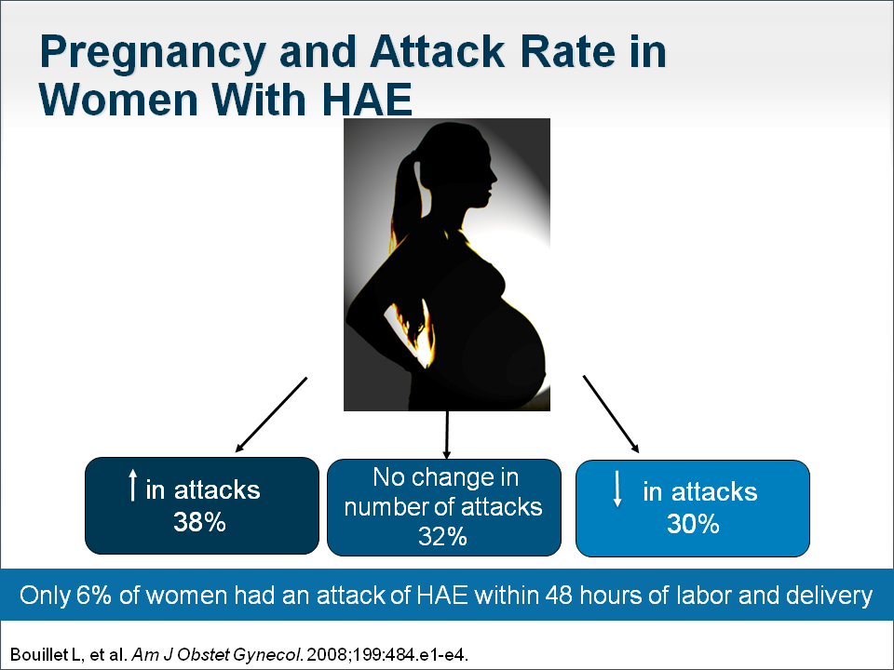
Pregnancy and Attack Rate in Women With HAE
↑ in attacks
38%
No change in
number of attacks
32%
↓ in attacks
30%
Only 6% of women had an attack of HAE within 48 hours of labor and delivery.
Bouillet L, et al. Am J Obstet Gynecol. 2008;199:484.e1-34.

Slide 121
HAE in Pregnancy
C1-INH may be low during pregnancy due to dilutional effects
Symptoms during previous pregnancy do not predict symptoms during current pregnancy
Fetus with HAE may cause more attacks in mother during third trimester
HAE attacks are rare during labor and delivery
Androgens are contraindicated
Tranexamic acid for LTP only if C1-INH is not available
Cabellero T. J Allergy Clin Immunol. 2012;129:308-320.

Slide 122
Special Populations: Pediatrics
Characteristics
At birth antigenic and functional C1-INH levels correspond to 70% and 61.8% of adult values, respectively, and increase to the normal level by the age of 1 year
Angioedema episodes usually begin between 5 and 11 years of age
  Mean age at disease onset was 11.2 years (Bork), 9.5 years (Bygum), and
  4.4 years (Martinez)
Laryngeal attacks are rare: 0.9% of all attacks
Compared to adults, asphyxia may ensue more rapidly because of smaller airway diameter
The earlier the onset of symptoms, the more severe the course of HAE
Farkas H. Allergy Asthma Clin Immunol. 2010;6:1-10.

Slide 123
Special Populations: Pediatrics (Cont’d)
Treatment
Long-term prophylaxis options include tranexamic acid, attenuated androgens, and pdC1-INH
Older consensus statements by various authorities unanimously advocate tranexamic acid as the agent of choice because of its safety profile. When antifibrinolytics fail, treat with the lowest effective maintenance dose of danazol (2.5 mg/kg per day); 50 mg/day initial dose
More recent data suggest pdC1-INH as best acute and prophylactic treatment
FDA approved pdC1-INH (Berinert®*) for acute therapy in children (July 2016)
Experience is limited with ecallantide, icatibant, and rhC1-INH for acute treatment
*Kankakee, IL: CSL Behring LLC.
Farkas H. Allergy Asthma Clin Immunol. 2010;6:1-10.
Wahn V. Eur J Pediatr. 2012;171:1339–1348.

Slide 124
HAEA Medical Advisory Board
Prophylactic Treatment Suggestions
Long-term prophylaxis is appropriate for patients who do not achieve sufficient benefit from on-demand therapy
Androgens should not be used if the patient does not tolerate them, in patients under the age of 16, or in pregnant/breastfeeding women
Caution should be exercised if the danazol dose exceeds 200 mg/day
Patients on prophylaxis still require on-demand treatment be available
Prophylaxis should be used at the lowest effective dose that controls disease activity
HAEA, Hereditary Angioedema Association.
Zuraw B, et al. J Allergy Clin Immunol Pract. 2013;1:458.

Slide 125
At Home Treatment of HAE
Current clinical guidelines recommend home-based treatment where feasible and that all patients have access to medication supply at all times
Postmarketing studies show home therapy is a convenient and safe option preferred by many HAE patients
Administration in a healthcare facility may be hindered by accessibility and convenience factors
Li HH. Patient Prefer Adherence. 2016;10:1727-1737.

Slide 126
Faculty Discussion
Considerations for prophylaxis therapy
Home vs healthcare facility administration of therapy
Expanding treatment options

Slide 127
Summary
HAE is a rare, but serious, disease that imposes a substantial health and economic burden due to recurrent, unpredictable, and potentially fatal attacks
Patients with clinical symptoms and a family history of angioedema should be promptly evaluated for HAE to ensure early diagnosis and optimal disease management
Several agents effective for acute and prophylactic treatment of HAE attacks are currently available
All patients with HAE should have access to on-demand treatment to reduce the duration of attacks and the risk of asphyxiation
Short- and long-term prophylactic treatment plans should be individualized based upon patient characteristics, including age, gender, and attack burden, to achieve optimal care and normalize QOL

Slide 128
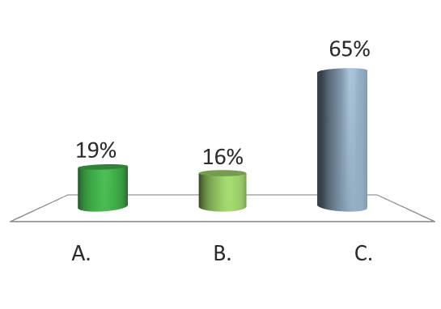
Posttest Audience Response Question
1
A 22-year-old female patient with a family history of HAE presents to your office with a complaint of symptoms of HAE. She describes 2 attacks over the past 6 months that included peripheral angioedema and moderate abdominal pain. Peripheral edema affects approximately 96% of patients with HAE while abdominal attacks occur in what percentage of patients with HAE?
73
83
93

Slide 129
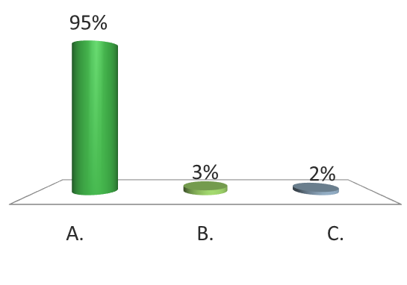
Posttest Audience Response Question
2
The patient’s history reveals that she first developed symptoms consistent with HAE approximately 3-4 years ago. The onset of symptoms for the majority of patients with HAE occurs at what age?
0-20 years old
21-30 years old
>30 years old

Slide 130
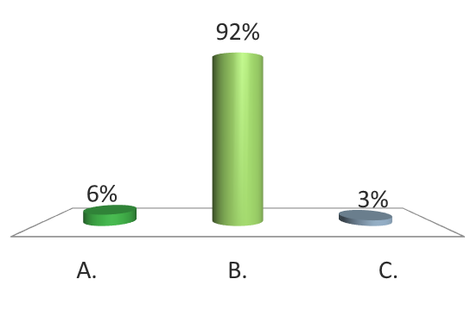
Posttest Audience Response Question
3
To confirm the diagnosis of HAE in this patient, complement testing is completed. The patient’s results indicate a normal to high C1-INH level, low C1-INH function, and a low C4 level. Her C3 and C1q levels are also normal. The appropriate diagnosis for this patient is which of the following?
HAE Type I
HAE Type II
HAE with normal C1-INH

Slide 131
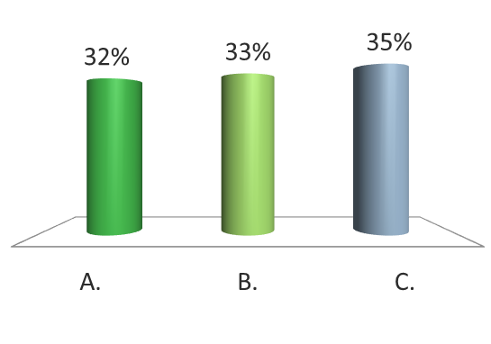
Posttest Audience Response Question
4
A recent paper by Hofman et al presented an activation model that assumes a systemic fluid-phase activation of the contact system leading to HAE attacks. This pathogenic model implicates which of the following as an explanation for the systemic activation process resulting in local attacks and why angioedema can occur at multiple sites during an attack?
Initial bradykinin (BK) formation
Activation of BK receptor 2
Activation of BK receptor 1

Slide 132
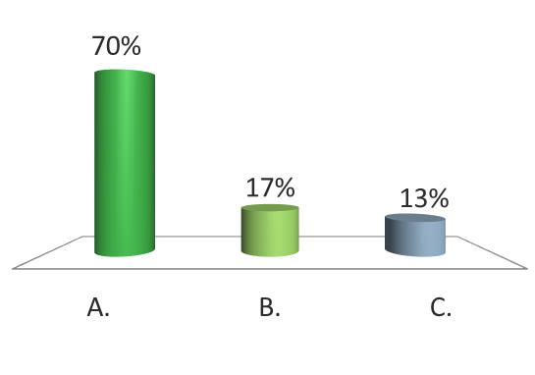
Posttest Audience Response Question
5
Ray is a 22-year-old patient who was diagnosed with HAE Type 1 at 16-years-old. His treatment plan for management of acute attacks has been administration of C1-INH at his local emergency department. Ray has recently graduated from college and is interested in self-administration of therapy for acute attacks. A 2015 paper by Wang et al indicated the greatest barrier to choosing self-administered therapy (occurring in 32% of patients) was which of the following?
Performance
Expense
Learning correct technique

Slide 133
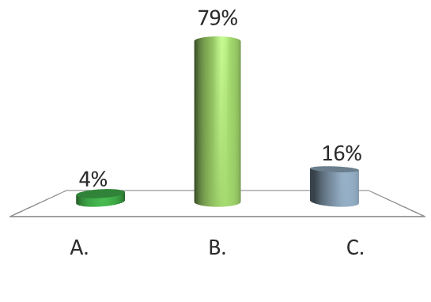
Posttest Audience Response Question
6
Ray’s treatment plan is revised for at home administration of treatment for acute attacks. Education is provided and an HAE action plan is put in place. Early treatment of the acute attack is stressed, as a 2013 paper by Maurer et al indicated that the average duration of an acute attack treated within the first 2 hours after onset was 7.2 hours vs a duration of approximately how many hours for an attack treated >2 hours after onset?
10 hours
20 hours
30 hours

Slide 134
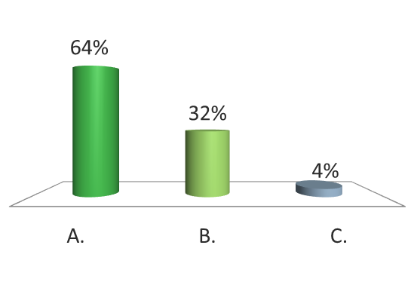
Posttest Audience Response Question
7
Allison is a 29-year-old female who presents to your office following treatment in the ED for an acute attack of HAE. She was diagnosed with HAE at 24-years-old. Her current treatment regimen for acute attacks is self-administered icatibant. Her attack frequency has increased over the past 2 years. When considering prophylactic therapy, an attack frequency of which of the following may indicate a need for prophylactic therapy?
≥1 attack per month
≥2 attacks per month
≥3 attacks per month

Slide 135

Posttest Audience Response Question
8
Allison is open to prophylactic therapy. She explains that she would prefer to be able to administer therapy at home and she and her husband are considering having children. The most appropriate therapy for Allison is which of the following?
Androgens
Tranexamic acid
C1-INH

Slide 136
Questions & Answers

Slide 137
Thank you!

