Slide 1

Anaphylaxis 101:
Diagnosis and Management
This program is sponsored by an independent medical education grant from ARS Pharmaceuticals, Inc.
Notes:
No notes.

Slide 2
Author Acknowledgements and Disclosures
All identified relevent financial relationships with ineligible companies have been mitigated
David M. Fleischer, MD, FACAAI, Professor of Pediatrics, Children’s Hospital Colorado and University of Colorado School of Medicine, Aurora, Colorado; Section Head, Pediatric Allergy & Immunology, and Director, Allergy & Immunology Center.
Disclosures: Researcher: ALK, ARS Pharmaceuticals, Aquestive Therapeutics, DBV Technologies, Nasus Pharma; Consultant: Aquestive, ARS Pharmaceuticals, DBV Technologies, Genentech, Nasus Pharma, Phylaxis; Speaker: Genentech; Stock options: Nasus Pharma, Grow Happy; Royalties: UpToDate
Michael Pistiner, MD, MMSc, FACAAI, Assistant Professor of Pediatrics, Harvard Medical School, Boston, Massachusetts; Director, Food Allergy Advocacy, Education and Prevention, Food Allergy Center, Mass General Brigham for Children
Disclosures: Advisor and Consultant: Kaleo Pharmaceutical, Anjo; Food Allergy Research and Education (FARE) Advisor: Bryn Pharma, FoodGraph; Researcher: Kaleo Pharmaceutical; Program Support: Allergy & Asthma Network, Asthma and Allergy Foundation of America, ARS, DBV Technologies, Aquestive Therapeutics, Kaleo, National Peanut Board, Ownership Interest: Anjo; Stock Options: FoodGraph
Notes:
No notes.

Slide 3
Learning Objectives
After participating in this activity, participants should be better able to:
Improve diagnostic accuracy by applying current evidence‑based criteria to recognize anaphylaxis across typical and atypical clinical presentations.
Implement timely, guideline‑concordant acute management, including appropriate use of epinephrine, correct sequencing of adjunctive therapies, and standardized post‑event observation and follow‑up.
Enhance patient and caregiver education by developing individualized emergency action plans, identifying likely triggers, and providing clear guidance to prevent recurrence and improve community response.
Notes:
After participating in this activity, participants should be better able to:
Improve diagnostic accuracy by applying current evidence‑based criteria to recognize anaphylaxis across typical and atypical clinical presentations.
Implement timely, guideline‑concordant acute management, including appropriate use of epinephrine, correct sequencing of adjunctive therapies, and standardized post‑event observation and follow‑up.
Enhance patient and caregiver education by developing individualized emergency action plans, identifying likely triggers, and providing clear guidance to prevent recurrence and improve community response.

Slide 4
Accurate Recognition and Diagnosis of Anaphylaxis
Notes:
No notes.

Slide 5
Definition of Anaphylaxis
From the WAO:
Serious, systemic hypersensitivity reaction that is usually rapid in onset and may cause death.
Severe anaphylaxis is characterized by potentially life-threatening compromise in respiration and/or the circulation. It may occur without typical skin features, circulatory shock, or compromised breathing being present.
Simons FE, Ardusso LR, Bilò MB, et al. World allergy organization guidelines for the assessment and management of anaphylaxis. World Allergy Organ J. 2011;4(2):13-37.
Notes:
Definition of anaphylaxis and severe anaphylaxis from the World Allergy Organization (WAO).

Slide 6
Definition of Anaphylaxis
From the Dribin et al:
It may involve the skin/mucosa (includes lip/tongue), respiratory (lungs, breathing), cardiovascular (heart, blood pressure), and/or gastrointestinal (stomach/gut) systems.
Life-threatening anaphylaxis is characterized by respiratory and/or cardiovascular involvement and may occur without skin/mucosa involvement.
Serious allergic (hypersensitivity) reaction that can progress rapidly and may cause death.
Dribin TE, Muraro A, Camargo CA Jr, et al. Anaphylaxis definition, overview, and clinical support tool: 2024 consensus report-a GA²LEN project. J Allergy Clin Immunol. 2025;156(2):406-417.e6.
Notes:
Subsequently as part of an international consensus work group, that included patient advocacy groups, Galen; Dribin and colleagues proposed an updated definition of anaphylaxis.
Anaphylaxis is a serious allergic (hypersensitivity) reaction that can progress rapidly and may cause death. It may involve the skin/mucosa (includes lip/tongue), respiratory (lungs, breathing), cardiovascular (heart, blood pressure), and/or gastrointestinal (stomach/gut) systems. Life-threatening anaphylaxis is characterized by respiratory and/or cardiovascular involvement and may occur without skin/mucosa involvement.

Slide 7
2006 NIAID Anaphylaxis Criteria
Anaphylaxis is highly likely when any one of the following 3 criteria are fulfilled:
Acute onset of an illness (minutes to several hours) with improvement of the skin, mucosal tissue, or both and at least one of the following: Respiratory compromise Reduced BP or associated symptoms of end-organ dysfunction | Two or more of the following that occur rapidly after exposure to a likely allergen for that patient (minutes to several hours): Involvement of the skin mucosal tissue Respiratory compromise Reduced BP or associated symptoms Persistent GI symptoms | Reduced blood pressure after exposure to known allergen for that patient (minutes to several hours): Infants and children: low SBP (age specific) or greater than 20% decrease in SBP Adults: SBP less than 90 or greater than 30% decrease from that person’s baseline
91% sensitivity and 71% specificity
Sampson HA, Muñoz-Furlong A, Campbell RL, et al. Second symposium on the definition and management of anaphylaxis: summary report--Second National Institute of Allergy and Infectious Disease/Food Allergy and Anaphylaxis Network symposium. J Allergy Clin Immunol. 2006;117(2):391-397.
Notes:
Criteria to identify anaphylaxis were proposed in 2006 by the National Institute of Allergy and Infectious Diseases and Food Allergy & Anaphylaxis Network. Based on that criteria, anaphylaxis is highly likely with any one of the following 3 criteria is established. This has been a widely used criteria with a sensitivity of 91% and specificity of 71%.

Slide 8
2020 WAO Criteria
Anaphylaxis is highly likely when any one of the following 2 criteria are fulfilled:
Acute onset of an illness (minutes to several hours) with involvement of the skin, mucosal tissue, or both and at least one of the following: Respiratory compromise Reduced BP or associated symptoms of end-organ dysfunction Severe gastrointestinal symptoms, especially after exposure to non-food allergens | Acute onset of hypotension or bronchospasm* or laryngeal involvement after exposure to a known or highly probable allergen for that patient (minutes to several hours), even in the absence of typical skin involvement. *Excluding lower respiratory symptoms triggered by common inhalant allergens or food allergens perceived to cause “inhalation” reaction in the absence of ingestion.
Not yet validated
Cardona V, Ansotegui IJ, Ebisawa M, et al. World allergy organization anaphylaxis guidance 2020. World Allergy Organ J. 2020;13(10):100472. Published 2020 Oct 30.
Notes:
In 2020, the World Allergy Organization proposed streamlined modifications to the NIAID/FAAN criteria, in which anaphylaxis is considered highly likely when either of two criteria is fulfilled.

Slide 9
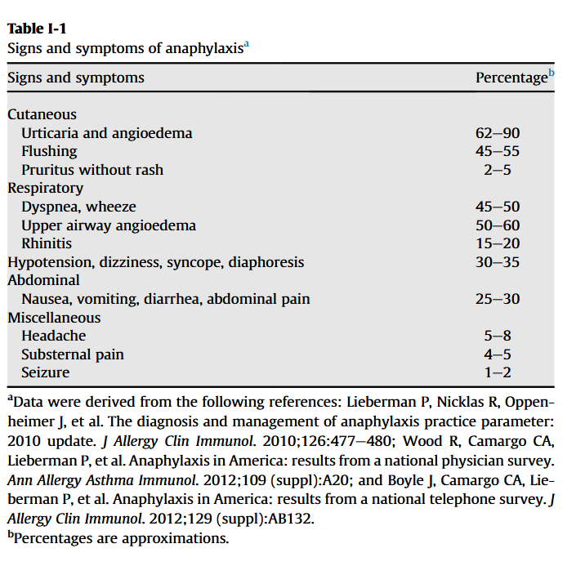
Symptoms of Anaphylaxis
Lieberman P, Nicklas R, Oppenheimer J et al. The diagnosis and management of anaphylaxis practice parameter: 2010 update. J Allergy Clin Immunol 2010; 126:477-80
Notes:
Here are the signs and symptoms of anaphylaxis with percentages of patients who experience these during anaphylaxis.

Slide 10
Anaphylaxis May Present Differently in Infants and Toddlers
Behavior: irritable or withdrawn
Skin red/flushed, itchy, generalized hives
Itchy mouth and ears: scratching of the tongue, tugging at ears
Coughing, wheezing, retractions, tachypnea, runny nose, sneezing, hypoxia
Hoarse cry/voice, drooling
Vomiting, diarrhea
Tachycardia, bluish around lips, non-responsive, low blood pressure
The most serious symptom of anaphylaxis in childhood is bronchospasm.
Maintain position of comfort.
Pistiner M, Mendez-Reyes JE, Eftekhari S, et al. Caregiver-Reported Presentation of Severe Food-Induced Allergic Reactions in Infants and Toddlers. J Allergy Clin Immunol Pract. 2021;9(1):311-320.e2.
Notes:
Anaphylaxis can present differently in younger patients. Here are the signs and symptoms of anaphylaxis you may see with infants and toddlers. Note the most serious symptoms of anaphylaxis in childhood is bronchospasm.

Slide 11
Anaphylaxis in Older Children and Adults
Anxiety, feeling of “impending doom”
Cough, chest tightness, difficulty breathing, tachypnea, retractions, hypoxia
Itchy skin/palms/soles, flushed appearance, hives, swelling
Nausea, abdominal pain, vomiting, diarrhea
Hoarse voice, difficulty swallowing
Tachycardia, low blood pressure, dizziness, fainting
Uterine contractions
The most serious symptom of anaphylaxis in adulthood is cardiovascular collapse.
Maintain venous blood returns to heart-position horizontal, Trendelenburg, legs elevated, transport lying flat, IVF resuscitation to maintain BP.
Notes:
Here are signs and symptoms typically seen with older children and adults. Note the most serious symptom of anaphylaxis in adulthood is cardiovascular collapse as opposed to bronchospasm in children.

Slide 12
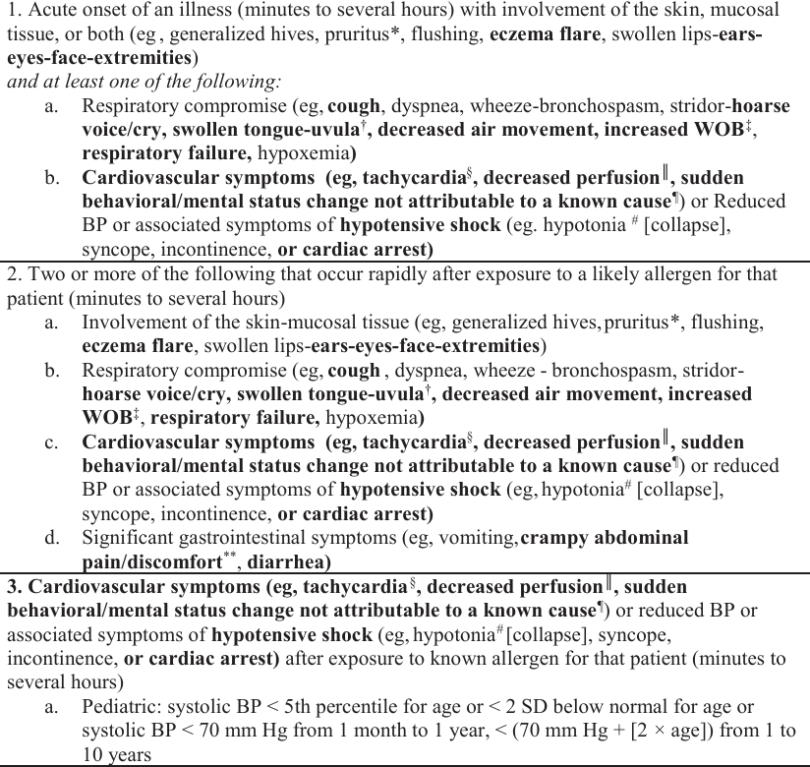
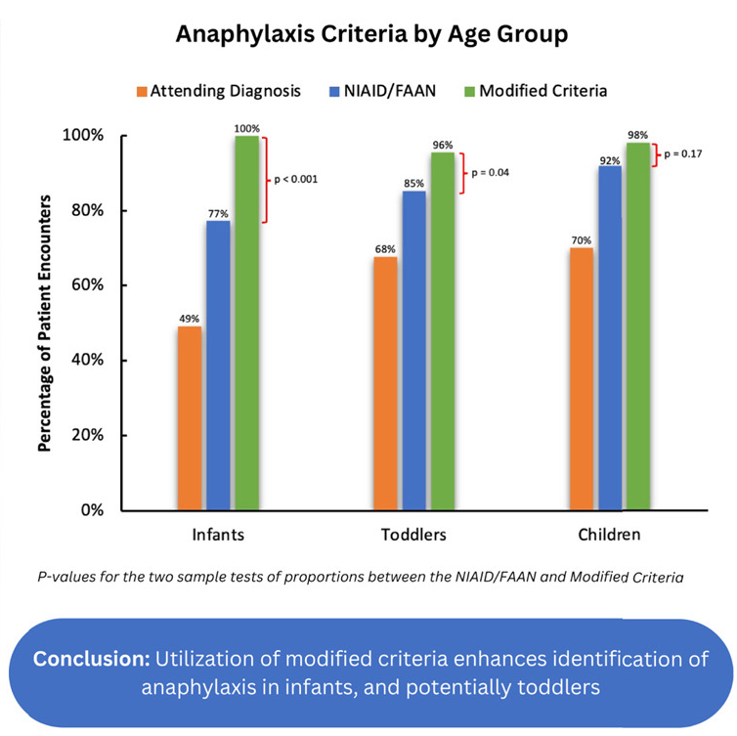
Modified Criteria for Infant and Toddler Anaphylaxis
Handorf A, Roy IR, Cohen A, Camargo CA Jr, Dribin TE, Pistiner M. Development and Evaluation of Modified Criteria for Infant and Toddler Anaphylaxis. J Allergy Clin Immunol Pract. 2024;12(8):2026-2034.e2.
Notes:
In 2024, an infant- and toddler-specific modified criteria was proposed that included several modifications to the NIAID/FAAN criteria that account for age-specific differences. Using the modified criteria resulted in enhanced identification of anaphylaxis in infants and toddlers in this chart review of 175 cases meeting predefined criteria for anaphylaxis. Compared with current criteria, modified criteria had 23% improved performance among infants (p < 0.001) and 10% improved performance among toddlers (p = 0.04).

Slide 13
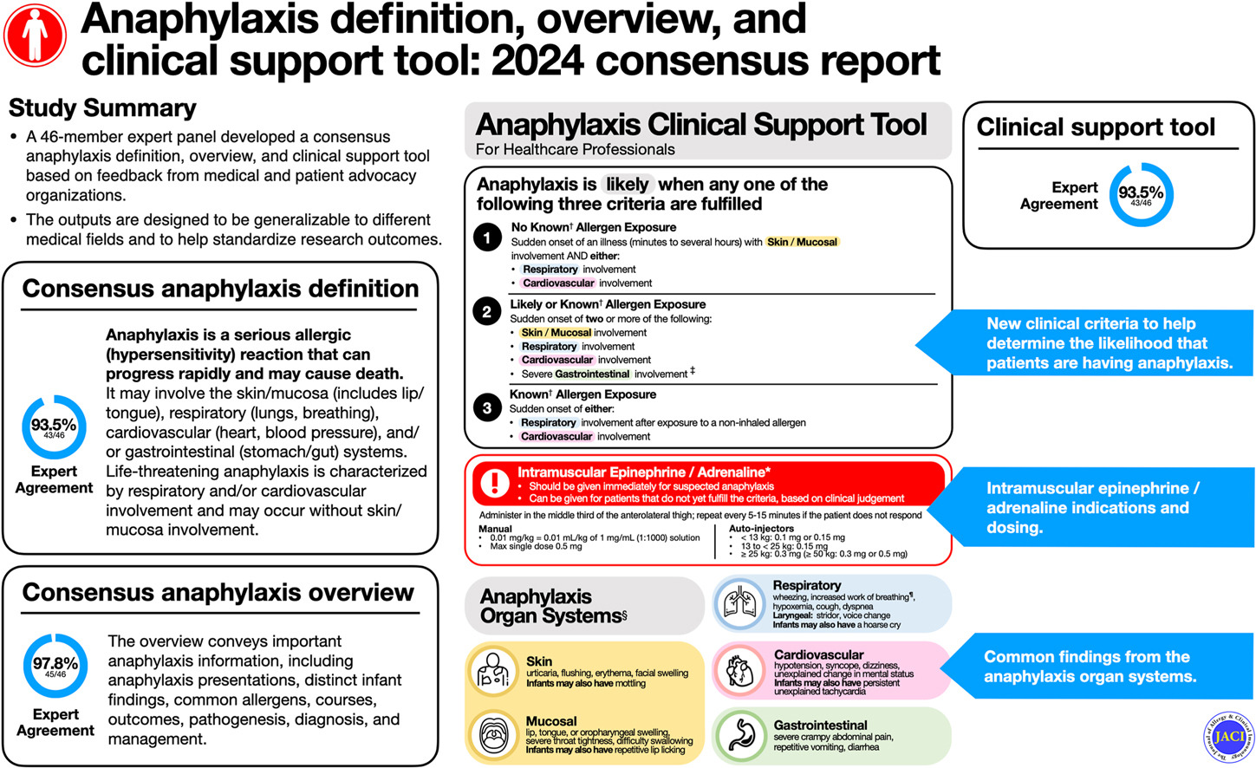
Primary Care
Primary Care
Dribin TE, Muraro A, Camargo CA Jr, et al. Anaphylaxis definition, overview, and clinical support tool: 2024 consensus report-a GA²LEN project. J Allergy Clin Immunol. 2025;156(2):406-417.e6.
Notes:
Subsequently, Dribin and colleagues, along with the updated definition of anaphylaxis, proposed a clinical support tool designed to address all ages and incorporated the aforementioned infant and toddler specific elements.

Slide 14
2024 Clinical Support Tool Criteria
Primary Care
Primary Care
Dribin TE, Muraro A, Camargo CA Jr, et al. Anaphylaxis definition, overview, and clinical support tool: 2024 consensus report-a GA²LEN project. J Allergy Clin Immunol. 2025;156(2):406-417.e6.
Notes:
As in all criteria, the clinical support tool includes criteria to make anaphylaxis likely. Also dependent on allergen exposure statue and system involvement.
Anaphylaxis is likely when any one of the following three criteria are fulfilled:
1: No known allergen exposure – sudden onset of an illness (minutes to several hours) with skin/mucosal involvement AND either:
Respiratory involvement
Cardiovascular involvement
2: Likely or known allergy exposure – sudden onset of two or more of the following:
Skin/mucosal involvement
Respiratory involvement
Cardiovascular involvement
Severe gastrointestinal involvement
3: Known allergen exposure – sudden onset of either:
Respiratory involvement after exposure to a non-inhaled allergen
Cardiovascular involvement

Slide 15
Types of Anaphylaxis
Biphasic Anaphylaxis
Anaphylaxis after initial signs and symptoms have completely resolved for at least 1 hour before the onset of repeated anaphylaxis within 48 hours without re-exposure to an allergen trigger.
Persistent Anaphylaxis
Anaphylaxis that persists for 4 hours
Refractory Anaphylaxis
Anaphylaxis that continues despite appropriate epinephrine dosing (2-3 doses) and symptom-directed medical management
Epi Dose
Epi Dose
Epi Dose
Reaction 1
Reaction 2
Asymptomatic
1-48 hours
4 hours
Golden DBK, Wang J, Waserman S, et al. Anaphylaxis: A 2023 practice parameter update. Ann Allergy Asthma Immunol. 2024;132(2):124-176.
Notes:
Here are some different types of anaphylaxis, including biphasic, persistent and refractory anaphylaxis.

Slide 16
Biphasic Anaphylaxis
Risk factors
Increased severity of reaction
Patients who required more than 1 epinephrine dose
Wide pulse pressure
Unknown trigger
Cutaneous signs and symptoms
Drug trigger in children
Seen in 6.5% of anaphylactic reactions
Median duration between symptoms is 10.5 hours
One hour symptom free observation after resolution of initial anaphylaxis had 95% NPV
Golden DBK, Wang J, Waserman S, et al. Anaphylaxis: A 2023 practice parameter update. Ann Allergy Asthma Immunol. 2024;132(2):124-176.
Notes:
These are data on biphasic anaphylaxis, with risk factors for developing it.
Use of steroids and antihistamine has not been demonstrated to decrease risk of biphasic Practice Parameter 2020.

Slide 17
Refractory Anaphylaxis
  Possible Causes
  Delayed or insufficient treatment with epinephrine
  Ongoing release of inflammatory mediators
  Tachyphylaxis to epinephrine treatment (rare)
Seen in 2% of anaphylactic reactions
Most common triggers are drugs followed by food allergens
Pouessel G, Deschildre A, Dribin TE, et al. Refractory Anaphylaxis: A New Entity for Severe Anaphylaxis. J Allergy Clin Immunol Pract. 2023;11(7):2043-2048.
Notes:
Here is more information of refractory anaphylaxis, Network for Online Registration of Anaphylaxis showed antibiotics and radiocontrast materials were most common triggers (truly IgE-mediated?)

Slide 18
Case 1
8-year-old (40kg) female with prior history of facial swelling who presented to the ED for evaluation of bilateral swelling of her eyes and lips with subjective sensation of difficulty breathing (reported normal vital signs) and hives on her flank.
Prior to this reaction, she last ate at ~7 hours before arrival. There was no new food introduction at that time.
She went several hours without symptoms then went to sleep. When she woke up from sleep, approximately 7 hours after eating she noted swelling of her face and hives on her trunk which prompted POC to bring her to the ED for further evaluation.
She has a history of similar symptoms with no identifiable trigger. She did not have any coughing, wheezing, or GI symptoms. She does not currently have any infectious symptoms.
Notes:
Key Points: Subjective sensation of difficulty breathing without objective signs of respiratory distress, hypoxia, or wheezing. Symptoms occurred approximately 7 hours after eating, with no new food exposure or known food allergy history.

Slide 19
Case 1
ED management:
  Received a dose of IM EPINEPHrine without significant improvement of symptoms
Consult Allergy:
  Most likely experienced episodes of histaminergic angioedema. She has had multiple episodes separated by weeks where she is asymptomatic
  Started Zyrtec in the ED with improvement of symptoms
  Continued on Zyrtec 10mg BID and follow-up with allergy
Notes:
History is most important in this case, timing of symptoms not related to foods. Nonetheless, the patient got epinephrine in the ED because of the significant angioedema, urticaria, and subjective sensation of difficulty breathing.
This patient did not have anaphylaxis – but rather has recurrent histaminergic angioedema and urticaria – with no findings of respiratory distress, wheezing, cough, or hypoxia. The role of the ED is to promptly recognize and treat potentially serious reactions, while allergists have the opportunity to perform a more detailed evaluation, including a thorough history and assessment of potential triggers.

Slide 20
Case 1
Allergy appointment 2 days later:
She has experienced 3 distinct episodes in the last month of severe angioedema involving her face, particularly the periorbital area and lips. She has exhibited some urticarial lesions. Potentially occurring within 4-6 hours after ingestion of milk
  Improvement of symptoms with antihistamines suggestive of histaminergic angioedema
Work-up performed to evaluate for bradykinin mediated angioedema (low suspicion)
  Normal C4 complement level
  C1 inhibitor function
  C1 inhibitor level
  Tryptase level
  Skin testing to milk also negative
2-month follow-up, no recurrence of symptoms while on Zyrtec 10mg daily
Notes:
Given the recurrent angioedema, a workup for hereditary forms was performed and was normal. At 2 months post treatment with Zyrtec, she was angioedema free.

Slide 21
Case 2
A 19-year-old female who was previously diagnosed with food-dependent exercise-induced anaphylaxis (FDEIA), now presenting to the ED for the third time in a week due to concern for anaphylaxis
Overall, she has had a sensation of difficulty breathing, throat tightness, facial erythema, which has occurred with riding her bike but also while walking to class at school
She has not eaten any food that had previously triggered FDEIA before these episodes occur
Each time she has received IM EPINEPHrine prior to presentation and in the ED she has had normal exam findings and vital signs
Tryptase normal at each of the 3 visits to ED
She did not have hives, coughing, wheezing, angioedema, or vomiting while in the ED
Notes:
Key Points: 19-year-old with a history of FDEIA with new onset possible anaphylaxis not related to exercise or food. Throat tightness and sensation of difficulty breathing without objective findings of respiratory distress; no other allergic symptoms but got Epi each time. Normal tryptase each time.

Slide 22
Based on presenting symptoms, what would be your next step?
a.) Two-hour observation then discharge home with return precautions
b.) Administer IM epinephrine 0.3mg upon arrival
c.) Administer Zyrtec 10mg
d.) Administer prednisone 40mg po with 5-day home taper
Notes:
With no other signs or symptoms of anaphylaxis, normal tryptase, no further treatment for anaphylaxis is warranted, as this was not anaphylaxis. This is inducible laryngeal obstruction, formerly known as vocal cord dysfunction. Patient was referred to speech therapy to learn breathing exercises, and no further ED visits for this have occurred.

Slide 23
Special Forms of Anaphylaxis
Notes:
There are several forms of anaphylaxis to discuss next.

Slide 24
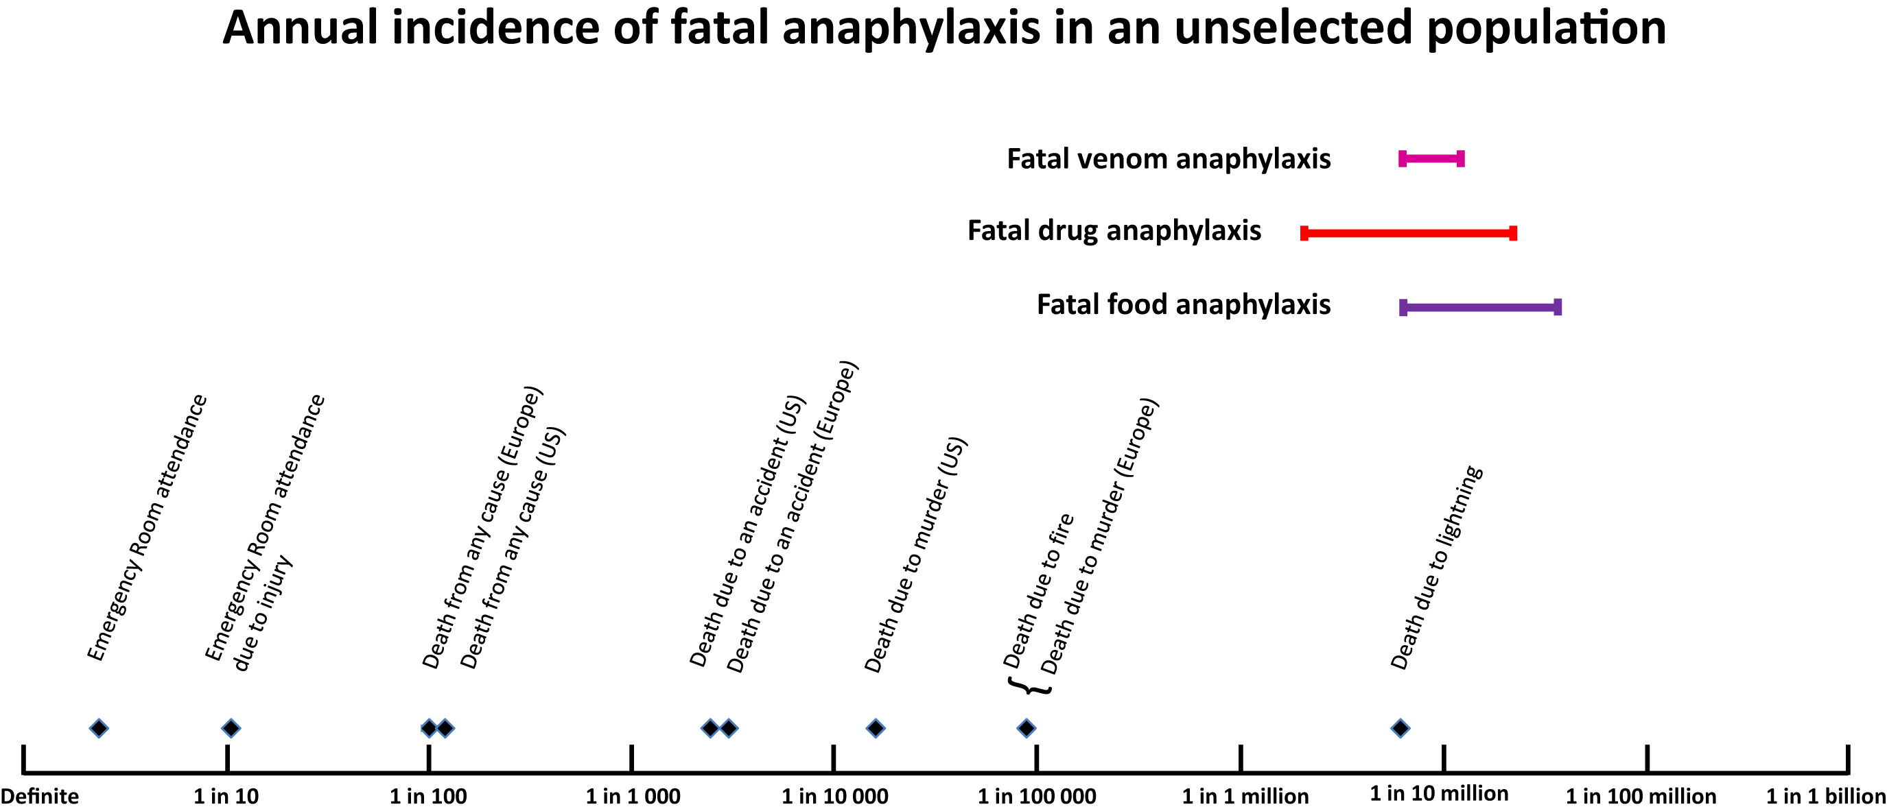
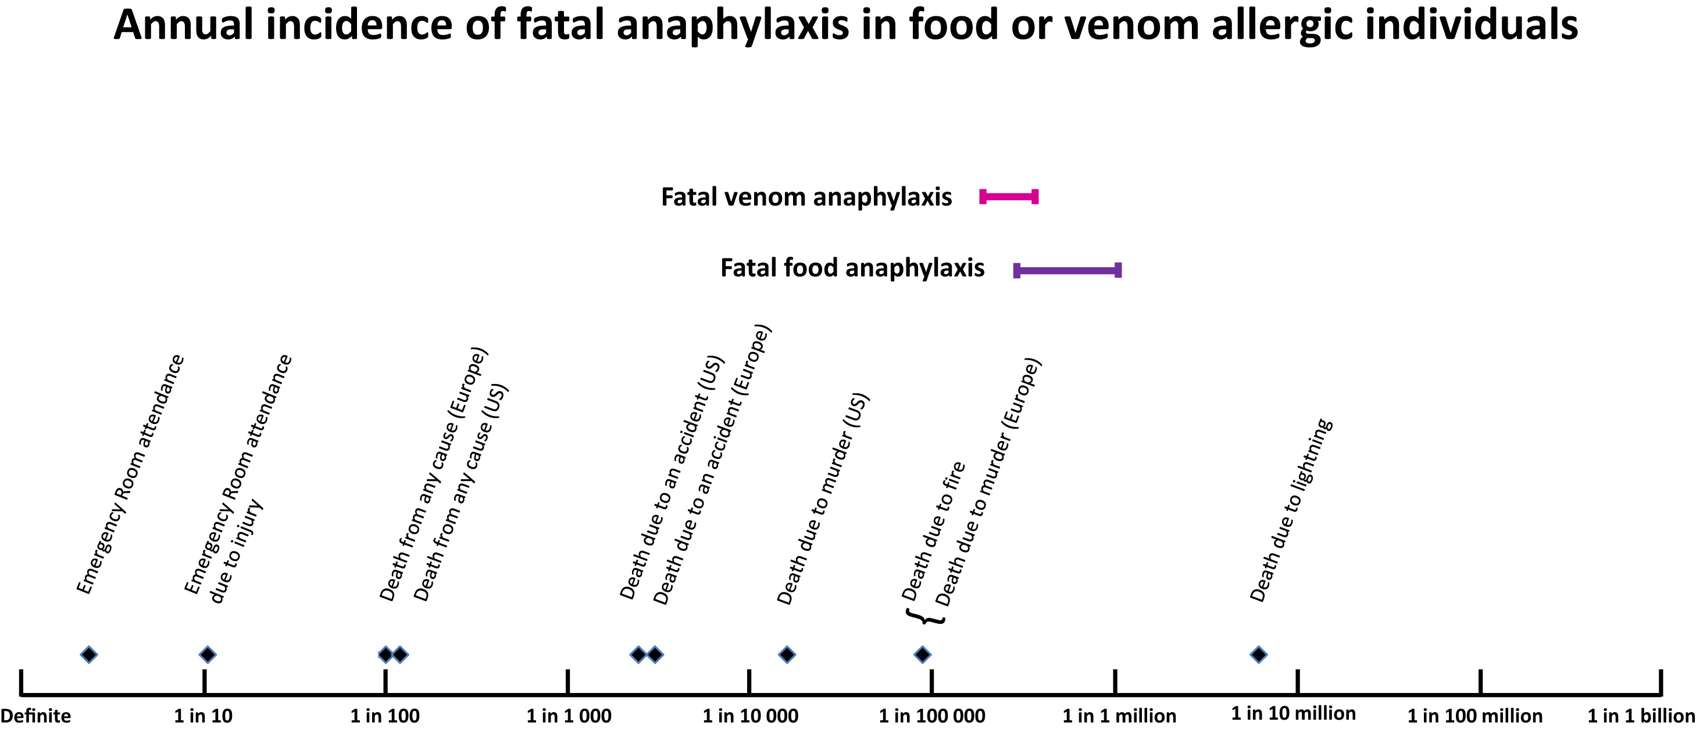
Fatal Anaphylaxis
Seen in < 1% of anaphylactic reactions
Risk factors
Older age
  10–29-year-old for food
Comorbidities (CVD for drugs, asthma for food)
Upright position
Delayed epinephrine administration
Mastocytosis (especially venom)
Turner PJ, Jerschow E, Umasunthar T, Lin R, Campbell DE, Boyle RJ. Fatal Anaphylaxis: Mortality Rate and Risk Factors. J Allergy Clin Immunol Pract. 2017;5(5):1169-1178.
Notes:
Fatal anaphylaxis is fortunately rare with risk factors listed above.

Slide 25
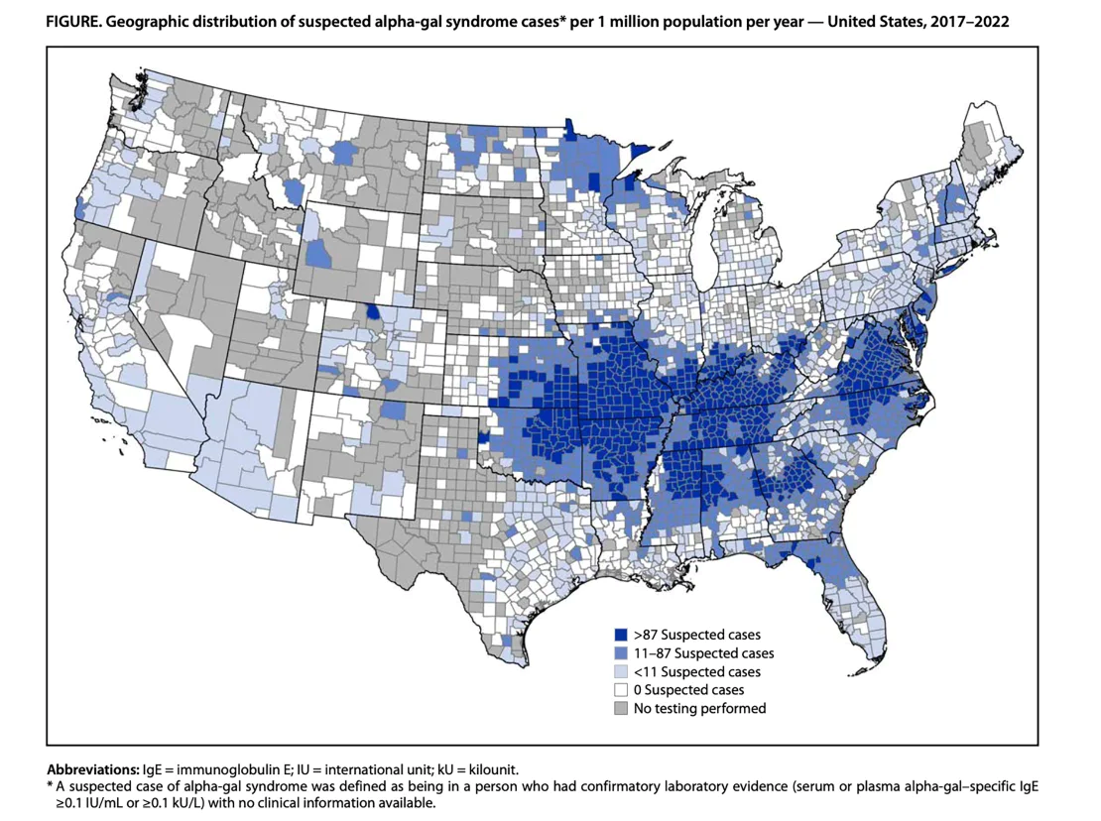
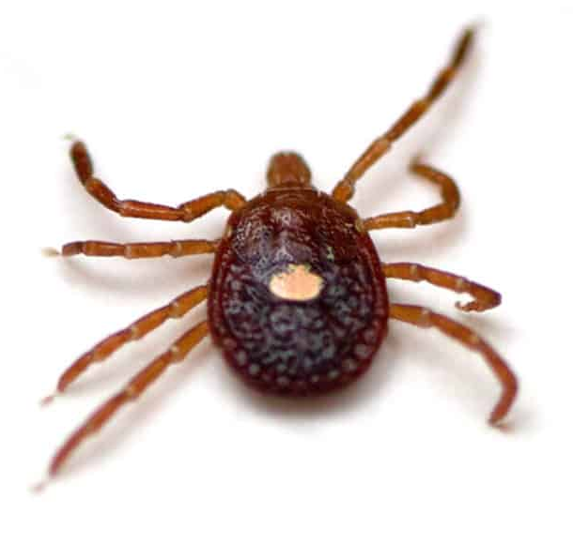
Alpha Gal Syndrome
Due to IgE directed to galactose-α-1,3-galactose carbohydrate
Sensitization following Lone Star Tick bite
Causes delayed reactions 2-6 hours after ingestion of red (mammalian) meat
Diagnose by clinical history and specific IgE to α-gal
Medications, such as cetuximab can contain α-gal
1) Platts-Mills TAE, Li RC, Keshavarz B, Smith AR, Wilson JM. Diagnosis and Management of Patients with the α-Gal Syndrome. J Allergy Clin Immunol Pract. 2020;8(1):15-23.e1.
2) Figure from CDC.gov
Notes:
Alpha gal syndrome is seen here. This is a delayed anaphylactic reaction to red mammalian meat that occurs via a sensitization process from a tick bite.

Slide 26
Food-Dependent Exercise-Induced Anaphylaxis
Combination of intake of trigger foods and exercise (or possibly other augmenting factors) within 4 hours resulting in anaphylaxis.
Other augmenting factors:
NSAIDs
Alcohol
Infections
Stress, Sleep Deprivation
Menstruation
Most common food triggers
Wheat,
other grains
Shellfish
Vegetables
(celery, tomato)
Golden DBK, Wang J, Waserman S, et al. Anaphylaxis: A 2023 practice parameter update. Ann Allergy Asthma Immunol. 2024;132(2):124-176.
Notes:
Food-dependent exercise-induced anaphylaxis occurs when a food allergen is ingested, and exercise or other augmenting factors are needed to induce the reaction. Without these cofactors, a reaction does not occur.

Slide 27
Food-Dependent Exercise-Induced Anaphylaxis
Diagnosis
  Symptoms of anaphylaxis that occurred during (or within an hour of) exercise but only when exercise was preceded by food ingestion.
  No other diagnosis that explains the clinical presentation.
  Positive specific IgE to the implicated food
    Wheat commonly will present with positive omega-5 gliadin IgE (Tri a 19)
  No symptoms with food ingestion without exercise/augmenting factors
Management
  Avoid exercising within 4-6 hours of eating trigger food
  Carry epinephrine
  Exercise with others, Medic-alert jewelry
Golden DBK, Wang J, Waserman S, et al. Anaphylaxis: A 2023 practice parameter update. Ann Allergy Asthma Immunol. 2024;132(2):124-176.
Notes:
The diagnosis of FDEIA is mainly a clinical one, but could be diagnosed by ingestion followed by an exercise challenge. Management is avoiding exercising within 4-6 hours of eating the food and carrying epinephrine.

Slide 28
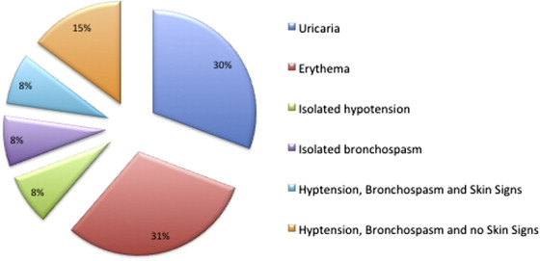
Perioperative Anaphylaxis
Mortality is higher than other cause of anaphylaxis (3-9%)
  More likely to present as cardiovascular collapse or bronchoconstriction
  Less likely to also note cutaneous symptoms (in part due to patient being draped)
Savic LC, et al. Incidence of suspected perioperative anaphylaxis: A multicenter snapshot study. J Allergy Clin Immunol Pract. 2015 May-Jun;3(3):454-5.e1.
Notes:
Perioperative anaphylaxis has a higher mortality than other causes, and is more likely to present with cardiovascular collapse or bronchoconstriction and may not have cutaneous symptoms.

Slide 29
Perioperative Anaphylaxis
Common Triggers:
Neuromuscular blocking agents (30-70% of cases)
Antibiotics, most commonly cefazolin (20-55% of cases)
Latex
Disinfectants (chlorhexidine, povidone iodine, bacitracin)
Blue dye
Sugammadex
Due to many different medications administered concurrently, identification of trigger may be difficult
Tryptase should be elevated in most cases of perioperative anaphylaxis
Testing is limited due to poor validation and difficulty to perform challenges
Savic LC, et al. Incidence of suspected perioperative anaphylaxis: A multicenter snapshot study. J Allergy Clin Immunol Pract. 2015 May-Jun;3(3):454-5.e1.
Notes:
Identifying triggers may be difficult with these cases, and testing is limited due to lack of validation of testing. Common triggers are listed here.

Slide 30
Idiopathic Anaphylaxis
Diagnosis of exclusion
Rates of IA are declining with better recognition of other causes of anaphylaxis
Possible underlying etiology of idiopathic anaphylaxis is unclear
Episodes of anaphylaxis should meet NIAID or WAO criteria for anaphylaxis and elevation of tryptase at time of symptoms should be observed
Need work-up to rule out systemic mastocytosis
Carter MC, Akin C, Castells MC, Scott EP, Lieberman P. Idiopathic anaphylaxis yardstick: Practical recommendations for clinical practice. Ann Allergy Asthma Immunol. 2020;124(1):16-27.
Notes:
Idiopathic anaphylaxis is a diagnosis made after excluding all possible triggers. The underlying pathophysiology of this is unclear, and episodes should meet criteria for anaphylaxis. Tryptase levels should be obtained with episodes and ruling out systemic mast cell disease is recommended.

Slide 31
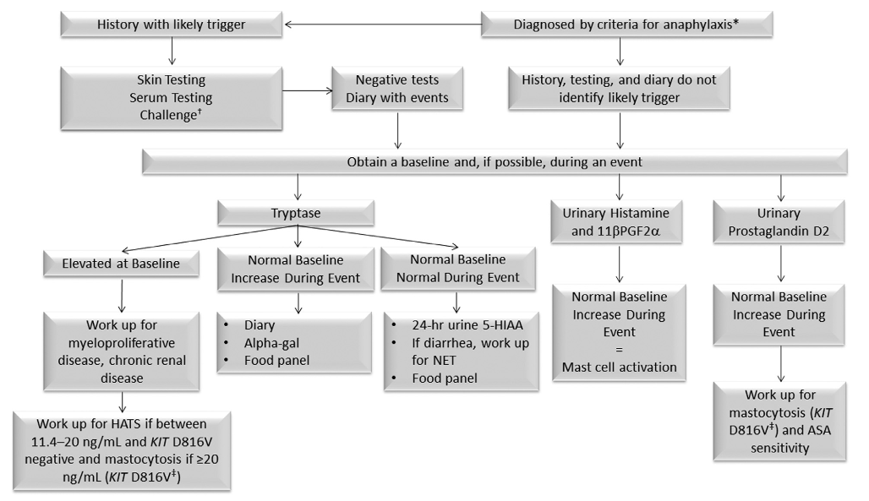
Diagnostic Algorithm for Idiopathic Anaphylaxis
Carter MC, Akin C, Castells MC, Scott EP, Lieberman P. Idiopathic anaphylaxis yardstick: Practical recommendations for clinical practice. Ann Allergy Asthma Immunol. 2020;124(1):16-27.
Notes:
Here is a diagnostic algorithm for idiopathic anaphylaxis, evaluating for different diseases if tryptase if elevated or not, and working up mast cell disease further if warranted.
HAT: hereditary alpha-tryptasemia syndrome

Slide 32
Differential Diagnosis
Alternative Diagnoses | Differentiating Features
Urticaria/Angioedema | No respiratory compromise (unless there is laryngeal involvement)
Inducible laryngeal obstruction | No cutaneous symptoms/pruritus
Vasovagal Syncope | No cutaneous symptoms/pruritus or respiratory compromise Resolves with recumbency without further medications
Scombroid Poisoning | History of ingestion of spoiled fish
Systemic Mastocytosis | Persistently elevated tryptase
Carcinoid | Frequently will have associated diarrhea
Other forms of shock | No pruritus
Red Man Syndrome | Vancomycin, improvement with reduced infusion rate
Psychogenic (Panic disorder, etc.) | Limited objective findings
Modified from Cardona V, Ansotegui IJ, Ebisawa M, et al. World allergy organization anaphylaxis guidance 2020. World Allergy Organ J. 2020;13(10):100472. Published 2020 Oct 30.
Notes:
Here is the differential diagnosis of anaphylaxis with the alternative diagnoses and differentiating features from anaphylaxis.

Slide 33
Evidence-based Acute Management
Notes:
No notes.

Slide 34

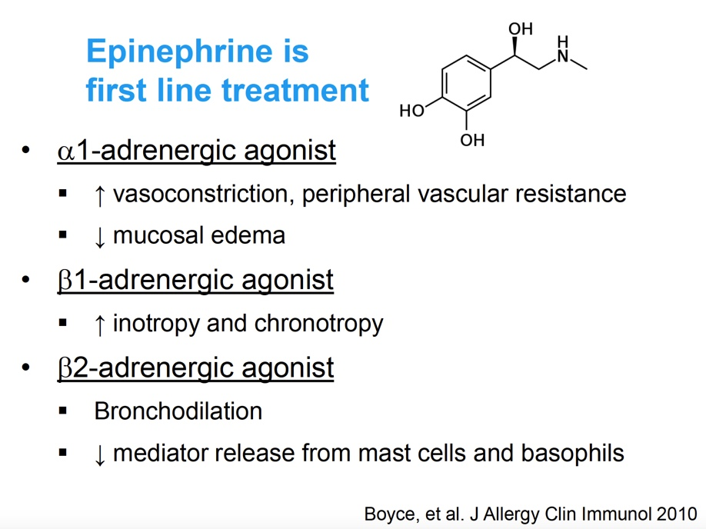
Anaphylaxis: Epinephrine
Epinephrine is first line treatment
α1-adrenergic agonist
↑ vasoconstriction, peripheral vascular resistance
↓ mucosal edema
β1-adrenergic agonist
↑ inotropy and chronotropy
β2-adrenergic agonist
Bronchodilation
↓ mediator release from mast cells and basophils
0.01 mg/kg using a 1mg/ml concentration (formally 1:1000 dilution) IM
(max 0.3mg children, 0.5mg adults)
Repeated doses every 5-15 min if no significant improvement in symptoms
IV dosing 0.1mg/ml concentration via infusion/drip(formally 1:10,000 dilution)
NIAID-Sponsored Expert Panel, Boyce JA, Assa'ad A, et al. Guidelines for the diagnosis and management of food allergy in the United States: report of the NIAID-sponsored expert panel. J Allergy Clin Immunol. 2010;126(6 Suppl):S1-S58.
Notes:
Epinephrine is the first line drug of choice for anaphylaxis. IM or nasal forms are recommended; IV usage should be restricted to acute care settings such as the ED or ICU and when needed via infusion instead of bolusing or push as there are associations with dosing error and increased morbidity. Epinephrine's pharmacologic effects are listed here.

Slide 35
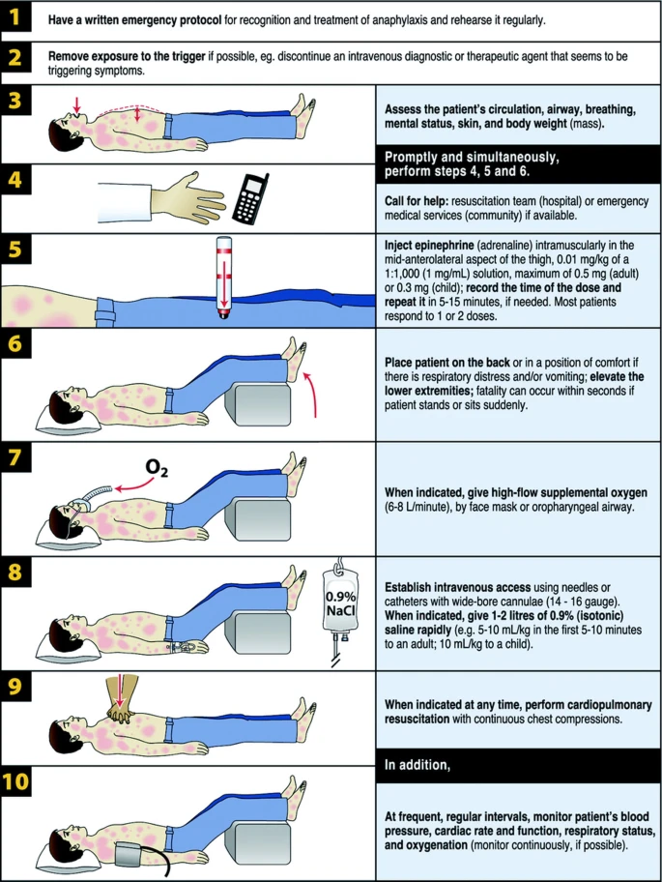
Acute Management
Prompt epinephrine
Supine position (caution with respiratory distress or vomiting)
Adjuvant Therapies
  SABA
  Antihistamines
  Fluids
  No role for steroids (exception is in cases of known or suspected adrenal suppression)
Indications for prolonged observation
  Severe reaction
  Need for multiple doses of epinephrine
  Previous history of biphasic reaction
  Concern for asthma exacerbation
Golden DBK, Wang J, Waserman S, et al. Anaphylaxis: A 2023 practice parameter update. Ann Allergy Asthma Immunol. 2024;132(2):124-176.
Notes:
Acute management strategies are listed here. Adjuvant therapies in addition to epinephrine are listed here in addition to indications for prolonged observation.
In cases of known or suspected adrenal suppression stress dose steroids do serve a role, but otherwise use of systemic corticosteroids is not necessary as an adjuvant therapy for anaphylaxis.

Slide 36
Epinephrine Treatment
Prompt treatment of anaphylaxis with epinephrine may improve mortality
  Reduces rates of biphasic and hospitalization
    Most fatal cases did not have timely epinephrine treatment
Use of epinephrine is based on consensus guidelines, but lacks data from RCTs
Large registries have shown that up to 80% of anaphylactic episodes resolve without epinephrine treatment.
There is no benefit for preemptive treatment prior to onset of symptoms
Recent guidelines do not mandate immediate activation of EMS with use of epinephrine
Golden DBK, Wang J, Waserman S, et al. Anaphylaxis: A 2023 practice parameter update. Ann Allergy Asthma Immunol. 2024;132(2):124-176.
Notes:
Epinephrine remains the primary drug, but data from RCTs are lacking. Many cases of anaphylaxis resolve without epinephrine, but prompt usage of it reduces rates of biphasic reactions and hospitalizations. Most fatal cases result from lack of timely administration, and there is no benefit from preemptive treatment with epinephrine prior to the onset of symptoms.
Recent guidelines have also changed that no longer mandate 911 activation or observation in the ED. Can watch and wait at home if stable, does not need second dose of episode, no history of atypical episodes of anaphylaxis, e.g., biphasic.

Slide 37
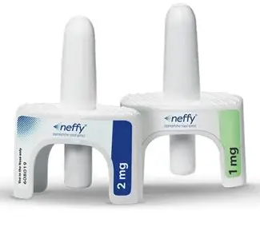
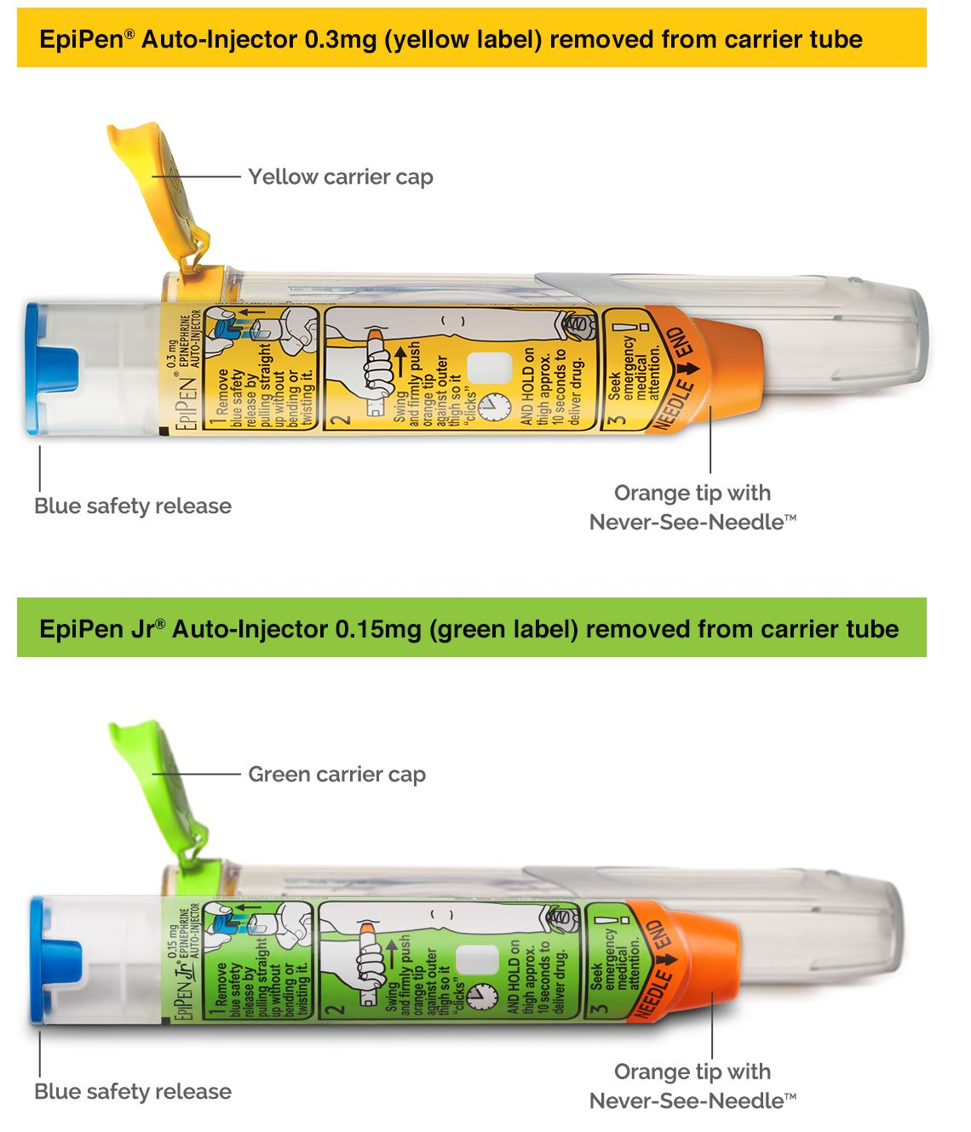
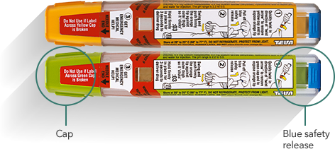
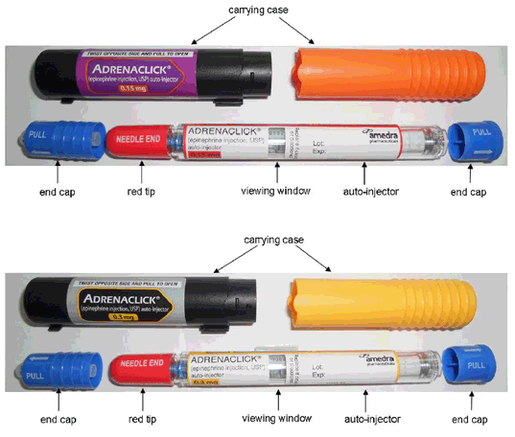

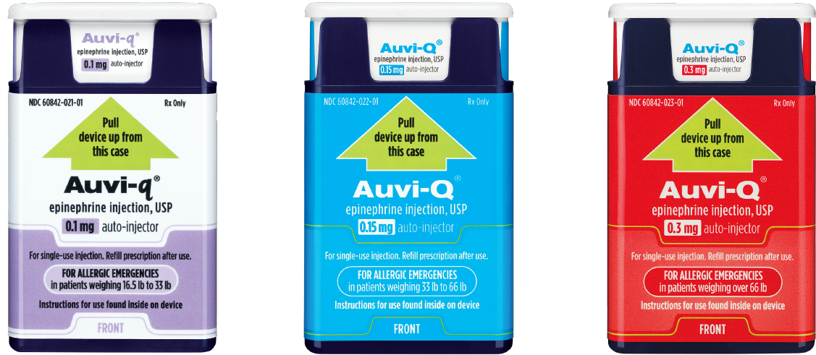
Types of Epinephrine Delivery Systems
Investigational sublingual epinephrine film; not FDA approved
Notes:
There are several epinephrine devices currently available. Note though that these are not available in all other countries; in fact, many countries do not have any devices and use syringes/vials. Currently there are various forms of FDA approved auto-injectors and a relatively recently approved for of intranasal epinephrine available. The picture on the bottom right is of an anaphylaxis sublingual film that is being developed.

Slide 38
Types of Epinephrine Delivery Systems
Epinephrine auto-injectors are available in a limited number of premeasured doses
  FDA has approved 0.15 mg EAIs for 15–30 kg, and a 0.1 mg EAI (Auvi-Q) for 7.5–15 kg
    AAP and JTFPP support use of 0.15 mg EAIs for young children less than 15 kg as the 0.1mg EAI is not universally available; consideration for up-dosing from 0.1mg at 13 kg (AAP)
  FDA has approved 0.3 mg EAIs for >=30 kg
    AAP and JTFPP support use of 0.3 mg EAIs for patients weighing >=25 kg due to imperfect dosing and issue of underdosing at this weight
Golden DBK, Wang J, Waserman S, et al. Anaphylaxis: A 2023 practice parameter update. Ann Allergy Asthma Immunol. 2024;132(2):124-176.
Notes:
Epinephrine delivery systems are available in a limited number of premeasured doses. FDA has approved the 0.15 mg for patients weighing 15–30 kg, and a 0.1 mg auto-injector for patients weighing 7.5–15 kg. The American Academy of Pediatrics and Joint Task force for Practice Parameters support the use of 0.15 mg auto-injectors for young children less than 15 kg, as the 0.1mg auto-injector is not universally available. Further, the AAP has suggested consideration to up-dose from 0.1mg to 0.15mg, at 13kg as reflected in the AAP Allergy and Anaphylaxis Emergency Plan.
From the 2023 Anaphylaxis Practice Parameter Update: "The current standard practice is to treat anaphylaxis with a dosage of epinephrine of 0.01 mg/kg, up to a maximum of 0.3 mg for children and teenagers and 0.5 mg for adults. EAIs are only available in a limited number of premeasured doses. Although the US Food and Drug Administration (US FDA) has approved 0.3 mg EAIs for patients weighing above or equal to 30 kg, 0.15 mg EAIs for patients weighing 15 to 30 kg, and a 0.1 mg EAI (Auvi-Q) for patients weighing 7.5 to 15 kg, multiple medical organizations (American Academy of Allergy, Asthma & Immunology [AAAAI], American Academy of Pediatrics [AAP], Canadian Society of Allergy and Clinical Immunology [CSACI], and European Academy Allergy and Clinical Immunology [EAACI]) support switching to 0.3 mg at 25 kg to limit underdosing in patients nearing 30 kg. The AAP supports the option to use the 0.1 mg dose (if available) for patients weighing 7.5 to 13 kg and the 0.15 mg dose for patients weighing 13 to 25 kg. However, the 0.1 mgEAI is not universally avail able, and the AAP and Joint Task Force on Practice Parameters (JTFPP) support the use of 0.15 mgEAIs for young children less than 15 kg."

Slide 39
Types of Epinephrine Delivery Systems
Intranasal epinephrine is available in a limited number of premeasured doses
  FDA has approved 1 mg IN for 15–30 kg
  FDA has approved 2 mg IN for >=30 kg
Notes:
Currently, there is one intranasal epinephrine product (Neffy) available that is FDA approved for patients weighing 15 kg or greater.

Slide 40
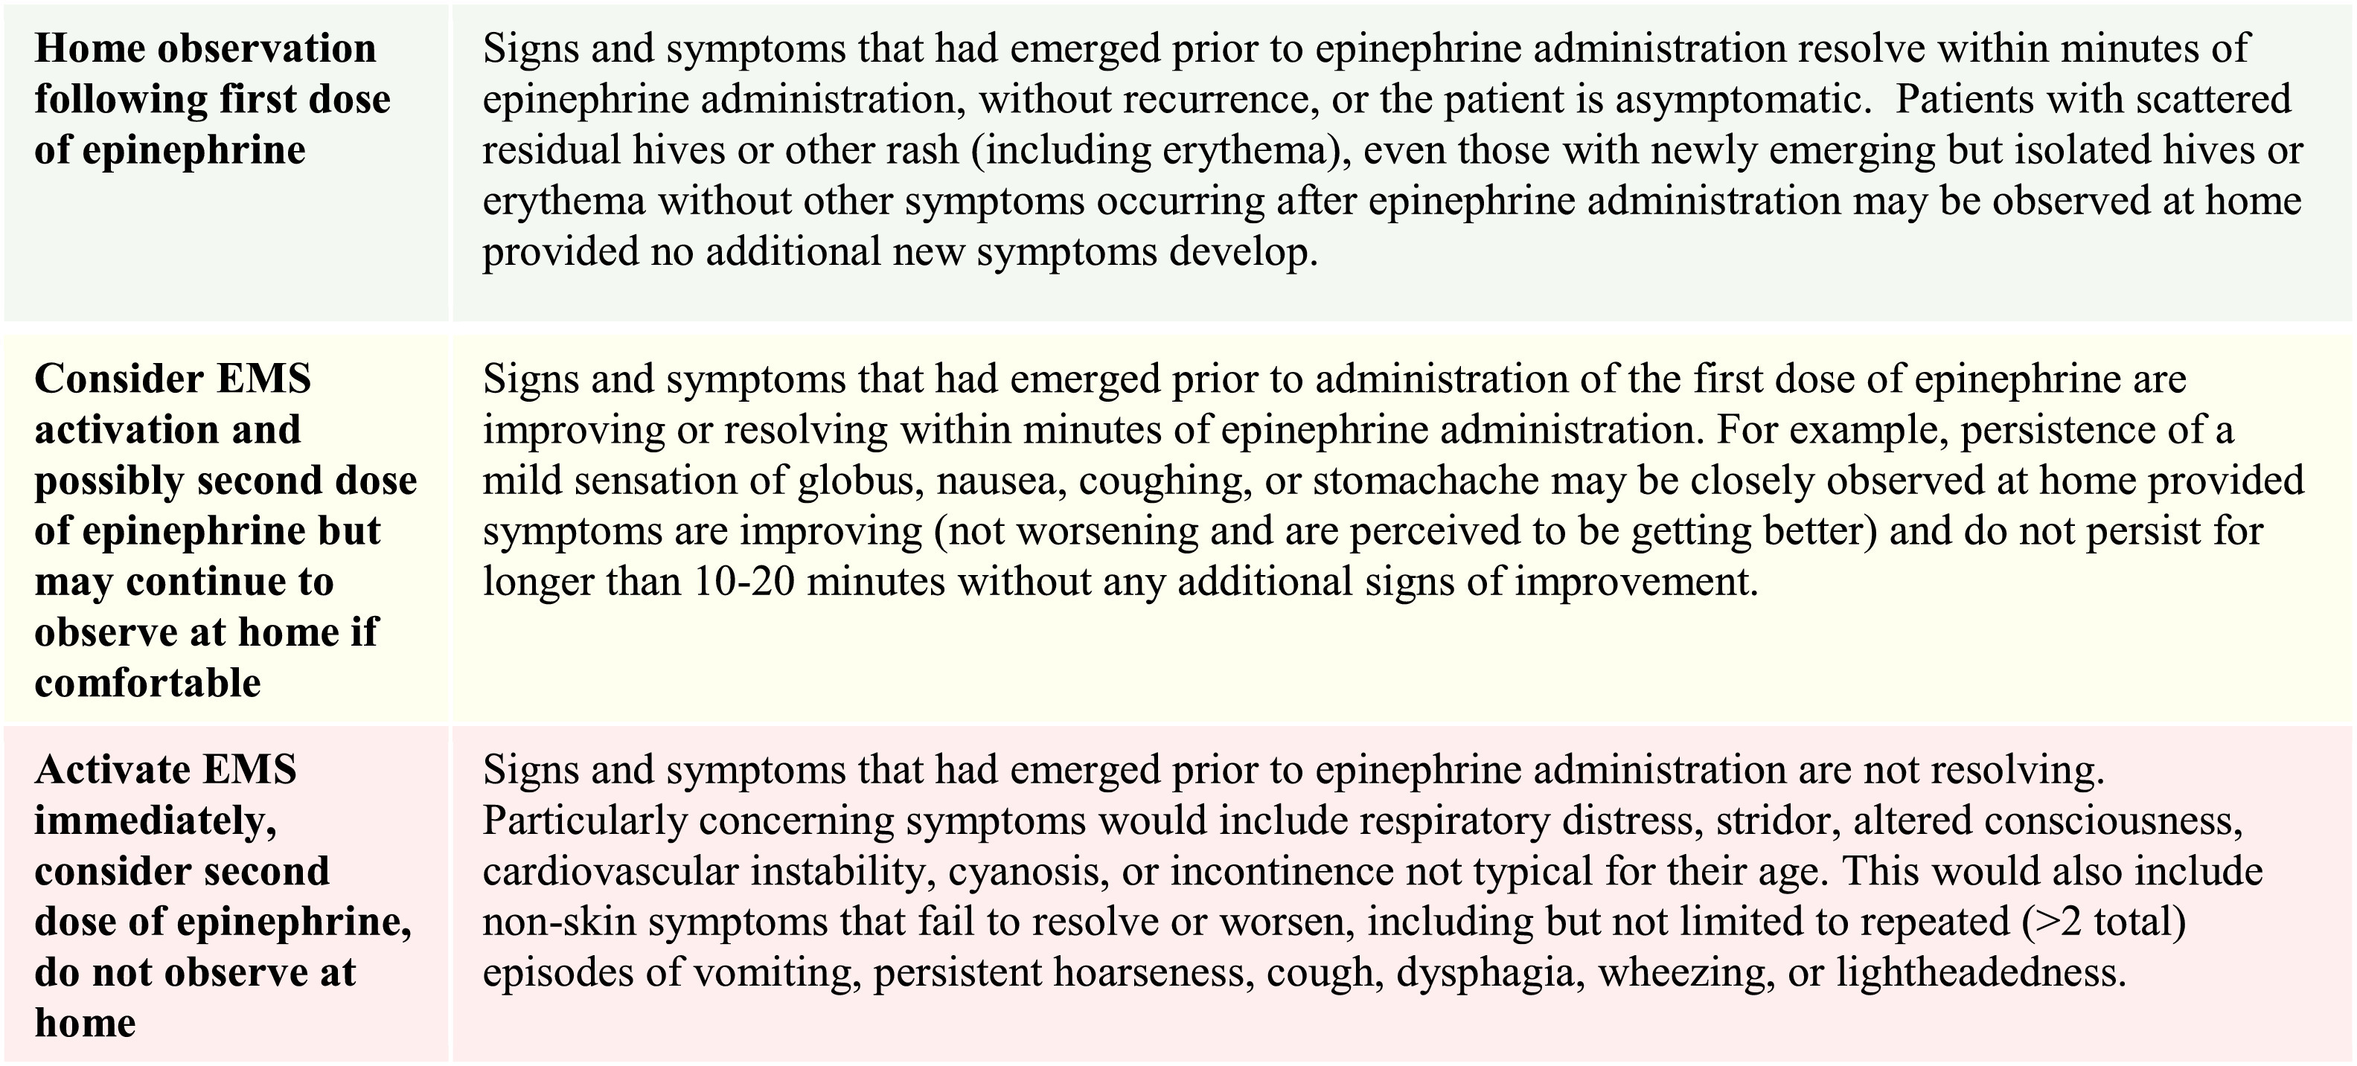
General Guidance for Activation of EMS and Administration of a Second Dose of Epinephrine
Golden DBK, Wang J, Waserman S, et al. Anaphylaxis: A 2023 practice parameter update. Ann Allergy Asthma Immunol. 2024;132(2):124-176.
Notes:
The 2023 Anaphylaxis Practice Parameter Update includes general guidance for activation of EMS and administration of a second dose of epinephrine. This guidance discusses situations when immediate activation of EMS/911 may not be necessary.

Slide 41
General Guidance for Activation of EMS and Administration of a Second Dose of Epinephrine
Golden DBK, Wang J, Waserman S, et al. Anaphylaxis: A 2023 practice parameter update. Ann Allergy Asthma Immunol. 2024;132(2):124-176.
Notes:
Home observation following the first dose of epinephrine can be considered if signs and symptoms that emerged prior to epinephrine administration resolve within minutes after administration and do not recur, or if the patient is asymptomatic. Patients with scattered residual hives or other rash, including newly emerging but isolated hives or erythema without other symptoms after epinephrine administration, may also be observed at home, provided that no additional new symptoms develop.

Slide 42
General Guidance for Activation of EMS and Administration of a Second Dose of Epinephrine
Golden DBK, Wang J, Waserman S, et al. Anaphylaxis: A 2023 practice parameter update. Ann Allergy Asthma Immunol. 2024;132(2):124-176.
Notes:
Consider EMS activation and possibly a second dose of epinephrine, but may continue to observe at home if comfortable if signs and symptoms that had emerged prior to administration of the first dose of epinephrine are improving or resolving within minutes of epinephrine administration. For example, persistence of a mild sensation of global nausea, coughing, or stomachache may be closely observed at home, provided symptoms are improving (not worsening and are perceived to be getting better) and do not persist for longer than 10 to 20 minutes without any additional signs of improvement.

Slide 43
General Guidance for Activation of EMS and Administration of a Second Dose of Epinephrine
Golden DBK, Wang J, Waserman S, et al. Anaphylaxis: A 2023 practice parameter update. Ann Allergy Asthma Immunol. 2024;132(2):124-176.
Notes:
Activate EMS immediately, consider a second dose of epinephrine, and do not observe at home for signs and symptoms that had emerged prior to epinephrine administration that are not resolving. Particularly concerning symptoms would include respiratory distress, stridor, altered consciousness, cardiovascular instability, cyanosis, or incontinence not typical for their age. This would also include non-skin symptoms that fail to resolve or worsen, including, but not limited to, repeated (greater than two total episodes of) vomiting, persistent hoarseness, cough, dyspnea, wheezing, or lightheadedness.

Slide 44
Monitoring, Observation, and Risk Stratification
"Timing of repeat epinephrine to inform pediatric anaphylaxis observation periods: a retrospective cohort study"
Multicenter retrospective cohort: 5,641 children (31 EDs) treated with epinephrine for anaphylaxis
Study objective: Determine the optimal observation period based on the timing of repeat epinephrine administration
Repeat epinephrine after first dose: >2 hours: 4.7%, >4 hours: 1.9%, >6 hours: 1.1%, >8 hours: 0.8%
95.3% of children would have been safely discharged after 2 hours of observation
98.1% would have been safely discharged after 4 hours of observation
Clinical implications:
2-hour observation is likely sufficient for most children who respond to epinephrine and remain well.
4-hour observation is reasonable for children with cardiovascular involvement who have clinically recovered.
Observation should still be individualized based on ongoing symptoms, need for multiple epinephrine doses, severe
asthma or other risk factors, and caregiver reliability/access to emergency care.
Dribin TE, Sampson HA, Zhang Y, et al. Timing of repeat epinephrine to inform paediatric anaphylaxis observation periods: a retrospective cohort study. Lancet Child Adolesc Health. 2025;9(7):484-496.
Notes:
In a recent publication from Dribin and colleagues, 5,461 children in 31 emergency departments were included in a retrospective multicenter study with the objective to determine optimal observation periods based on the timing of repeat epinephrine administration. With 95.3 % of children responding to 1 dose of epinephrine after a 2-hour observation period and 98.1 % after a 4-hour observation period. They conclude that a 2-hour observation is likely sufficient for most children who respond to epinephrine and remain well. That a 4-hour observation is reasonable for children with cardiovascular involvement who have clinically recovered. And that, observation should still be individualized based on ongoing symptoms, need for multiple epinephrine doses, severe asthma or other risk factors, and caregiver reliability/access to emergency care.

Slide 45
Disposition, Discharge Planning, and Follow-up
If initial episode of anaphylaxis, referral to allergist for evaluation and management of triggers; prescribe epinephrine before ER discharge
Subsequent anaphylaxis calls for review of avoidance and triggers
Provide positive feedback if treated appropriately
Educate about proper management of anaphylaxis if not treated appropriately with epinephrine
Notes:
Patients should be referred to an allergist for evaluation after an episode of anaphylaxis. Subsequent episodes should be an indication for review of avoidance and triggers; and providing positive feedback if managed properly or not.

Slide 46
Appropriate Billing and Coding
Diagnosis Coding (ICD-10-CM)
  Code by trigger:
    Food: T78.00–T78.09 [ specify peanut (.01), crustacean shellfish (.02), other fish (.03), fruit/vegetable (.04), tree nut/seed (.05), additive (.06), milk/dairy (.07), egg (.08), other food (.09)] (1)
    Drug, correctly administered: T88.6 (2)
    Serum/blood product: T80.5 (2])
    Unspecified trigger / anaphylactic shock NOS: T78.2 (1)
    Angioedema without anaphylaxis: T78.3 [do not substitute for anaphylaxis] (1)
  Formatting and companion codes:
    7th character is mandatory: A (initial), D (subsequent), S (sequela), with "X" placeholders [e.g., T78.2XXA, T78.01XA. Omission is a top cause of claim rejection].(1)
    Add external cause code (e.g., Y-codes for drug adverse effects) and Z88.x drug-allergy status / allergy history to preserve the longitudinal alert.(2)
    Avoid defaulting to T78.40 / T78.49 ("allergy, unspecified" / "other allergy") when clinical criteria for anaphylaxis are met.(1)
1) National Center for Health Statistics (U.S.) "ICD-10 Coordination and Maintenance Committee Meeting March 20, 2024 Diagnosis Agenda" , 2024
2) de Sordi D, Kappen S, Otto-Sobotka F, et al. Validity of hospital ICD-10-GM codes to identify anaphylaxis. Pharmacoepidemiol Drug Saf. 2021;30(12):1643-1652.
Notes:
Diagnosis Coding (ICD-10-CM)
Code by the trigger:
Food: T78.00–T78.09 — specify peanut (.01), crustacean shellfish (.02), other fish (.03), fruit/vegetable (.04), tree nut/seed (.05), additive (.06), milk/dairy(.07), egg (.08), other food (.09) (1)
Drug, correctly administered: T88.6 (2)
Serum/blood product: T80.5 (2])
Unspecified trigger / anaphylactic shock NOS: T78.2 (1)
Angioedema without anaphylaxis: T78.3 — do not substitute for anaphylaxis (1)
Formatting and companion codes:
7th character is mandatory: A (initial), D (subsequent), S (sequela), with "X" placeholders — e.g., T78.2XXA, T78.01XA. Omission is a top cause of claimrejection.(1)
Add external cause code (e.g., Y-codes for drug adverse effects) and Z88.x drug-allergy status / allergy history to preserve the longitudinal alert.(2)
Avoid defaulting to T78.40 / T78.49 ("allergy, unspecified" / "other allergy") when clinical criteria for anaphylaxis are met.(1)

Slide 47
Appropriate Billing and Coding
Encounter and Procedure Coding (CPT/HCPCS)
  Level of service:
    ED: 99284 (moderate MDM) or 99285 (high MDM) — anaphylaxis with airway or hemodynamic compromise generally supports high MDM (1)
    Critical care: 99291 (first 30–74 min) + 99292 (each additional 30 min) — time must be documented and exclusive of separately billed procedures (1)
    Observation/inpatient: 99221–99223 initial; 99234–99236 if admitted and discharged same day; 99238/99239 discharge management (1)
    Office/urgent care: 99213–99215 established; treat-and-refer visits after epinephrine still require documented MDM level (1)
  Procedures and drugs (bill in addition to E/M where not bundled into critical care):
    96372 — therapeutic IM/SC injection (epinephrine); 96374 IV push; 96365/96366 IV infusion; 96360/96361 hydration (1)
    J0171 / J0169 / J0165 — epinephrine injection HCPCS J-codes (product-specific) (1)
    94640/94644 — nebulized bronchodilator; 31500 — emergent intubation (1)
    Append modifier −25 to the E/M when a significant, separately identifiable service is performed alongside a procedure (1)
  Follow-up and prevention:
    Tryptase (84512), referral for skin testing (95004/95024) and specific IgE (2)
    Prescribe two epinephrine autoinjectors; document anaphylaxis action plan and counseling time (3)
1) Iglesia EGA, Kwan M, Virkud YV, Iweala OI. Management of Food Allergies and Food-Related Anaphylaxis. JAMA. 2024;331(6):510-521.
2) Li X, Ma Q, Yin J, et al. A Clinical Practice Guideline for the Emergency Management of Anaphylaxis (2020). Front Pharmacol. 2022;13:845689. Published 2022 Mar 28.
3) Golden DBK, Wang J, Waserman S, et al. Anaphylaxis: A 2023 practice parameter update. Ann Allergy Asthma Immunol. 2024;132(2):124-176.
Notes:
Encounter and Procedure Coding (CPT/HCPCS)
Level of service:
ED: 99284 (moderate MDM) or 99285 (high MDM) — anaphylaxis with airway or hemodynamic compromise generally supports high MDM (1)
Critical care: 99291 (first 30–74 min) + 99292 (each additional 30 min) — time must be documented and exclusive of separately billed procedures (1)
Observation/inpatient: 99221–99223 initial; 99234–99236 if admitted and discharged same day; 99238/99239 discharge management (1)
Office/urgent care: 99213–99215 established; treat-and-refer visits after epinephrine still require documented MDM level (1)
Procedures and drugs (bill in addition to E/M where not bundled into critical care):
96372 — therapeutic IM/SC injection (epinephrine); 96374 IV push; 96365/96366 IV infusion; 96360/96361 hydration (1)
J0171 / J0169 / J0165 — epinephrine injection HCPCS J-codes (product-specific) (1)
94640/94644 — nebulized bronchodilator; 31500 — emergent intubation (1)
Append modifier −25 to the E/M when a significant, separately identifiable service is performed alongside a procedure (1)
Follow-up and prevention:
Tryptase (84512), referral for skin testing (95004/95024) and specific IgE (2)
Prescribe two epinephrine autoinjectors; document anaphylaxis action plan and counseling time (3)

Slide 48
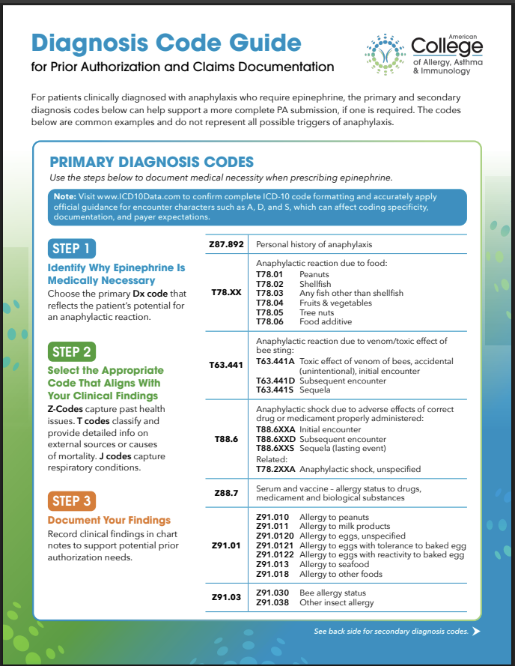
ACAAI Diagnosis Code Guide
Code accurately to support documentation, reimbursement, and insurance coverage.
Use diagnosis codes that reflect anaphylaxis and its trigger, when known.
Appropriate primary and secondary diagnosis codes can help support prior authorization for epinephrine when required.
Refer to the ACAAI Billing and Coding Guide for coding recommendations.
Common diagnosis codes are examples only and do not include all causes of anaphylaxis.
Notes:
Appropriate billing and coding for anaphylaxis are important for multiple reasons, and the ACAAI has provided some guidance on this topic. For patients clinically diagnosed with anaphylaxis who require epinephrine, the primary and secondary diagnosis codes seen here on the ACAAI guide can help support a more complete prior authorization submission if one is required for insurance. The primary diagnostic codes listed here are common examples and do not represent all the possible triggers of anaphylaxis.

Slide 49
Patient Education, Prevention, and Long-term Management
Notes:
No notes.

Slide 50
Identification of Likely Triggers and Risk Factors
Following an Episode of Anaphylaxis
Refer to an allergist after an initial episode of anaphylaxis to identify the trigger, assess risk factors, and develop a long-term management plan.
Assess for potential triggers, including foods, medications, insect stings, latex, and other suspected exposures.
Identify comorbidities (e.g. asthma, mast cell activation disorder) and cofactors (e.g. exercise, alcohol, infection, NSAIDS etc.) that may increase the risk or severity of reactions.
Evaluate for IgE-mediated allergy, as appropriate:
  Skin prick testing (Allergist)
  Allergen-specific IgE (± component testing)
  Oral food challenge when indicated (Allergist)
Notes:
Following an initial episode of anaphylaxis, referral to an allergist is recommended to identify the trigger, assess risk factors, and develop a long-term management plan.
A focused history should evaluate common triggers, including foods, medications, insect stings, and latex, as well as comorbidities such as asthma or mast cell activation disorder and cofactors such as exercise, alcohol, infection, NSAIDS etc. that may increase the risk or severity of reactions. Evaluation for IgE-mediated allergy may include skin prick testing by an allergist, allergen-specific IgE testing (with component testing when indicated), and, when appropriate, an oral food challenge performed by an allergist.

Slide 51
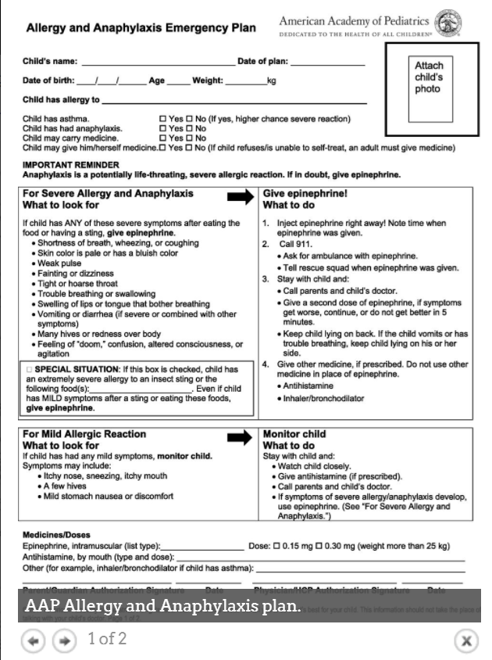
Emergency Action Plan Development
Develop a written emergency action plan for every patient at risk for anaphylaxis.
Use a standardized care plan (e.g., American Academy of Pediatrics Allergy & Anaphylaxis Care Plan).
Write in plain language so caregivers, teachers, coaches, and other non-licensed personnel can easily understand and follow the plan.
Clearly specify:
  Allergens to avoid
  Symptoms that require immediate epinephrine
  When to activate EMS
Use the action plan as an educational tool to teach recognition and treatment of severe allergic reactions.
Encourage families to provide the plan to schools, childcare programs, and other community settings.
Know your state and local regulations:
  Policies regarding treatment of students without a documented allergy action plan vary.
  Non-licensed personnel may be authorized to administer epinephrine, but not other medications (e.g., antihistamines).
Wang J, Sicherer SH; SECTION ON ALLERGY AND IMMUNOLOGY. Guidance on Completing a Written Allergy and Anaphylaxis Emergency Plan. Pediatrics. 2017;139(3):e20164005.
Notes:
Every patient at risk for anaphylaxis should have a written emergency action plan. Whenever possible, use a standardized plan, such as the American Academy of Pediatrics Allergy & Anaphylaxis Care Plan, which is designed for use in community settings. The plan should be written in plain language so that caregivers, teachers, coaches, and other non-licensed personnel can quickly recognize anaphylaxis and respond appropriately. It should clearly identify the allergens to avoid, the symptoms that require immediate epinephrine, and when to activate EMS. Review the action plan with patients and caregivers as part of routine education, and encourage families to share it with schools, childcare programs, and other community settings. Finally, be aware that state and local regulations vary. In some jurisdictions, policies regarding treatment of students without a documented action plan differ, and non-licensed personnel may be authorized to administer epinephrine but not other medications, such as antihistamines.

Slide 52
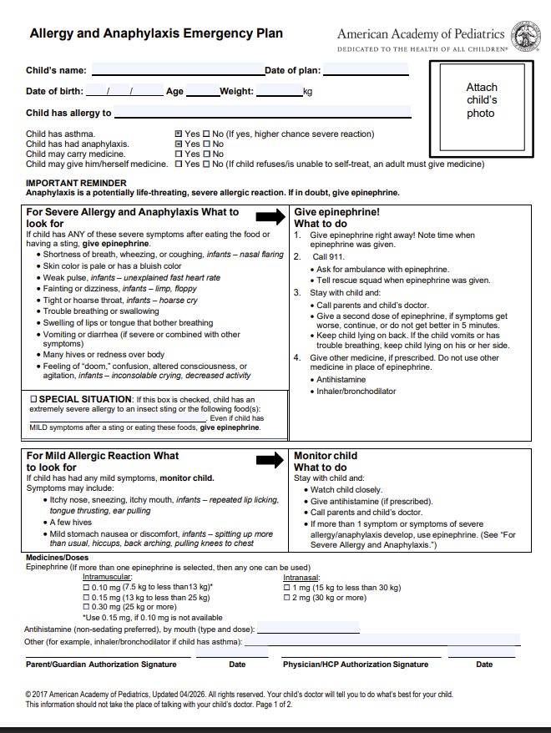
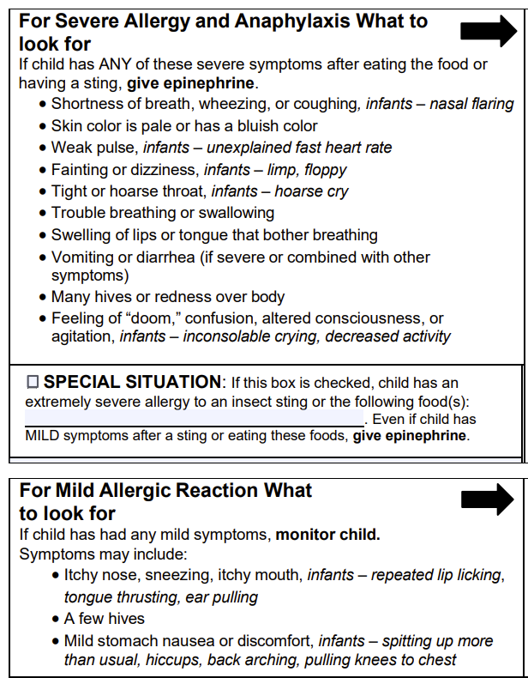
American Academy of Pediatrics Allergy and Anaphylaxis Emergency Plan
Wang J, Sicherer SH; SECTION ON ALLERGY AND IMMUNOLOGY. Guidance on Completing a Written Allergy and Anaphylaxis Emergency Plan. Pediatrics. 2017;139(3):e20164005.
Notes:
The American Academy of Pediatrics Allergy and Anaphylaxis Emergency Plan has been endorsed by the National Association of School Nurses, can serve as medical authorization form in school and has been recently updated to include infant and toddler specific symptoms and…

Slide 53
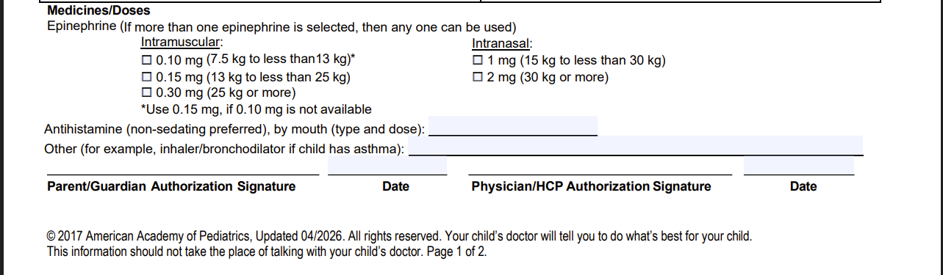
HealthyChildren.org Resource: Create an Allergy and Anaphylaxis Emergency Plan
Wang J, Sicherer SH; SECTION ON ALLERGY AND IMMUNOLOGY. Guidance on Completing a Written Allergy and Anaphylaxis Emergency Plan. Pediatrics. 2017;139(3):e20164005.
Notes:
…now also reflects all available forms of epinephrine including intranasal. The American Academy of Pediatrics' HealthyChildren.org website has a family-facing resource that discusses this action plan.

Slide 54
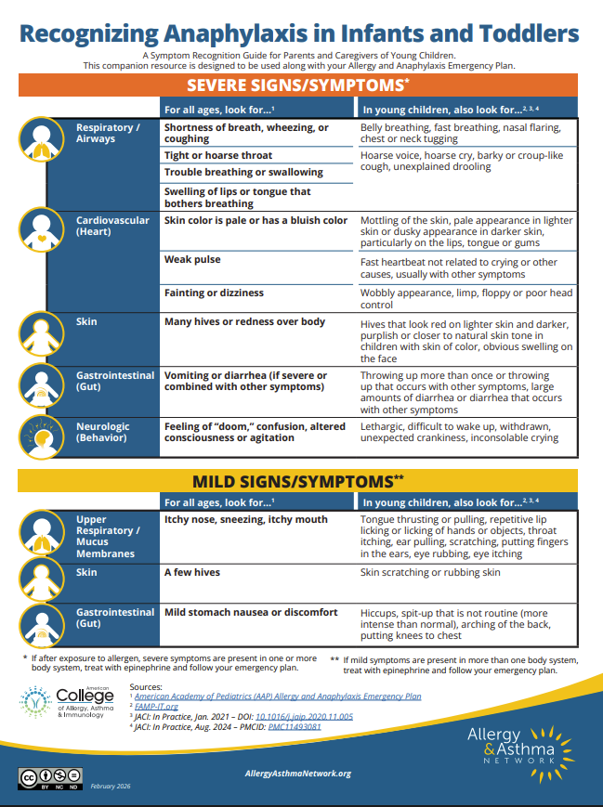
Patient and Caregiver Education
Recognizing anaphylaxis in infants and toddlers: A symptom recognition guide for parents and caregivers of young children
  This companion resource is designed to be used along with your Allergy and Anaphylaxis Emergency Plan.
  Created by Allergy Asthma Network in collaboration with ACAAI
https://allergyasthmanetwork.org/anaphylaxis/infant-anaphylaxis/
Notes:
In addition to using the Allergy and Anaphylaxis Emergency Plan as a tool to educate families and facilitate clear communication, providing additional support for symptom recognition in infants and toddlers can help families identify the unique signs and symptoms of anaphylaxis in this nonverbal population. The Allergy Asthma Network in collaboration with the ACAAI developed "Recognizing anaphylaxis in infants and toddlers: A symptom recognition guide for parents and caregivers of young children“
This companion resource is designed to be used along with your Allergy and Anaphylaxis Emergency Plan.

Slide 55
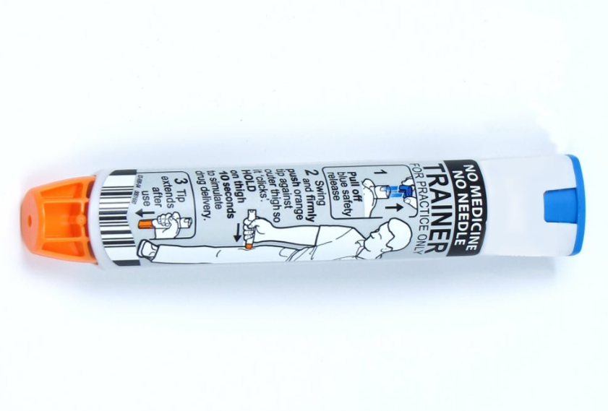
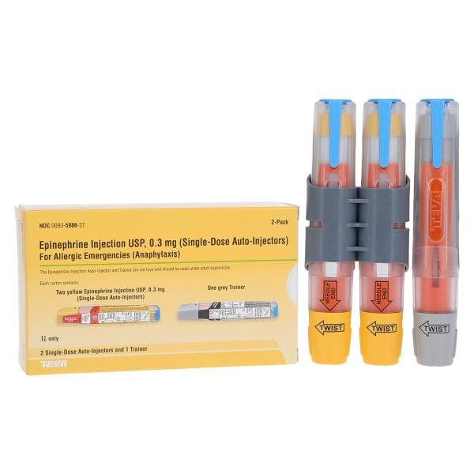
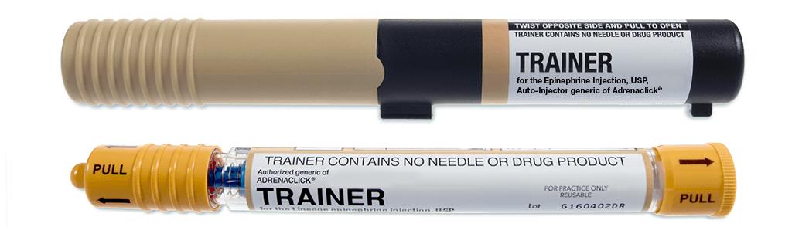
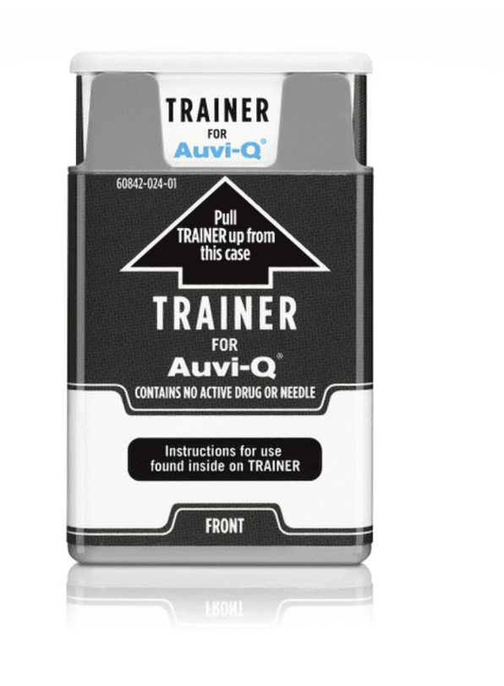
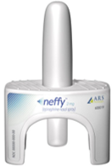
Epinephrine Device Education and Preparedness
HealthyChildren.org Resource: How to Use an Epinephrine Auto-Injector or Nasal Spray for Anaphylaxis
Notes:
Instructions on the proper use of epinephrine auto-injectors should be reviewed verbally with the patient and accompanied by hands-on training with a trainer (if available), as well as a written anaphylaxis emergency action plan. Time should be taken to emphasize the importance of having epinephrine available at all times and to encourage patients and families to educate and train all caregivers on allergen avoidance, recognition of anaphylaxis, and proper epinephrine administration.
https://www.healthychildren.org/English/health-issues/injuries-emergencies/Pages/How-to-Use-an-Epinephrine-Auto-Injector.aspx

Slide 56
Prevention of Recurrence and Community Response
Community Preparedness
Schools and Preschools
  Individual allergy and anaphylaxis action plans
  Patient/student-carried and/or school-supplied epinephrine
  Stock (undesignated) epinephrine when available
Colleges and Universities
  Individual emergency action plans
  Patient-carried epinephrine
  Stock (undesignated) epinephrine where available
Public Settings
  Restaurants, recreational venues, and other public spaces
  Variable state laws regarding stock epinephrine
  Variable training requirements for personnel
Notes:
Preventing recurrent anaphylaxis extends beyond the clinic and requires preparedness across community settings. In schools and preschools, every at-risk student should have an individualized allergy and anaphylaxis action plan, with ready access to epinephrine, including stock epinephrine where available.
The same principles apply in colleges and universities, where students should have an emergency action plan and carry epinephrine, while institutions should be familiar with policies regarding stock epinephrine.
Finally, preparedness in public settings—including restaurants, entertainment venues, and recreational facilities—continues to evolve. State laws and training requirements for stock epinephrine vary, so clinicians should be aware of local regulations and encourage patients to advocate for safe environments wherever they live, learn, work, and travel.

Slide 57
Case-based Management Application
A 6-year-old boy presents for a well-child visit. His father reports that 2 weeks earlier, while attending a friend's birthday party, the child ate a dessert containing walnuts. Shortly afterward, he developed mild lip swelling, red itchy eyes, abdominal pain, and ultimately hives scattered across his body.
Which of the below would be appropriate next steps?
Prescribe an epinephrine delivery system
Train the family with a training device
Provide an Allergy and Anaphylaxis Emergency Plan
Refer to allergy
Teach family allergen avoidance strategies
Notes:
Treatment case; all of the above apply and are correct.

