Slide 1
Anaphylaxis Update and Treatment Options
This program was developed by the American College of Allergy, Asthma & Immunology with independent medical education grant support from ARS Pharmaceuticals, Inc.
Notes:
No notes.

Slide 2
Presented by
Insert presenter name here
Notes:
Note: Speaker can insert their name above.
Note to speaker: If you are not planning to use the attendee handout provided on the Anaphylaxis Teaching Tools Resources page, please be sure not to include speaker notes in the version you create for your attendees.
If you need assistance with how to convert PowerPoint slides into handouts, please access Microsoft’s Support page at https://support.microsoft.com/en-us/powerpoint.

Slide 3
Author Acknowledgements
David B.K. Golden, MD, FACAAI, Associate Professor of Medicine at Johns Hopkins University in Baltimore, Maryland
Matthew J. Greenhawt, MD, MBA, MSc, FACAAI, Professor of Pediatrics at Children’s Hospital Colorado and the University of Colorado School of Medicine in Aurora, Colorado
Jay A. Lieberman, MD, FACAAI, Professor of Pediatrics at the University of Tennessee Health Science Center and LeBonheur Children’s Hospital in Memphis, Tennessee
Notes:
No notes.

Slide 4
Additional Acknowledgements
Anaphylaxis: A 2023 practice parameter update.
Julie Wang, Susan Waserman, Cem Akin, Ronna Campbell, Anne Ellis, Matthew Greenhawt, David Lang, Dennis Ledford, Jay Lieberman, John Oppenheimer, Marcus Shaker, Dana Wallace
Joint Task Force on Practice Parameters of AAAAI/ACAAI
allergyparameters.org
Notes:
We acknowledge the efforts of the members of the Anaphylaxis Practice Parameter workgroup, and the Joint Task Force on Practice Parameters.
Visit the website of the JTFPP at allergyparameters.org for more information, and to download any of the Allergy/Immunology Practice Parameters.

Slide 5
Learning Objectives
Discuss the 2023 update of the Anaphylaxis Practice Parameter
Recognize and accurately diagnose anaphylaxis in their patients in accordance with the 2023 Update of the Anaphylaxis Practice Parameter
Educate and treat their anaphylactic patients in accordance with the 2023 Update of the Anaphylaxis Practice Parameter
Notes:
During this session, you will gain insights into the latest updates and recommendations for managing anaphylaxis. Specifically, we will:
-Discuss the key updates from the 2023 Anaphylaxis Practice Parameter, providing an overview of the latest evidence and guidelines.
-Guide you on how to recognize and accurately diagnose anaphylaxis in your patients, ensuring alignment with the 2023 recommendations.
-Equip you with strategies to educate and treat anaphylactic patients effectively, incorporating the updated best practices into your clinical care.

Slide 6
Overview of Anaphylaxis Practice Parameter Update
Notes:
No notes.

Slide 7
Overview of Practice Parameter Update
  Epidemiology and scope of anaphylaxis
  What do guideline recommendations mean?
  (and why shared decision making?)
  What’s new in the Anaphylaxis Practice Parameters?
  Beta-blockers and ACE inhibitors
  Community exposures
Notes:
In this overview, we will look at changes in the epidemiology of anaphylaxis and review how guideline recommendations are developed and how they should be interpreted. We will preview the 7 topics that were updated in the Anaphylaxis Practice Parameter, which will be discussed in more detail during this session. We will discuss the recommendations made for 2 of those topics: cardiovascular medications, and anaphylaxis in the community.

Slide 8
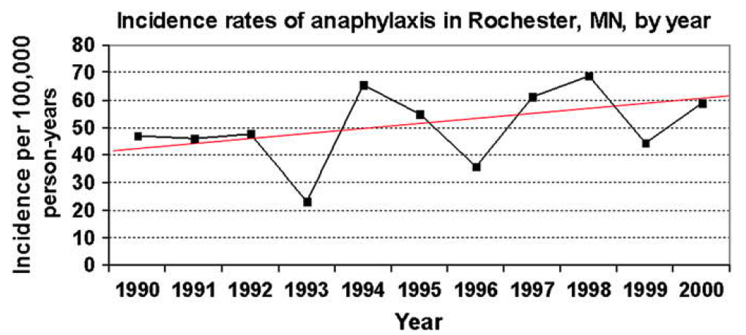
Incidence of anaphylaxis in Rochester Minnesota
(Decker WW et al. J Allergy Clin Immunol 2008; 122:1161-5.)
Notes:
This study was a follow-up to a previous 10-year study at the Mayo Clinic. It showed that the incidence of anaphylaxis increased 50% from one 10-year period to the next. Studies in other western countries have shown the same pattern of increasing incidence of anaphylaxis. Even though anaphylaxis is not necessarily atopic or familial, this increase is similar to that seen in other allergic conditions.

Slide 9
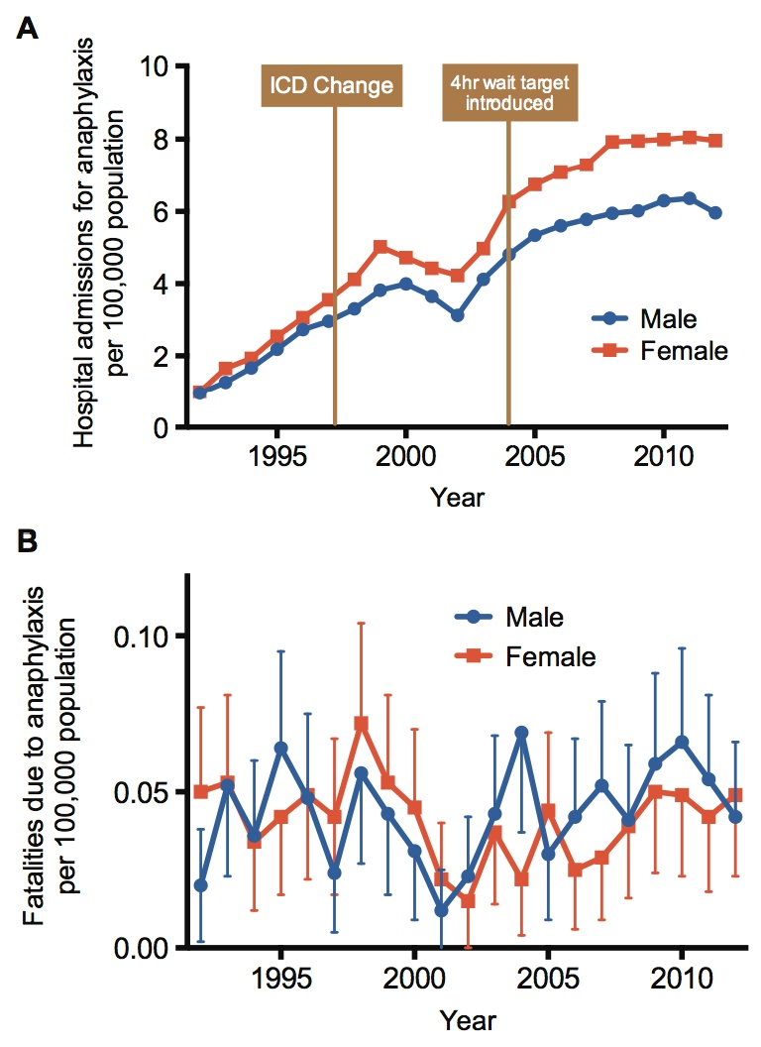
Anaphylaxis hospitalization and fatality rates in the UK 1992-2012.
Turner P et al. JACI 2015; 135:956-963
Notes:
Over a 20-year period in the UK, hospitalization for anaphylaxis increased 6- to 8-fold, more in females than males. In the same time period, anaphylaxis deaths did not increase, showing that expert management of anaphylaxis has improved and can prevent fatal outcomes.

Slide 10
The changing face of anaphylaxis in adults and adolescents
Pattanaik D, Lieberman P, Lieberman J, Pongdee T, Keene A.
Total 218 patients
Idiopathic 76 (35%)
Definite Cause 85 (39%)
Probable Cause 57 (26%)
Food 20%
alpha-gal 19%
Venom 9%
Drug 8%
Exercise 2.5%
Mastocytosis 2.5%
Other 4%
Annals Allergy Asthma Immunol 2018; 121:594-7
Notes:
When allergists evaluate patients with a history of anaphylaxis, they may find a definite cause, or suspect a probable cause, based on the details of the history and diagnostic testing that may include supervised challenge. However, there has always been a large proportion of cases of anaphylaxis for which no specific cause can be determined. These cases of idiopathic anaphylaxis accounted for more than 50% of the 601 cases reported by the authors in 2006, but only 35% of the cases in this updated report. One of the major reasons for this change was the discovery of alpha-gal syndrome causing delayed anaphylaxis to red meat. This demonstrates how the epidemiology of anaphylaxis changes over time as our knowledge and understanding of this condition improve.

Slide 11
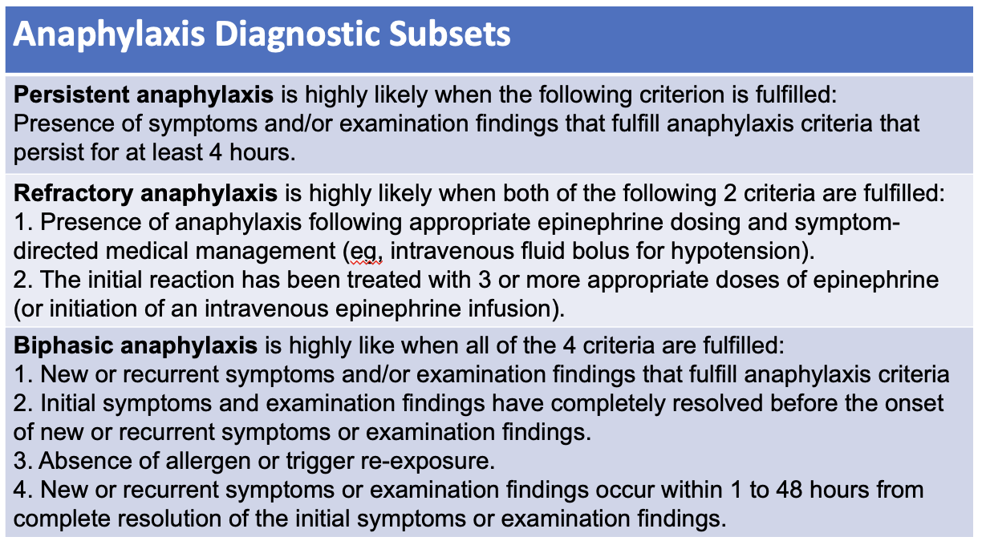
Dribin, Sampson, Camargo, et al. JACI; 2020;146:1089-96.
Notes:
Most cases of anaphylaxis are uniphasic, meaning they resolve completely within a few hours. It is important to recognize other patterns of anaphylaxis. Reactions can be persistent of they do not resolve within 4 hours and are refractory if they persist despite treatment with 3 or more doses of epinephrine and adjunctive therapy (e.g., intravenous fluids). This may occur in about 2% of cases of anaphylaxis.
A major concern is the occurrence of biphasic anaphylaxis, in which anaphylaxis recurs hours after complete resolution of the initial reaction. The 2020 Anaphylaxis Practice Parameter reviewed the potential risk factors for biphasic anaphylaxis, including severe reactions and delayed treatment with epinephrine.

Slide 12
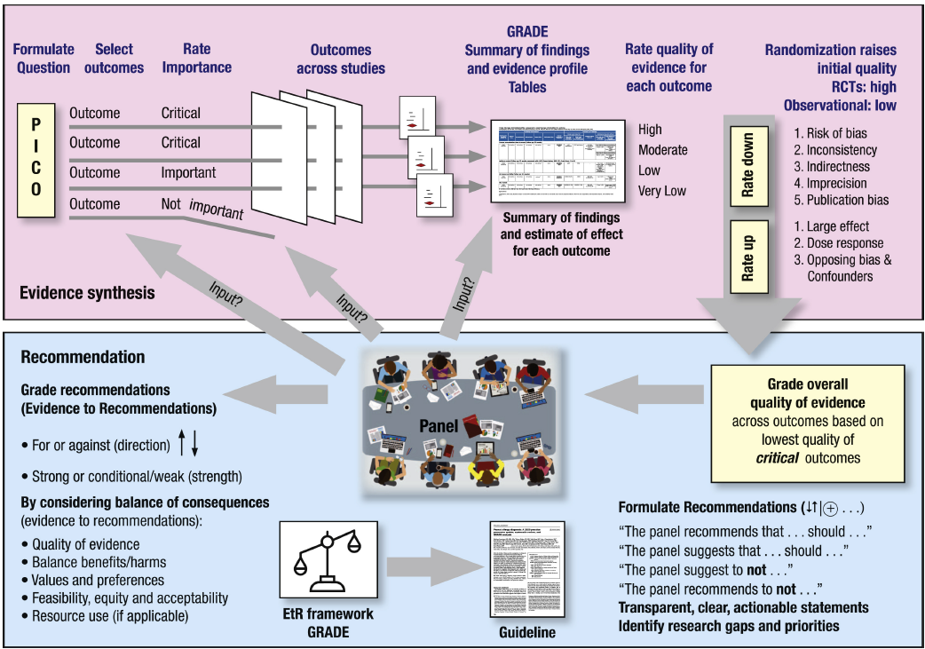
GRADE Approach to Developing Recommendations
Summary of findings and estimate of effect for each outcome
EtR framework
GRADEpro
Guideline
Notes:
Guidelines are developed by expert groups using a method described for optimal application of evidence-based medicine. Initially, focused questions are developed in PICO format (population, intervention, comparator, outcome). When all evidence is collected, the quality of the evidence is rated based on whether the studies were randomized controlled trials or observational, and whether they might be affected by negative or positive factors that affect the reliability of the observations. But before a recommendation is formulated, other factors must be considered including the values and preferences of the patient. The final recommendation is presented as either strong or conditional.

Slide 13
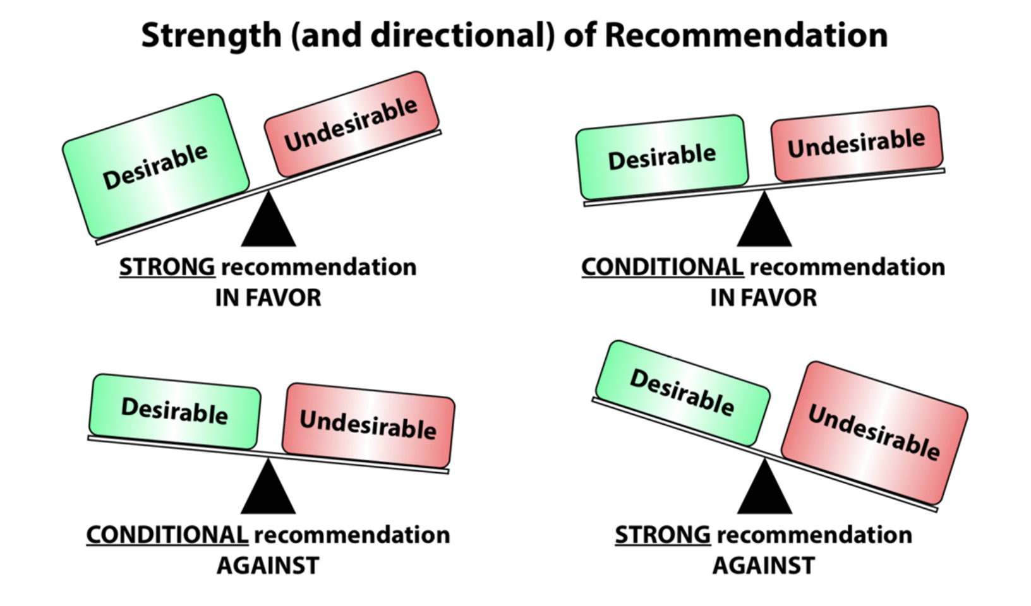
Shaker M et al. Annals of Allergy, Asthma, Immunology. 2020; 124:526-535
Notes:
A strong recommendation indicates that the desirable outcomes clearly outweigh any negative considerations. Most clinicians would favor this recommendation, and most patients would want to accept it.
A conditional recommendation reflects some degree of uncertainty about the conclusion and whether further research might or might not support it. Such a recommendation indicates that there is evidence indicating that the desirable outcomes still outweigh the negative considerations, but that the negative considerations might play a bigger role in clinical decisions. Many patients would want to follow this recommendation, but some may not. A conditional recommendation is a signal for shared decision-making, which incorporates patient values and preferences.

Slide 14
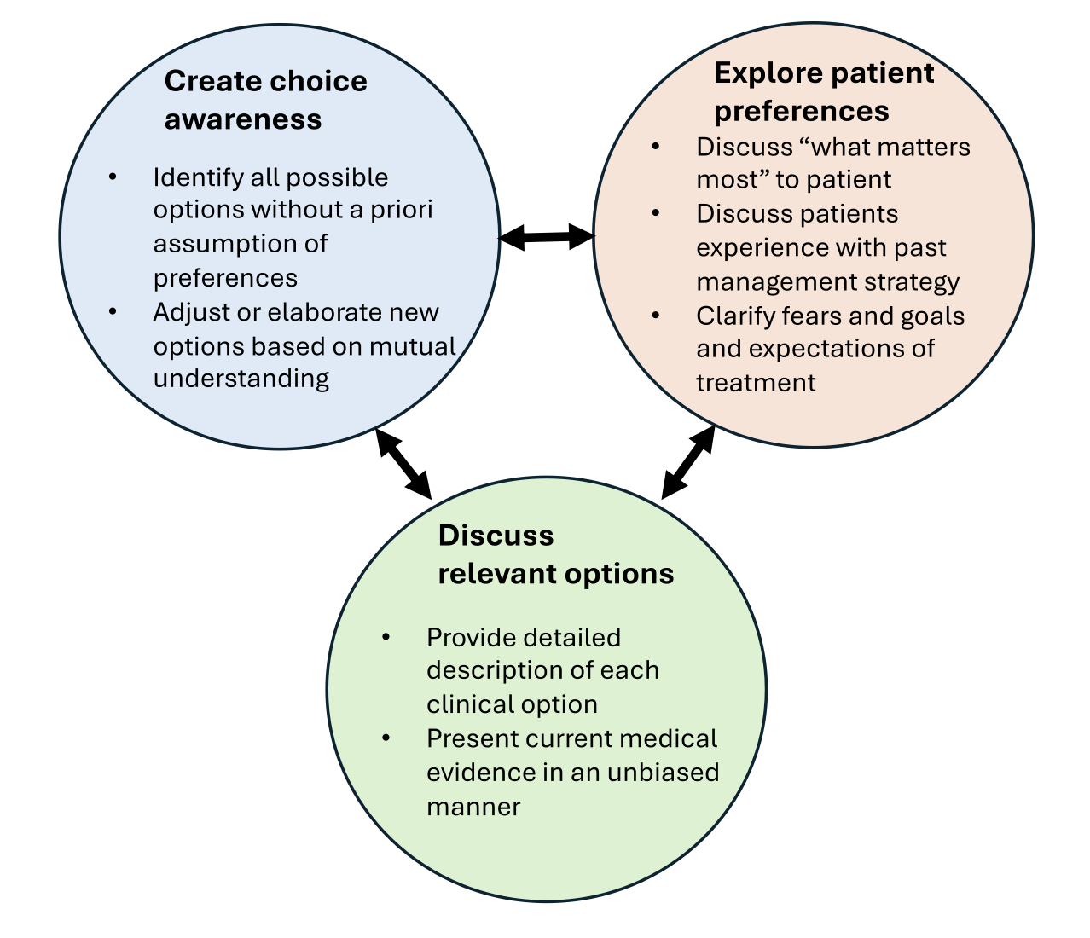
Decisions With Patients, Not for Patients: Shared Decision-Making in Allergy and Immunology
Mack DP et al. J Allergy Clin Immunol Pract 2024;12:2625-33
Notes:
Since most of the clinical questions in our field are lacking evidence from large randomized controlled trials, almost all the recommendations in our practice parameters are conditional. Thus, shared decision-making (SDM) must play an important role in reaching individualized decisions with our patients.
SDM requires that the clinician present, without judgment or bias, all available options, with detailed descriptions of the options and a summary of the current medical evidence. The clinician should elicit what matters most to the patient and their expectations for treatment, discuss the medical evidence regarding the available options and how they meet the needs and preferences of the individual (and family).

Slide 15
What’s New in the Anaphylaxis Practice Parameter Update
Diagnosis of Anaphylaxis
  Use of diagnostic criteria in diagnosis and research
  Biomarkers
  New causes and tests
Infants and Toddlers
  Age-specific symptoms and manifestations
  Factors associated with severity
  Age-appropriate treatment
Notes:
This slide highlights 2 topics of importance in this Practice Parameter. There is more detailed discussion of these topics later in the presentation.
There have been continued efforts to improve the criteria applied to the diagnosis of anaphylaxis. This has great relevance when analyzing the epidemiology, characteristics, and patterns of anaphylaxis, and enables more accurate research to improve diagnosis and treatment. There are refinements in the use of biomarkers, primarily serum tryptase, as diagnostic factors. New causes of anaphylaxis emerge that require new recommendations for diagnostic evaluation of patients with a history of anaphylaxis.
Anaphylaxis in infants and toddlers is more difficult to recognize, because of unique expression of symptoms. It is important to recognized factors that are associated with more severe reactions, and to optimize treatment for specific ages.

Slide 16
What’s New in the Anaphylaxis Practice Parameter Update
Self-Administered Epinephrine
  Risk stratification for prescribing, with shared decision-making
  Timing of epinephrine use
  Financial and psychosocial burdens
  Routine review, practice, and counseling
When to call 911
  Recognize high-risk factors
  Shared decision-making (patient values and preferences)
Notes:
We will describe the rationale for prescribing epinephrine and the role of shared decision-making in many patients. It is crucial to know when to administer epinephrine without delay, and when not to, and to recognize the financial and psychosocial burdens associated with prescribing epinephrine and carrying a self-administered epinephrine device. It is important to routinely review and practice the proper use of epinephrine, and to counsel patients on the best approach to their specific condition and needs.
There are new recommendations on when to call 9-1-1 and how to recognize high-risk factors. In many patients this decision should be addressed in the context of shared decision-making that incorporates the values and preferences of the patient.

Slide 17
What’s New in the Anaphylaxis Practice Parameter Update
Mast Cell Disorders
  Spectrum of disorders with strong associations with anaphylaxis
  Patient characteristics
  Steps in evaluation
Perioperative Anaphylaxis
  Encourage appropriate use of skin tests
  Role of challenge procedures whenever feasible
  Alternatives and shared decision-making
Notes:
In recent years there has been a growing understanding of the special role of mast cell disorders in the spectrum of anaphylaxis. It is important to recognize the typical clinical patterns of reaction and characteristics of patients with these conditions, and to pursue the necessary steps in evaluation.
Peri-operative anaphylaxis is one of the most deadly and difficult to evaluate and manage. There are specific recommendations for testing procedures to identify the culprit in affected patients. However, the most accurate diagnosis is achieved by supervised challenge when feasible. In many cases there is a need to identify the safest and most effective alternative agents.
We will not have time to discuss peri-operative anaphylaxis, so please visit the Joint Task Force on Practice Parameters (JTFPP) website to download the complete document to learn more.

Slide 18
Beta-blockers and ACE-inhibitors
For most medical indications, the risk of stopping or changing BB/ACEI may exceed the risk of more severe anaphylaxis if the medication is continued, especially in patients with insect sting anaphylaxis
Initiation of VIT may be considered for patients receiving BB/ACEI, with shared decision-making
Patients on maintenance AIT have minimal incremental absolute risk of severe anaphylactic reaction when receiving BB/ACEI
Notes:
There is evidence that beta-blockers or angiotensin converting enzyme inhibitors (ACEi) increase the chance that any anaphylactic reaction may be more severe. When the frequency of anaphylaxis low (e.g., maintenance immunotherapy or an easily avoided allergen), the increased risk is still low and may not justify stopping or changing an important medication.
In the case of insect sting anaphylaxis, the risk of severe sting anaphylaxis if VIT is withheld exceeds the risk of a more severe systemic reaction to VIT injections. Also, the risk of stopping or changing the medication (i.e., cardio-vascular events) may exceed the risk of anaphylaxis being more severe if the medications are continued.
This decision may be best made with shared decision-making involving the prescribing clinician, the allergist, and the patient.
Patients on maintenance immunotherapy, either venom or inhalant allergens, have a very low risk for anaphylaxis that remains low even if they are on these medications.

Slide 19
BB/ACEi: High Risk Conditions/Patients
Some conditions are associated with greater frequency or severity of anaphylactic reactions, often at unpredictable times.
  Such as idiopathic anaphylaxis, underlying mast cell disorders, severe food allergy, or severe insect sting allergy (prior to VIT).
Counsel such patients to take special measures to mitigate this risk.
  Caution regarding contributing factors (e.g., alcohol, vigorous exercise, medications).
  Increased vigilance for the earliest signs of the beginning of a reaction, and ready availability of treatment with epinephrine.
There could reasonably be increased concern in these patients for the potential risk associated with BB or ACEi.
Notes:
Anaphylaxis can be more frequent, more severe, and more unpredictable in patients with idiopathic anaphylaxis, underlying mast cell disorders, and severe allergy to food or insect stings. When such patients are on beta-blockers or ACEIs, special measures are warranted to mitigate the increased risk. Augmentation factors and cofactors should be avoided, and the patient should be alert to the earliest signs of reaction and the need for immediate treatment. Additional consideration may be given to possible alternative medications to replace the beta-blocker or ACEI.

Slide 20
Anaphylaxis in Community Settings
Patients at high risk for anaphylaxis should have access to self-administerable epinephrine. Shared decision-making (SDM) may be appropriate for patients at lower risk for anaphylaxis to determine the most suitable option.
Counsel patients on proper indications and timing for use of epinephrine.
Educate patients about main routes of exposure (by ingestion, not by contact or inhalation).
Counsel patients on safe practices for dining outside the home.
School-wide allergen bans are not recommended.
Stock epinephrine programs are encouraged.
Schools and childcare centers should implement staff training on anaphylaxis.
Notes:
Most anaphylactic reactions do not occur in medical settings, but in the community. Prescription of self-administered epinephrine is crucial in patients with a history of anaphylaxis, but may be unnecessary or even harmful in many patients whose risk of severe anaphylaxis is relatively low.
Extensive counseling is needed on the indications and appropriate timing of epinephrine (early, but not pre-emptively when there are no symptoms).
There are many tips and precautions for dining outside the home where ingredients and exposures are more difficult to avoid.
Schools and childcare centers are encouraged to have stock epinephrine programs, to implement staff training on anaphylaxis, and to avoid school-wide bans.

Slide 21
Diagnosis of Anaphylaxis
Notes:
No notes.

Slide 22
Diagnosis Outline
Definitions and criteria what is anaphylaxis?
  Do we even know what anaphylaxis is?
Infants and toddlers
  Do we need different criteria?
Appropriate evaluation
  How to evaluate someone in the outpatient setting referred for confirmed or possible anaphylaxis
Recognition of “high-risk” patients
  Risk factors for severe or fatal anaphylaxis
Challenges and misconceptions
Notes:
As mentioned earlier, the new parameter is divided into different sections. I will cover the sections on this outline slide.
Unless otherwise stated, the reference for all information is the 2023 Anaphylaxis Practice Parameter
David B.K. Golden, Julie Wang, Susan Waserman, Cem Akin, Ronna L. Campbell, Anne K. Ellis, Matthew Greenhawt, David M. Lang, Dennis K. Ledford, Jay Lieberman, John Oppenheimer, Marcus S. Shaker, Dana V. Wallace, Elissa M. Abrams, Jonathan A. Bernstein, Derek K. Chu, Caroline C. Horner, Matthew A. Rank, David R. Stukus, Alyssa G. Burrows, Heather Cruickshank, David B.K. Golden, Julie Wang, Cem Akin, Ronna L. Campbell, Anne K. Ellis, Matthew Greenhawt, David M. Lang, Dennis K. Ledford, Jay Lieberman, John Oppenheimer, Marcus S. Shaker, Dana V. Wallace, Susan Waserman, Elissa M. Abrams, Jonathan A. Bernstein, Derek K. Chu, Anne K. Ellis, David B.K. Golden, Matthew Greenhawt, Caroline C. Horner, Dennis K. Ledford, Jay Lieberman, Matthew A. Rank, Marcus S. Shaker, David R. Stukus, Julie Wang
Anaphylaxis: A 2023 practice parameter update,
Annals of Allergy, Asthma & Immunology,
Volume 132, Issue 2,
2024,
Pages 124-176,
ISSN 1081-1206,
https://doi.org/10.1016/j.anai.2023.09.015.

Slide 23

So. . . What is Anaphylaxis?
Notes:
The picture is a stamp commemorating Richet and Portier’s discovery of ‘anaphylaxis’ for which they won the Nobel prize. They coined the term to describe the hypersensitivity reaction in dogs when injected with the toxin of the Portuguese Man O’ War or jellyfish. They stated the reaction was the opposite of protection or prophylaxis. So, they called it anaphylaxis. From Richet’s speech on receiving the Nobel Prize: “Phylaxis, a word seldom used, stands in the Greek for protection. Anaphylaxis will thus stand for the opposite. Anaphylaxis, from its Greek etymological source, therefore, means that state of an organism in which it is rendered hypersensitive, instead of being protected.”

Slide 24
The Current Definition of Anaphylaxis is Murky
Country, region, or organization | Date | Definition | Reference
USA/NIAID | 2006 | Anaphylaxis is a serious allergic reaction that is rapid in onset and may cause death. | Sampson et al 2006
US PP guidelines | 2010 | Anaphylaxis is an acute, life-threatening systemic reaction with varied mechanisms, clinical presentations, and severity that results from the sudden systemic release of mediators from mast cells and basophils | Lieberman et al 2010
WAO | 2011 | Anaphylaxis is a serious life- threatening generalized or systemic hypersensitivity reaction" and “a serious allergic reaction that is rapid in onset and might cause death | Simons et al 2011
Pakistan | 2013 | Anaphylaxis is a serious allergic reaction that is rapid in onset and may cause death. | Khan et al 2013
EAACI | 2014 | Anaphylaxis is a severe (potentially) life-threatening generalized or systemic hypersensitivity reaction. This is characterized by being rapid in onset with life-threatening airway, breathing, or circulatory problems and is usually, although not always, associated with skin and mucosal changes | Muraro et al 2014
Germany | 2016 | Anaphylaxis is a severe, life-threatening, generalized or systemic hypersensitivity reaction. Grade 1: Local with no systemic symptoms. Grade 2: mild/moderate systemic reaction with skin and/or GI. Grade 3: severe anaphylaxis, systemic with respiratory and/or cardiovascular involvement | Niggemann et al 2016
WHO ICD-11 | 2019 | Anaphylaxis is a severe, life-threatening systemic hypersensitivity reaction characterized by being rapid in onset with potentially life-threatening airway, breathing, or circulatory problems and is usually, although not always, associated with skin and mucosal changes. | WHO 2021
WAO | 2019 2020 | Anaphylaxis is a serious systemic hypersensitivity reaction that is usually rapid in onset and may cause death. Severe anaphylaxis is characterized by potentially life-threatening compromise in breathing and/or the circulation, and may occur without typical skin features or circulatory shock being present. | Turner et al 2019 Cardona et al 2020
EAACI | 2020 | Anaphylaxis is a severe allergic reaction. [Defined in the context of when to use epinephrine autoinjectors] | Kraft et al 2020
ASCIA | 2021 | Any acute onset illness with typical skin features (urticarial rash or erythema/flushing, and/or angioedema), plus involvement of respiratory and/or cardiovascular and/or persistent severe gastrointestinal symptoms; or any acute onset of hypotension or bronchospasm or upper airway obstruction where anaphylaxis is considered possible, even if typical skin features are not present. | ASCIA 2021
Brighton Collaboration Working Group | 2022 | Anaphylaxis presents acutely and leads to a marked change in an individual’s previous stable condition and is characterized by the following: Rapid progression of symptoms and signs which typically affects multiple body systems (skin/mucosa / respiratory / cardiovascular / gastrointestinal) at the same time or sequentially but occurring over a short period of time (within 1 h of onset of the first symptoms or signs). | Gold et al 2022
Notes:
Since that time, various organizations have attempted to create a definition of anaphylaxis. I won’t go through and read all these definitions, but the point is that multiple international organizations have created definitions for anaphylaxis and none of them are the same.

Slide 25
Remember – It is really a clinical definition
NIAID/FAAN (2006) | WAO (2020)
Acute onset of an illness (minutes to several hours) with involvement of the skin, mucosal tissue, or both (e.g., generalized hives, pruritus, flushing, lip/tongue-swelling) and at least one of the following: Respiratory compromise (e.g., dyspnea, wheezing, stridor, reduced PEF, hypoxia) Reduced BP or associated symptoms of end-organ dysfunction (e.g., hypotension, syncope. | Acute onset of illness (minutes to several hours) with simultaneous involvement of the skin, mucosal tissue, or both (e.g., generalized hives, pruritus, flushing, lip/tongue-swelling) and at least one of the following: Respiratory compromise (e.g., dyspnea, wheezing, stridor, reduced PEF, hypoxia) Reduced BP or associated symptoms of end-organ dysfunction (e.g., hypotension, syncope) Severe gastrointestinal symptoms (e.g., severe gastrointestinal pain, repetitive vomiting), especially after exposure to a non-food allergen
Two of more of the following that occur rapidly (minutes to hours) after exposure to a likely allergen for that patient Skin/mucosal tissue involvement (e.g., generalized hives, itchy/flush swollen lips/tongue/uvula) Respiratory compromise (e.g., dyspnea, wheezing, stridor, reduced PEF, hypoxia) Reduced BP or associated symptoms of end-organ dysfunction (e.g., hypotension, syncope) Persistent gastrointestinal symptoms (e.g., crampy abdominal pain, vomiting) | Acute onset of hypotension or bronchospasm or laryngeal involvement after exposure to a known or highly probable allergen for that patient (minutes to several hours), even in the absence of typical skin involvement Excluding lower respiratory symptoms triggered by common inhalant allergens
Reduced BP after exposure to a known allergen for that patient (minutes to hours after exposure)
Notes:
The diagnosis of anaphylaxis is really made based on symptoms and timing and not based on biomarkers or pathology. The most common clinical criteria utilized are the NIAID/FAAN criteria (sometimes referred to as the Sampson criteria) and the World Allergy Organization criteria. These differ slightly. There is an attempt to harmonize the definition currently underway. You can see in red, some of the ways in which they differ.

Slide 26
Do the criteria differ for infants and toddlers?
Infant/toddler symptoms may be different during acute allergic reactions.
  Skin symptoms more common in younger children
  Behavior changes, such as irritability, crying, and clinging
  Pulling at ear
  Thrusting of tongue
Notes:
Infants may present with symptoms that are different than older children or adults when experiencing an allergic reaction, such as irritability, crying, pulling at their ear, or thrusting out their tongue.
The current practice parameters recommends using the established criteria just reviewed.
However, there are new proposed criteria:
Development and Evaluation of Modified Criteria for Infant and Toddler Anaphylaxis.
Handorf A, Roy IR, Cohen A, Camargo CA Jr, Dribin TE, Pistiner M.
J Allergy Clin Immunol Pract. 2024 Aug;12(8):2026-2034.e2. doi: 10.1016/j.jaip.2024.05.018. Epub 2024 May 20.
PMID: 38777125
It’s important to know that younger age does not suggest more or less severe reaction, but that severe anaphylaxis is rare in infants in large population studies of early introduction of allergenic foods.

Slide 27
How to evaluate a patient presenting with history of anaphylaxis?
Presentation with history of possible anaphylaxis
History with likely trigger
Skin Testing
Serum Testing
Challenge
(Consider baseline serum tryptase measurement)
Notes:
This is an algorithm adapted from the practice parameter.
When the cause is clear, such as a patient who presents with hives, swelling, and wheezing after eating peanut for the first time or being stung by a yellow jacket, the work up should be directed at the cause and testing/challenge done when feasible and treatment plan created.

Slide 28
How to evaluate a patient presenting with history of anaphylaxis?
Presentation with history of possible anaphylaxis
History Random
Obtain baseline tryptase and if possible, during an event
Normal Baseline
Normal During Event
Elevated at Baseline
Normal Baseline
Increase During Event
Work up for Mastocytosis and/or
HαT
Anxiety
24-hr urine PGF2α
24-hr urine 5HIAA
Serum VIP
calcitonin
Metanephrines
Diary
Alpha-gal
MCAD
Notes:
When history is random however, the diagnostic approach is likely to be different. In this case, it is very important to get a baseline tryptase and ideally a tryptase during any event. Random skin or serum testing is not advised as false negatives are frequent. The tryptase will help guide the provider as to a possible diagnosis. If the tryptase is elevated at baseline, this should lead one to consider a clonal mast cell disease or perhaps hereditary alpha tryptasemia. If normal at baseline, but elevated during an event, this should lead one to suspect less obvious causes of anaphylaxis, such as alpha-gal allergy or possibly mast cell activation. When there is never a bump in tryptase, one must consider non-mast cell diseases.

Slide 29
Tryptase can be very helpful, but a single tryptase is not diagnostic
“20% + 2 rule”
  Acute tryptase: [1.2 x baseline value plus 2] ng/ml over baseline
  Example: Baseline = 5.
  Then 5 x 1.2 = 6 + 2 = 8.
Validated in perioperative anaphylaxis
  High sensitivity and PPV (>95%), but low specificity and NPV (<50%)
Alternative thresholds with the ratio of acute to baseline levels
  Ratio 1.685
  Reported higher specificity (>90%) while maintaining a high sensitivity (>90%)
  High vs. Low Clinical Suspicion can use different ratios
    High 1.374
    Low: 1.868
  https://triptase-calculator.niaid.nih.gov/
Notes:
As discussed, using a change in tryptase over the baseline is very helpful in determining if a patient is likely experiencing mast cell activation or anaphylaxis during an acute event.
There are different equations to determine what change in the tryptase value is meaningful.
There is a website through the NIH that you can use to calculate this: https://triptase-calculator.niaid.nih.gov/

Slide 30
Notes on severe anaphylaxis
There are different severity scoring systems. These are mainly for research purposes
Clonal mast cell diseases and maybe HαT predispose to more severe reactions
  At least in adult and stinging insect reactions
Fatal anaphylaxis, especially with food-allergic reactions is VERY rare
Risk factors seem to differ by etiology of the reaction
  Medication-induced: Older age (>60y/o), CV/Respiratory disease, ACEi/BB use
  Venom: Older age, underlying mast cell disease, male, NSAID use, ACEi/BB use
  Food-induced: Adolescence, uncontrolled asthma, exercise, alcohol, trigger? (peanut/tree nut/milk)
Notes:
Severity of reactions is hard to predict. Retrospective studies attempt to identify risk factors, but these may be very cohort dependent.
This is one reason why patients at risk should have epinephrine available, because we are not great at predicting who is really at risk. And uncontrollable risk factors may be present.

Slide 31
Challenges and Misconceptions on Diagnosis
Challenges:
  No perfect biomarker or pathology
  Different clinical criteria
  Patients present to outpatient center in normal state of health
  Predicting severity is hard
Misconceptions:
  The next reaction will be more severe
  Fatal-food reactions are common
  A normal tryptase rules out anaphylaxis and mastocytosis
  Everyone who received epinephrine or who gets referred had anaphylaxis
Notes:
There are lots of challenges for allergists and primary care provides on patients who have maybe had anaphylaxis.
Utilizing the discussed content can hopefully improve accurate diagnosis and allow then for more tailored and appropriate therapy.

Slide 32
Educational Considerations for Anaphylaxis Management
Notes:
No notes.

Slide 33
The Emergency Action Plan—A Key Step for Individual Education and Preparedness
Notes:
No notes.

Slide 34
Emergency Strikes—The Action Plan
Emergency “action plan” (EAP) initially developed in the 1990’s for emergency care of food allergies in school, based on early fatality data from school cases
  1998 AAAAI statement recommended that schools have EAP’s in place to help reduce risk
  Early studies cited that these plans were rarely in place at school, and if so, they were rarely followed
FAAN created 1st layperson action plan for non-medical setting, since copied
EAP’s now standard, often mandated by state/district and recommended per 2013 CDC voluntary school guidelines
  These direct EMS activation post-epinephrine use, which is felt to decrease risk of fatality
  EAP’s are medical treatment plans authorizing medication use and supplement individualized health care plans
  No RCT data support EAP use, so level of evidence is weaker than for asthma plans
Sampson et al N Eng J Med 1992; 1992 Aug 6;327(6):380-4.
Young et al J Allergy Clin Immunol 2009; 124(2):175-182.e4.
Centers for Disease Control and Prevention. Voluntary Guidelines for Managing Food Allergies in Schools and Early Care and Education Programs
Notes:
The action plan was developed in the early 1990’s and has been a mainstay of community anaphylaxis management. This tool has been recognized as crucial to effective management of allergic reactions at schools. These supplement individualized health plans for students at risk. There are no studies that support their use or that these promote beneficial outcomes. No study and no data substantiate the benefit of immediate EMS activation and ED transport.

Slide 35
EAP—Evidence Not Guaranteed….
Contents on these plans are largely unchanged over the past 25 years
ID’s patient, age, allergy, asthma status, past reaction severity, emergency contacts
Stratifies mild vs severe symptoms by particular organ specific findings
  Instructs medication based on mild or severe symptoms, when to give 2nd epinephrine dose
  Instructs immediate activation of EMS/911 if epinephrine used
2008 meta-analysis found plans largely varied except for epinephrine instruction
  No agreement on necessary items to include or utility of the plans, though most parents “accept” these
  4 studies suggested these may reduce “frequency and severity of further reactions”
Nurmatov et al J Allergy Clin Immunol 2008;122: 353-61
Notes:
There is very limited study of these plans, The plans have no evidence to support necessity of inclusion or exclusion of particular content. Instructions for management are based on expert opinion and not validated. These are supported by observational data and not RCTs, which means they are of lower certainty of evidence.

Slide 36
EAP Controversies and Evolution
There has been recent challenge to the notion that there is effectiveness of immediately activating EMS/911 for epinephrine use
  This was never evidenced, but based on older fatality data
  Most never need 2nd dose of epinephrine or receive additional doses
  Shaker et al showed this was not cost-effective unless the fatality risk was 500-fold and chance of receiving additional care was 75% vs “watchful waiting” for response
  Casale et al modified the FARE plan during the pandemic to allow for watchful waiting based on this evidence
2023 practice parameter considering watchful waiting as a conditional recommendation under a SDM paradigm
Casale et al J Allergy Clin Immunol Pract 2020; 8: 1795-97
Shaker M, Kanaoka T, Feenan L, Greenhawt M. Ann Allergy Asthma Immunol. 2018; 122: 79-85
Wang et al Ann Allergy Asthma Immunol 2024; 132(2):124-176
Notes:
For years action plans instructed to call 911 or seek emergency care immediately after epinephrine use
--such instructions lacked any evidence that this improved outcomes or was necessary
--data suggest that ~10% require a second dose of epinephrine and many patients are asymptomatic on arrival to ED, requiring no further care
It is hypothesized that such instructions may DISINCENTIVIZE patients to use epinephrine as they do not want to go to the ED
2018 study by Shaker et al used simulation to investigate the health and economic outcomes of seeking immediate care vs. watchful waiting for resolution of symptoms after epinephrine use
--this presumed a 10-fold increased fatality risk with the watchful waiting strategy (vs going to the ED)
--the watchful waiting strategy was the most cost-effective strategy,
The incremental cost per life year saved was $142,943,447 for seeking emergency care immediately vs “wait and see”, with the cost per death prevented reaching $1,349,335,651
As the probability of needing additional care in the “wait and see” cohort ranged from 5% to 25%, the incremental cost was $370,353,632 per life year saved ($3,495,911,838 per death prevented) - $58,477,946 per life year saved ($552,008,532 per death prevented).
Essentially, the risk of fatality from not going to the ED had to both be implausibly high and the probability of needing care when you got to the ED be at least 75% for the ED strategy to be cost effective
During the early phase of the pandemic, FARE action plans adopted the “wait and see” strategy given a desire to reduce potential COVID exposure in the ED
The 2023 anaphylaxis practice parameter adopted the wait and see approach as a conditional recommendation

Slide 37
What Should I Advise My Patients After They Use Epinephrine?
Notes:
No notes.

Slide 38
Updated Practice Parameter Statement
 | Recommendation | Strength of Recommendation | Certainty of Evidence
CBS 26 | We suggest that clinicians counsel patients that immediate activation of EMS may not be required if the patient experiences prompt, complete, and durable response to treatment with epinephrine, provided that additional epinephrine and medical care are readily available, if needed. | Conditional | Very low
 | We suggest that clinicians counsel patients to always activate EMS following epinephrine use, if anaphylaxis is severe, fails to resolve promptly, fails to resolve completely or nearly completely, or returns or worsens following a first dose of epinephrine. | Conditional | Very low
 | Potential exceptions: history of rapidly progressive near-fatal anaphylaxis or underlying mastocytosis
Wang et al Ann Allergy Asthma Immunol 2024; 132(2):124-176
Notes:
Underlying evidence and rationale:
Recommendations to give epinephrine at the first sign of anaphylaxis are based on findings from observational studies, which have linked delays in epinephrine use to increased risk of:
> biphasic reaction (Shaker 2020)
> hospitalization (Fleming 2015; Hochstadter 2016; Robinson 2017)
> death (Bock 2001; Pumphrey 2000, 2007; Sampson 1992)
Some caregivers may not be sure if a patient is experiencing anaphylaxis…
WHEN IN DOUBT, THEY SHOULD GIVE EPINEPHRINE
Some organizations and clinicians have gone further, by recommending epinephrine following a suspected or known allergen exposure—even when there are no symptoms of anaphylaxis
> This is what we call “pre-emptive use in asymptomatic patients.”
> For example, see FARE’s Anaphylaxis Care Plan:
It includes 2 boxes that a caregiver or clinician can check off, to ask care providers to pre-emptively give epinephrine when (1) only mild symptoms have developed following a suspected allergen exposure, or (2) no symptoms have developed following a known allergen exposure.
The presumed goal of pre-emptive epinephrine use is to prevent anaphylaxis from developing, but we found no evidence that it actually prevents anaphylaxis or improves health outcomes.
A predictive modeling study on pre-emptive epinephrine use in peanut allergy (Shaker 2018) found that it would provide low protective effects and would not be cost-effective.
> They based their model on reported rates of accidental exposures and allergic reactions to peanut, including fatal anaphylaxis.
> They assumed that pre-emptive use of epinephrine in asymptomatic exposures would reduce the fatality rate by 10-fold.
There may be some limited cases where pre-emptive epinephrine use is reasonable to consider, such as when a patient has:
> a history of rapidly progressive near-fatal anaphylaxis
> underlying mastocytosis.
It’s important to engage in patient counseling and shared decision-making that takes the individual patient’s risk factors, values, and preferences into account.

Slide 39
“Do I Stay, or Do I Go?”
Home observation following first dose of epinephrine | Signs and symptoms that had emerged prior to epinephrine administration resolve within minutes of epinephrine administration, without recurrence, or the patient is asymptomatic. Patients with scattered residual hives or other rash (including erythema), even those with newly emerging but isolated hives or erythema without other symptoms occurring after epinephrine administration may be observed at home provided no additional new symptoms develop.
Consider EMS activation and possibly second dose of epinephrine but may continue to observe at home if comfortable | Signs and symptoms that had emerged prior to administration of the first dose of epinephrine are improving or resolving within minutes of epinephrine administration. For example, persistence of a mild sensation of globus, nausea, coughing, or stomachache may be closely observed at home provided symptoms are improving (not worsening and are perceived to be getting better) and do not persist for longer than 10-20 minutes without any additional signs of improvement.
Activate EMS immediately, consider second dose of epinephrine, do not observe at home | Signs and symptoms that had emerged prior to epinephrine administration are not resolving. Particularly concerning symptoms would include respiratory distress, stridor, altered consciousness, cardiovascular instability, cyanosis, or incontinence not typical for their age. This would also include non-skin symptoms that fail to resolve or worsen, including but not limited to repeated (>2 total) episodes of vomiting, persistent hoarseness, cough, dysphagia, wheezing, or lightheadedness.
If EMS is contacted, position patient with legs up, and inform them that at least one dose of epinephrine was given and to make sure they have additional doses available. Also inquire if they have IV fluids
Timing of symptom onset and when medications were given/response noted should be communicated
Wang et al Ann Allergy Asthma Immunol 2024; 132(2):124-176
Notes:
Every patient has a different comfort level, and so does every prescribing clinician.
This is intended to be a shared decision—be careful to not instill your values.
The point is that the patient should be improving—rash can persist or even continue to develop, but respiratory and CV symptoms should be resolving and no new symptoms developing.
For an initially unresponsive patient or a patient that collapsed, it is probably best to activate EMS/call 911.
If a patient is more comfortable just seeking care after epinephrine, they can always do so.

Slide 40
Use Best Judgement
For home management | Against home management
The patient / caregiver: Has engaged in shared decision-making and is comfortable with home management Has immediate access to: At least 2 EAI Person(s) who can provide help if needed. Has an anaphylaxis treatment plan available Has a clear understanding of the symptoms warranting immediate epinephrine and the benefits of early epinephrine in anaphylaxis Has technical proficiency with an EAI Has demonstrated good adherence to previous treatment recommendations and plans | The patient / caregiver: Has a prior history of severe or near-fatal anaphylaxis, requiring treatment with more than 2 doses of epinephrine, hospitalization, or intubation Lacks immediate access to: At least 2 EAI Person(s) who can provide help if needed Isn’t comfortable managing anaphylaxis without activating EMS Lacks a clear understanding of the symptoms warranting immediate epinephrine Lacks technical proficiency with an EAI Has a needle phobia, hesitancy using an EAI, or concerns about potential side effects Has demonstrated poor adherence to previous treatment recommendations or plans
Casale et al. J Allergy Clin Immunol Pract 2022;10:2274-9
Notes:
These are factors to consider and discuss with a patient when considering if the wait and see strategy is right for them.
Table adapted from Casale 2020, 2022

Slide 41
Where Else Should We Be Using Shared Decision-Making In Anaphylaxis Care?
Use of Beta Blockers and Angiotensin Converting Enzymes as a Focused Example
Notes:
No notes.

Slide 42


BB/ACEI: New Considerations
We no longer have to automatically stop these agents in patients with a risk of anaphylaxis
Both drugs have theoretical concern for interfering with the body’s response to epinephrine
  ACE inhibitors block angiotensin conversion, promote vasodilation and breakdown of bradykinin
  Beta blockers reduce the body’s compensatory response to anaphylaxis
  Systematic review noted both drugs are associated with increase severity, but not increased incidence of anaphylaxis and quality of evidence was low
Changing agents may have equally harmful effects for the primary condition
Given the current propensity to use more cardio-selective beta-blocking agents, the risk/benefit ratio for each of the interventions, we recommend a shared decision-making discussion between patient and providers to convey the absolute and relative risk of the treatment/procedure while receiving the BB/ACEI, the risk of stopping the BB/ACEI, and alternative medicines or procedures
Recommendation to the individual patient should include evaluation of many potential risk factors including the frequency of exposure (to the anaphylaxis trigger), predictability of exposure (expected vs unexpected), severity of underlying cardiovascular condition, additive risk of BB plus ACEI, medical necessity and benefits of treatment/procedure
Wang et al Ann Allergy Asthma Immunol 2024; 132(2):124-176
Notes:
A feature of the 2023 practice parameter, is the ability to make discontinuation of a beta blocker or ACE inhibitor a shared decision.
--this evolved prior recommendations to discontinue these in patients at risk for anaphylaxis who were on or considering AIT/VIT.
Use of more cardio-selective agents reduces the theoretical risk that these will inhibit the body’s response to epinephrine.

Slide 43
Stinging Insect Allergy and Venom Immunotherapy
 | Recommendation | Strength of Recommendation | Certainty of Evidence
CBS 31 | We suggest patients with a history of insect sting anaphylaxis who are not receiving VIT should continue BB or ACEI when the medical necessity of the daily medication outweighs the chance of increased severity of anaphylaxis to a sting. | Conditional | Low
CBS 32 | We suggest VIT may be prescribed for patients with a history of insect sting anaphylaxis who are treated with BB or ACEI, with shared decision-making regarding the potential benefits and harms of concurrent VIT treatment and medication, compared to withholding either the treatment or the medication. | Conditional | Low
CBS 33 | We suggest in most cases, treatment with BB or ACEI should not be changed or discontinued in patients receiving maintenance VIT. | Conditional | Moderate
Wang et al Ann Allergy Asthma Immunol 2024; 132(2):124-176
Notes:
Summary of the conditional recommendations:
As reviewed earlier, there is an update to how to manage patients on a beta blocker or ACE inhibitor, where SDM can be used to weigh the risks and benefits of discontinuing or changing medications versus the risks of a more severe sting reaction. The daily cardiovascular risk may significantly outweigh the chance of a severe sting reaction for many patients. These patients can also be prescribed VIT while on these medications, also a shared decision with the same rationale where risk vs. benefit needs to be very carefully considered.

Slide 44
Allergen Immunotherapy (AIT)
 | Recommendation | Strength of Recommendation | Certainty of Evidence
CBS 34 | We suggest use of initial AIT may be considered in patients who are treated with BB or ACEI medication, with shared decision making. It would be preferable to replace the BB or ACEI, if there is a safe and effective alternative. | Conditional | Low
CBS 35 | We suggest patients receiving maintenance dose AIT have a minimal increased risk of a severe anaphylactic reaction when on BB/ACEI and may consider continuing AIT and medications based on shared decision-making. | Conditional | Low
Wang et al Ann Allergy Asthma Immunol 2024; 132(2):124-176
Notes:
Summary of AIT recommendations:
As was the case in VIT, for AIT, in these patients if there is a suitable alternative medication that can be considered, which will not place the patient at increased risk from the primary cardiovascular risk they carry because of that change, then again in a SDM conversation, discussing the risks and benefits of making this change vs. continuing the medication that may increase the anaphylaxis risk from AIT should occur. Once a patient on AIT reaches maintenance, even on a beta blocker or ACE inhibitor, the anaphylaxis risk from AIT is minimal.

Slide 45
Recommendations for Other Contexts
 | Recommendation | Strength of Recommendation | Certainty of Evidence
Planned Procedures
CBS 36 | For planned procedures (e.g., RCM, challenge/ desensitization, and infusion) if the BB/ACEI cannot be safely interrupted, we suggest a shared decision-making discussion of the medical necessity (benefit) of the procedure, the relative risk of anaphylaxis, the possibility of more severe reaction if the medication is continued, and the risk of stopping the medication. | Conditional | Very low
Unplanned or Unknown Exposures
CBS 37 | We suggest that all patients at significant risk for recurrent and unexpected anaphylaxis (e.g., those with confirmed severe food allergy, mastocytosis or MCAS, or recurrent idiopathic anaphylaxis) be counseled about the risk of more severe anaphylaxis, and consider avoiding, where possible, the use of non-selective BBs or ACEIs. | Conditional | Moderate
Wang et al Ann Allergy Asthma Immunol 2024; 132(2):124-176
Notes:
For other contexts where there is a possible risk of anaphylaxis (like when receiving IV contrast) the beta blocker or ACE inhibitor can’t be safely interrupted, this is again a SDM situation to discuss if the medication should be discontinued, weighing the risks and benefits. For patients who carry a significant risk factor for anaphylaxis who then have to start a beta blocker or ACE inhibitor, if it is possible to avoid older agents that are non-selective compared to the newer cardioselective agents.

Slide 46
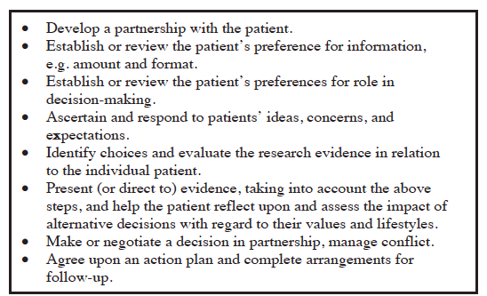
Principles of Shared Decision-Making
Shared Decision-Making: decision process where patients and clinicians jointly review the best medical evidence and patients’ preferences and values.
  Exploring potential outcomes are key to inform patients regarding the implications of their choice to help reach a joint treatment decision
Elwyn et al British Journal of General Practice, 2000, 50, 892-897
Veroff et al Health Affairs 2013; 32:2, 285-293
Notes:
This is an approach to shared decision-making. This is intuitive and we do this with our patients all the time, in routine encounters.

Slide 47
Preference Sensitive Decision-Making
Preference-sensitive care: conditions with multiple treatment options having significant tradeoffs and varying potential outcomes, with decisions reflective of personal values and preferences.
  Physician recommendations should always include the rationale, expected outcome, and alternatives.
  SDM promotes better understanding of care choices, can lower costs, reduce admissions and related surgeries
Patients may choose to deviate from evidence-based guidelines of care for many reasons, including quality-of-life concerns, cost considerations, lifestyle choices and family decisions.
  There is the risk that patient preferences for “nonstandard” care may result in lower reimbursement or physician quality ratings.
  However, we still must offer patients advice based on the best evidence available
  Adult patients have the right to choose care that may differ from what guidelines suggest.
  Unclear role in a pediatric disease where parents make decisions for their child
Stacey D, et al. Cochrane Database Syst Rev. 2011;(10):CD001431.
Charles C, et al. Soc Sci Med. 1997;44(5):681–92.
Dartmouth Atlas. http://dartmouthatlas.org.
RWJF. https://rwjf.org.
Keirns CC, Goold SD. JAMA. 2009;302(16):1805–6.
Notes:
The updated practice parameters recognize that many former recommendations surrounding anaphylaxis care were probably less evidenced based in terms of absolute necessity to do or not do something
--the 2020 parameter provided an evidence base to re-evaluate many decisions
--the 2023 parameter weighed the evidence and based on the low to very low certainty of most decisions, acknowledged that the recommendations should be conditional, and allow for patient values and preferences

Slide 48
What Isn’t A Shared Decision
When you narrow the choices that a patient chooses from
When you make the choice for them
When you don’t inform the patients of all the evidence for and against all therapy options
When you push them towards a particular option because it is what you prefer
When you push them away from a particular option because you don’t like it
What we may want for the patient does not matter—this is not our call, this is not our life. Our job is to inform them, completely, of all the options, risks/benefits, and alternatives.
They choose, not us. This process is as easy or as difficult as we make it.
Notes:
We need to recognize when we are being paternalistic and making the decision for our patients, based on what we want for them, and not accounting for what they want.

Slide 49
Discussion Supporting SDM and Anaphylaxis Management
Evidence now supports a modified approach to patients with sting allergy who are treated with BB or ACEI
Prior to VIT, there may be an increased severity of reaction to a sting, but not an increased chance of reaction
For patients on maintenance VIT, there is not increased risk associated with cardiovascular medications
Should acknowledge patients with cardiovascular disease have an inherently increased risk of severe anaphylaxis, which is more reason to maintain treatment that is medically indicated to mitigate that risk
It is safer for patients with sting anaphylaxis to remain on than stop appropriately prescribed BB or ACEI
Also, changing the medication may lead to increased morbidity or mortality which exceeds the risk of severe anaphylaxis that might result from continuing the medications
The clinician prescribing the BB or ACEI may be consulted about the medical necessity of the medication, but they should only make a change if there is a safe and effective alternative medication
Wang et al Ann Allergy Asthma Immunol 2024; 132(2):124-176
Notes:
Summary of findings supporting SDM

Slide 50
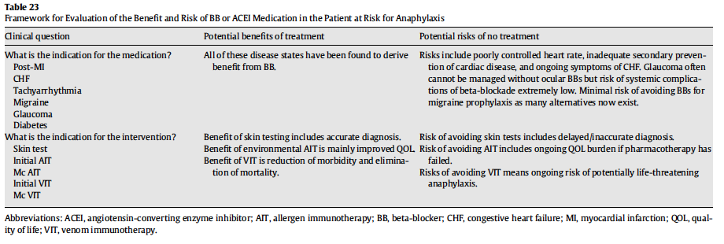
A Framework for Evaluation
Similar methods can be used for SDM regarding prescription and number of epinephrine devices to carry, activating emergency services, prescribing an autoinjector vs nasal device, considering provocation challenge vs testing or repeat use of anesthesia
Wang et al Ann Allergy Asthma Immunol 2024; 132(2):124-176
Notes:
This table, from the 2023 parameter, is a high yield breakdown of the considerations regarding if it is more or less appropriate to recommend an ACEi or BB be stopped.
The main consideration is if the risk of adverse events relative to the primary condition needing these medicines outweighs the risk of their allergic condition causing anaphylaxis and if the risk of the underlying condition is increased by changing to a second line agent.

Slide 51
Common Myths and Misconceptions Regarding Anaphylaxis Management
Notes:
The next two slides are a smattering of myths that may still be prevalent beliefs by patients, referring clinicians, or even among allergists.
Each of these is addressed in the 2023 parameter sections.
There is a lot that we may believe or were taught to believe that may not have supporting evidence. These can sometimes be harder truths to accept.

Slide 52
Common Myths That Sound Plausible
Administering epinephrine immediately after exposure to a known trigger but before symptoms develop has benefit.
  FALSE—outside of one early 1970’s study of venom allergic patients (pre-dating knowledge of mast cell disease in severe venom allergy), there has been no demonstration of any benefit. This actually risks mistiming the Tmax of the drug to when it is needed most. This is also not cost effective
Everyone needs to always carry two devices.
  FALSE—this is another common misconception that has no evidence base. Fewer than 10% will need a second dose, and rates of biphasic anaphylaxis are lower than previously presumed. At current device prices, this is only cost-effective if the patient has required multiple epinephrine doses in the past or prior history of anaphylaxis
Severe reactions are common on first exposures to foods in infants.
  FALSE—this occurs in fever than 4% of cases.
Infants have distinct anaphylaxis criteria.
  FALSE—while symptoms may present differently such as higher likelihood of skin symptoms, behavioral changes, and less likely to have respiratory symptoms, the criteria are the same
Wang et al Ann Allergy Asthma Immunol 2024; 132(2):124-176
Notes:
No notes.

Slide 53
Common Myths That Sound Plausible
Reactions to foods have a high risk of a biphasic reaction.
  FALSE: per recent data from Mayo Clinic, food allergens are negative predictors for biphasic reactions.
We can predict anaphylaxis severity based on past reactions.
  FALSE: this is on a continuum and is hard to predict. A past severe reaction is a risk for a future severe one but does not predict all future episodes will be severe. Severe anaphylaxis risks include older age, drug as the allergen, and underlying cardiovascular disease.
Epinephrine is lifesaving.
  FALSE: epinephrine is the best and most strongly preferred treatment for anaphylaxis. Ethical considerations prevent controlled studies that can provide strong, direct evidence of such effects. The best available evidence is from case series which conclude prompt epinephrine use reduces the risk of fatality. However, there are innumerable documented instances of patients surviving anaphylaxis who have not received epinephrine, though prompt epinephrine administration is still the recommended treatment of choice.
Negative skin testing in the perioperative anaphylaxis setting indicates a lack of risk to the provoking agent.
  FALSE: these are non-irritating concentrations, and the positive/negative likelihood ratios associated with this testing—which is still recommended—are poorly established based on provocation challenge
Wang et al Ann Allergy Asthma Immunol 2024; 132(2):124-176
Notes:
No notes.

Slide 54
Uncomfortable Truths for Epinephrine
Guidelines aim to prevent severe reactions, including anaphylaxis-related fatality
Most recommendations are unevidenced
  Prior anaphylaxis poorly predicts future reaction severity
  Severity is multi-factorial, severe reactions may not replicate
  Asthma is not a consistently clear risk factor for severity
  Carriage of twin-packs was a recommendation made by the advocacy community, without evidence from any study
  Optimal dose, Tmax and Cmax are not established
  No data support epinephrine use reduces fatality
Some countries risk-stratify epinephrine prescribing but are not faring worse than the US, where we do not
Just how sure are we about how many devices someone should be prescribed?
Turner et al Allergy 2022; 77: 2634-52
Greenhawt et al Ann Allergy Asthma Immunol. 2023;131(2):279-282
Notes:
This slide, which was presented at the 2023 ACAAI Annual Scientific Meeting during the Anaphylaxis symposium, serves as a reminder that most of our prior or current dogmatic recommendations may lack evidence for support. Please don’t confuse this as them saying “don’t use epinephrine”. Please still use epinephrine. Just understand that while this is our most effective drug in anaphylaxis, we really have quite limited understanding and evidence for a lot of common management practices that we recommend. It is important to recognize where past policy may be overly dogmatic, and that with better understanding of what the evidence is and is not, we can let go of some of these dogmatic recommendations that are unlikely to help our patients.
--most recommendations for epinephrine are unevidenced or poorly evidenced
--we’ve grown accustomed to some absolutes based on expert opinion and small, low-quality studies
--all recommendations must evolve
--The sooner we recognize these hard truths, the sooner we can evolve policy and enhance care

