Slide 1
Food Allergy Diagnosis and Management
This program was developed by the American College of Allergy, Asthma & Immunology with grant support from DBV Technologies
Notes:
No notes.

Slide 2
Presented by
Insert presenter name here
Notes:
Note: Speaker can insert their name above.

Slide 3
Author Acknowledgements
Original Content Development (2019):
Jay A. Lieberman, MD, FACAAI, Associate Professor of Pediatrics, University of Tennessee Health Science Center and LeBonheur Children’s Hospital
Daniel H. Petroni, MD, PhD, Executive Director Seattle Allergy & Asthma Research Institute and the Northwest Food Allergy Treatment & Research Center
Julie Wang, MD, FACAAI, Professor of Pediatrics, Jaffe Food Allergy Institute Icahn School of Medicine at Mount Sinai
Review and Updates (2024):
Aikaterini Anagnostou, MD, PhD, FACAAI, Professor of Pediatrics, Texas Children's Hospital and Baylor College of Medicine.
Jay A. Lieberman, MD, FACAAI, Professor of Pediatrics, University of Tennessee Health Science Center and LeBonheur Children’s Hospital
Notes:
No notes.

Slide 4
Learning Objectives
Identify patients who should be evaluated for food allergy
Select appropriate tests to diagnose food allergy
Formulate a food allergy management plan including avoidance strategies and an emergency action plan
Discuss potential treatments options for food allergy
Notes:
No notes.

Slide 5

What is a Food Allergy?
Food allergy is an adverse health effect arising from a specific immune response that occurs reproducibly on exposure to a given food.
This reaction can be Immunoglobulin E (IgE)-mediated, non-IgE-mediated, or a combination of both, resulting in clinical symptomatology.
Boyce, JA et al. J Allergy Clin Immunol 2010;126:S1-58.
Notes:
Food allergies are adverse immune reactions to food proteins that can lead to a range of symptoms.
The exposure with clinical reaction is the key point here. Food Allergy Testing determines sensitivity, not clinical reactivity, and does not diagnose food allergy.

Slide 6
Immunologic Food Reactions
IgE-Mediated
Non-IgE-Mediated
IgE-mediated food allergy
Systemic allergic reaction (anaphylaxis)
Pollen Food Allergy Syndrome (PFAS), previously named ‘oral allergy syndrome’
Eosinophilic esophagitis (EoE)
Eosinophilic gastritis
Eosinophilic gastroenteritis
Atopic dermatitis
Food Protein-Induced Enterocolitis Syndrome (FPIES)
Protein-Induced Enteropathy
Celiac disease
Eosinophilic proctocolitis
Dermatitis herpetiformis
Contact dermatitis
Sampson H. J Allergy Clin Immunol 2004;113:805-9.
Chapman J et al. Ann Allergy Asthma & Immunol 2006;96:S51-68.
Notes:
The key disorders to point out are:
FPIES – Generally presents in infancy and is characterized by delayed vomiting 1-4 hours post ingestion.
Milk is the most common trigger in children, followed by soy.
FPIES can also be triggered by solid foods – rice and oat are the most common triggers for solid food FPIES.
Diagnostic criteria for FPIES include:
Major Criterion
Repetitive Vomiting 1-4 hours after eating suspect food
Minor Criteria
A second (or more) episode of repetitive vomiting after eating the same suspect food
Repetitive vomiting episode 1-4 hours after eating a different food
Extreme lethargy with any suspected reaction
Marked pallor with any suspected reaction
Need for emergency room visit with any suspected reaction
Diarrhea
The diagnosis of FPIES requires that a patient meets the major criterion and at least 3 minor criteria
EoE – Chronic, immune/antigen-mediated esophageal disease.
Characterized clinically by symptoms related to esophageal dysfunction
and histologically by eosinophil-predominant inflammation.
Most common trigger in children is milk.
Younger children most often present with vomiting, growth failure
and food refusal.
For older patients, dysphagia, impaction and heartburn are more often reported.

Slide 7
IgE-mediated Food Allergy
IgE-mediated food allergy reaction often occurs within minutes to 2 hours of
ingesting a food
Reactions can range from mild to severe (anaphylaxis)
Symptoms include:
Cutaneous | urticaria, angioedema, pruritus, flushing/erythema, rash
Respiratory | upper airway → rhinitis, stridor, hoarseness, sneezing lower airway → cough, wheeze, dyspnea, cyanosis
Cardiovascular | vasodilation, tachycardia, arrhythmia, hypotension, shock
Gastrointestinal | swelling of lips/tongue, palatal itch, nausea, vomiting, abdominal cramps, diarrhea
Neurologic | anxiety, headache, seizure, level of consciousness (LOC)
Notes:
This talk will focus on IgE-mediated food allergies.

Slide 8










Pollen Food Allergy Syndrome (PFAS)
(previously known as Oral Allergy Syndrome, OAS)
The reaction is due to cross reactivity between similar proteins in fruits, vegetables, seeds or nuts and a corresponding pollen
Symptoms are generally mild and limited to the oropharynx
In rare cases, systemic reactions can occur
Management: avoidance of the raw food, but cooked versions are well-tolerated
Apple
Peach
Plum
Pear
Cherry
Apricot
Almond
Peanut
Hazelnut
Rosaceae
Fabaceae
(old Leguminosae)
Betulaceae
Birch
Skypala IJ, et al. Clin Exp allergy 2022 Sep;52(9):1018–34.
Sicherer SH. J Allergy Clin Immunol 2001;108:881.
Ortolani, C, et al. Ann Allergy. 1993;71:470-6
Notes:
Pollen Food Allergy Syndrome or Oral allergy syndrome (previous name) is also an IgE-mediated allergy that is due to cross-reacting, homologous proteins between pollens and food proteins. Symptoms are triggered by fresh fruits and vegetables. Commonly associated foods with birch tree pollen are shown in the figure.
Symptoms are mild, and localized to the oropharynx; typical symptoms include lip/mouth itching, and swelling. However, systemic reactions can occur. In a study of 706 patients with OAS, 2.1% of individuals experienced anaphylaxis.
Management
Patients are advised to avoid the raw fruits and/or vegetables that trigger symptoms. Heating the food allergens that trigger OAS denatures the relevant protein, therefore cooked forms of the foods are generally well tolerated. The degree of clinical reactivity can have seasonal variations.

Slide 9
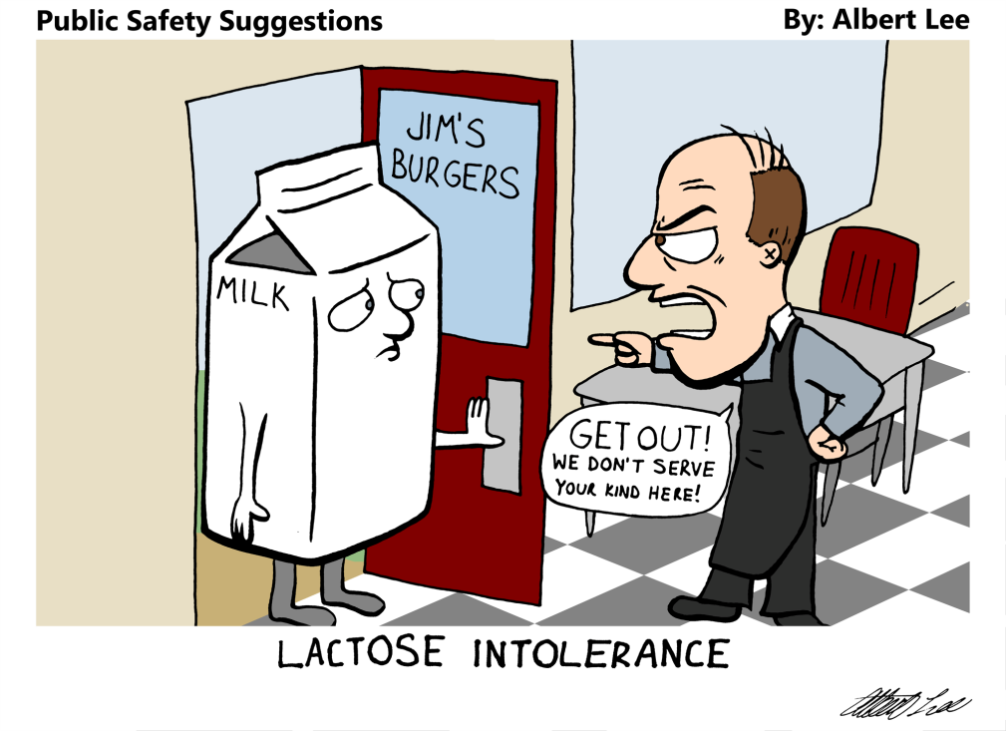
“Food Intolerance”
Term that encompasses non-immune food reactions.
Complaints variable and can include fatigue, brain fog, GI complaints.
Often delayed symptoms hours to days post consumption
Example: lactose intolerance - due to inability of the body to break down lactose milk sugar leading to increase bloating and GI pain.
Sampson H. J Allergy Clin Immunol 2004;113:805-9.
Cox AL, Sicherer SH.J Food Allergy. 2020 Sep 1;2(1):3-6.
Notes:
No notes.

Slide 10
Epidemiology of Food Allergy
Notes:
Going forward, this presentation will focus on IgE-mediated food allergies that are not oral allergy syndrome.

Slide 11
Epidemiology of Food Allergy
An estimated 8% of children and 10% of adults in the US are reported to be food allergic.
Food allergies are increasing in prevalence
Similar trends are seen in many countries around the world, including developing countries that are seen food allergies emerging as a health issue
Food allergic reactions are common
  42% of children with food allergy report at least 1 lifetime food allergy-related visit to the ED
  19% of children with food allergy report at least 1 food allergy-related ED visit in the last year.
Food allergy is associated with dietary, social, and psychological effects resulting in decreased quality of life
Estimated cost of food allergy is ~$25 billion annually
Gupta RS et al. Pediatrics 2011;128.
Gupta RS et al. JAMA Netw Open 2019;2.
Branum A, Lukacs S. Natl Cent Health Stat Data Brief 2008;10.
Gupta RS et al. Pediatrics 2018;142.
Gupta R et al. JAMA Pediatr 2013;167:1026-31.
Notes:
Surveys of the US population suggest that 8% of children and 10% of adults in the US are food allergic. Prevalence of food allergy appears to be increasing over time.
Food allergic individuals are at risk for allergic reactions – many children with food allergies have needed emergency medical attention to treat food-related allergic reactions. Similar data exists for adults with food allergy.
Food allergy carries a significant financial burden on patients, families and society, with the estimated cost of food allergy nearing $25 billion per year in the US.
Similar trends for food allergy are reported by other countries as well.

Slide 12
Estimated Prevalence in US Children
Any Food Allergy | 7.6%
Peanut | 2.2%
Tree nut | 1.2%
Milk | 1.9%
Shellfish | 1.3%
Egg | 0.9%
Fin fish | 0.6%
Wheat | 0.5%
Soy | 0.5%
Sesame | 0.2%
An estimated 39.9% of food allergic children are reported to have have multiple food allergies.
Gupta RS et al. Pediatrics 2018;142.
Notes:
The most common food allergens causing reactions in children include:
Peanut
Tree nut
Milk
Shellfish
Egg
Fish
Wheat
Soy
Sesame
Sesame was designated as the 9th major food allergen recognized in the U.S. after the Food Allergy Safety, Treatment, Education, and Research (FASTER) Act was signed into law in April 2021.

Slide 13
Natural History of Food Allergy
Allergen | Age of Diagnosis | Outgrowth? | Notes
Milk | Infant/toddler | Early to late childhood, ~50% by age 5 yrs | Exposure to extensively heated/baked milk (e.g., muffins and cake) may be safely tolerated before uncooked milk
Egg | Infant/toddler | Early to late childhood, ~50% by age 6 yrs | Exposure to extensively heated/baked egg (e.g. muffins, and cake) may be safely tolerated before cooked egg (e.g. scrambled egg)
Peanut | Infant/toddler | Uncommon, ~20% | Peanut oil (the refined one) is typically ok for most patients
Tree Nuts | Toddler/early childhood | Uncommon, ~10% | Some, but not all tree nuts cross react
Wheat | Infant/toddler | Early to late childhood, ~50% by age 7 yrs
Savage J et al. J Allergy Clin Immunol Pract 2016;4:196-203.
Notes:
The majority of children outgrow their allergy to milk, egg, wheat and soy. However, allergies to peanut, tree nuts, seeds, fish and shellfish likely persist into adulthood.
Therefore, the most common food allergens for adults are peanut, tree nuts, fish and shellfish.
For some individuals, food allergies do not develop until adulthood.

Slide 14
Diagnosis of IgE-Mediated Food Allergy
Notes:
No notes.

Slide 15

Diagnosis of Food Allergy Begins with the History
Symptoms within minutes to a few hours of ingesting a food, especially if these symptoms are consistently reproducible on exposure to the food
Symptoms can include:
  Skin – itching, hives, flushing, swelling (Most common)
  Mouth – itching, swelling lips and/or tongue
  Throat – itching, tightness/closure, hoarseness
  GI – immediate vomiting, diarrhea, cramps
  Lung – wheezing, cough, shortness of breath
  CV – hypotension, tachycardia
Boyce J et al. J Allergy Clin Immunol 2010;126.
Notes:
History is the most important factor in the diagnosis of food allergy. Symptoms of IgE-mediated food allergy generally develop quickly, within minutes to 2 hours after ingestion. If a specific allergen has triggered symptoms on multiple occasions, then the suspicion for allergy to that food is high.
Allergy symptoms are variable and can affect any body system. Skin symptoms are most commonly seen, though are not seen with every allergic reaction. Symptoms can also affect the mouth, throat, gastrointestinal tract, lung and cardiovascular system.

Slide 16
Associating Allergen Exposure and Symptoms
Timing of ingestion and onset of symptoms
Type and quantity of food that triggered the reaction
Prior exposures to the trigger or related foods
Association of additional factors such as exercise and concurrent medications
EXPOSURE
SYMPTOMS
Boyce J et al. J Allergy Clin Immunol 2010;125
Notes:
Information regarding timing of ingestion to the onset of symptoms, types of signs and symptoms, type and quantity of food that triggered the reaction, prior exposures to the trigger or related foods, and association of additional factors such as exercise and concurrent medications should be obtained.
A history of symptoms with exposures to the triggering food and lack of symptoms with exclusion of the food is highly suggestive of allergy. Based on the history, selected foods are evaluated by skin prick testing or serum specific IgE testing.
It is important to NOT diagnose food allergy based on positive testing alone – if there is no history of allergic reaction with food exposure, there is likely no food allergy and tests are unnecessary.

Slide 17
Unlikely to be Food Allergy
Hives that last more than a few hours (especially over 24 hours) or recurrent over several days
Reactions that occur only sporadically when the patient eats the food (not every exposure)
Headaches (migraines), hyperactivity, mood changes
Chronic nasal congestion or rhinorrhea
Notes:
Approximately 20% of people believe they have food allergy, but only about half have true allergies.
Here are some examples of concerns that are unlikely to be food allergy.
Food allergy reactions generally do not manifest as hives that persist for many hours or multiple days, without repeat allergen exposure.
Food allergies are reproducible such that every exposure to the allergen trigger should trigger symptoms, though the exact symptoms or severity of symptoms may vary with each exposure.
Headaches, hyperactivity, mood changes, chronic nasal congestion or rhinorrhea are unlikely to be signs of food allergy.

Slide 18
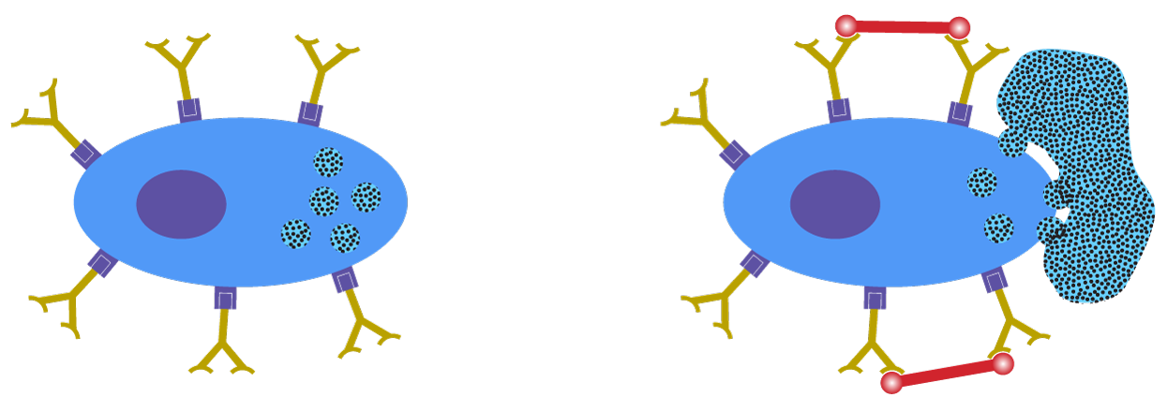
Pathophysiology: Definition
allergen
IgE antibody
effector cell
allergen
Pathophysiology: IgE production in response to allergen exposure, allergen cross-links IgE on surface of mast cells and basophils leading to release of mediators
allergen
effector cell
igE Antibody
allergen
Notes:
Binding of food allergens by specific IgE on effector cells, such as basophils and mast cells, leads to degranulation and mediator release (i.e. histamine, tryptase, cysteinyl leukotrienes, prostaglandin D₂), causing a variety of symptoms seen in allergic reactions.

Slide 19
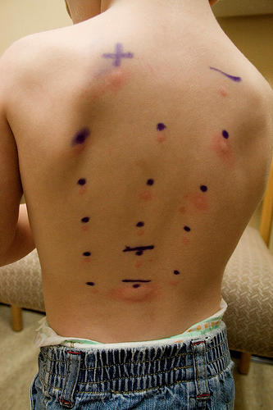
Diagnostic Testing
Both skin prick testing (SPT) and specific allergen IgE are tools to show IgE-mediated sensitivity to a particular food.
They do not predict severity of reactions or the dose of allergen that could trigger reactions.
They support the diagnosis of food allergy based on a positive history of allergic reactions with food exposure.
Do NOT test foods that are eaten and tolerated
Greenhawt M, et al. J Allergy Clin Immunol. 2020 Dec;146(6):1302-1334
Boyce, JA et al. J Allergy Clin Immunol 2010;126:S1-58.
Notes:
If the history and physical examination are consistent with IgE-mediated food allergy, skin prick testing and/or serum allergen-specific IgE testing can be performed to support the diagnosis.
Both tests provide an indication of the likelihood of allergic reaction with exposure to the food allergen. The results of these tests do not predict the severity of reactions that may occur as a result of allergen exposures.
These tests have high negative predictive values (NPV >95%), so negative tests largely exclude a specific IgE-mediated food allergy.

Slide 20
National Institute of Allergy and Infectious Diseases (NIAID) Guidelines for the Diagnosis of Food Allergy
Guideline 4 (Skin prick test): The Expert Panel (EP) recommends performing a skin prick test to assist in the identification of foods that may be provoking IgE-mediated food-induced allergic reactions, but the skin prick test alone cannot be considered diagnostic of food allergy.
Guideline 7 (Allergen-specific serum IgE): The EP recommends specific IgE tests for identifying foods that potentially provoke IgE-mediated food-induced allergic reactions, but alone these tests are not diagnostic of food allergy.
Boyce, JA et al. J Allergy Clin Immunol 2010;126:S1-58.
Notes:
While these are useful tests, we know that they are not perfect. The positive predictive value (PPV) is <50% for these tests, therefore a positive test in isolation without a clinical history is not diagnostic for food allergy. Test results need to be taken in the context of history, as cross-reactivity between proteins can give positive IgE test results that may not be clinically relevant.

Slide 21
Oral Food Challenge
The current gold standard for the diagnosis of food allergy is a Double-Blind Placebo Controlled Food Challenge. In clinical practice, open food challenges are generally used.
These must be performed at centers that are comfortable with handling allergic reactions, including severe reactions and anaphylaxis.
Reasons for food challenges:
  1. Determine whether the wrong food is suspected as the cause of symptoms.
  2. Prove that a food is NOT the cause of symptoms.
  3. Verify whether a patient has outgrown their food allergies.
  4. Identify the threshold of reactivity to a food (for example, prior to initiating therapy).
The decision to undergo a food challenge should be based upon a combination of history and diagnostic testing (SPT/serum IgE testing)
Nowak-Wegrzyn A et al. J Allergy Clin Immunol 2009;123.
Perry TT et al. J Allergy Clin Immunol 2004;114:144-149.
Notes:
When history and skin prick/IgE testing do not provide a diagnosis with high certainty, a food challenge should be performed. Because of the risk for severe allergic reaction (anaphylaxis) during food challenges, this procedure should be performed in settings where medical staff and equipment are readily available.
The gold standard tool for the diagnosis of food allergy is a double-blind, placebo-controlled oral food challenge – the allergen in question is gradually fed in increasing doses under medical supervision.

Slide 22
Additional Diagnostic Tests: Component Testing
Assess IgE binding to individual proteins within a food
May increase diagnostic accuracy
May provide indicators for severity or persistence of allergy
Example: peanut components (Ara h 2 provides the most diagnostic accuracy)
Allergen | Peanut Protein Characteristics
Ara h 1 | Seed storage protein, stable to heating, major allergen
Ara h 2 | Seed storage protein, stable to heating, major allergen
Ara h 3 | Seed storage protein, stable to heating, major allergen
Ara h 6 | Ara h 2 homologue
Ara h 8 | Bet v 1 (birch tree pollen) homologue; heat labile
Ara h 9 | Lipid transfer protein, associated with more severe symptoms as well as oral symptoms in the Mediterranean area
Notes:
Recent advances in the identification of relevant allergens, and the development of recombinant proteins now allow us to assess IgE binding to individual proteins within a food. This is known as component testing.
The hope is that this testing may have increased sensitivity and specificity, and thus diagnostic accuracy. This may assist in the decision-making process to decrease the need for food challenges. And perhaps provide prognostic information regarding the severity or persistence of the food allergy.
Peanut protein components that are currently available for testing by diagnostic laboratories are listed. Some studies suggest that having elevated IgE levels to specific components are more predictive of allergy, however, there is no consensus at this time for how these tests should be interpreted or cutoff levels.

Slide 23
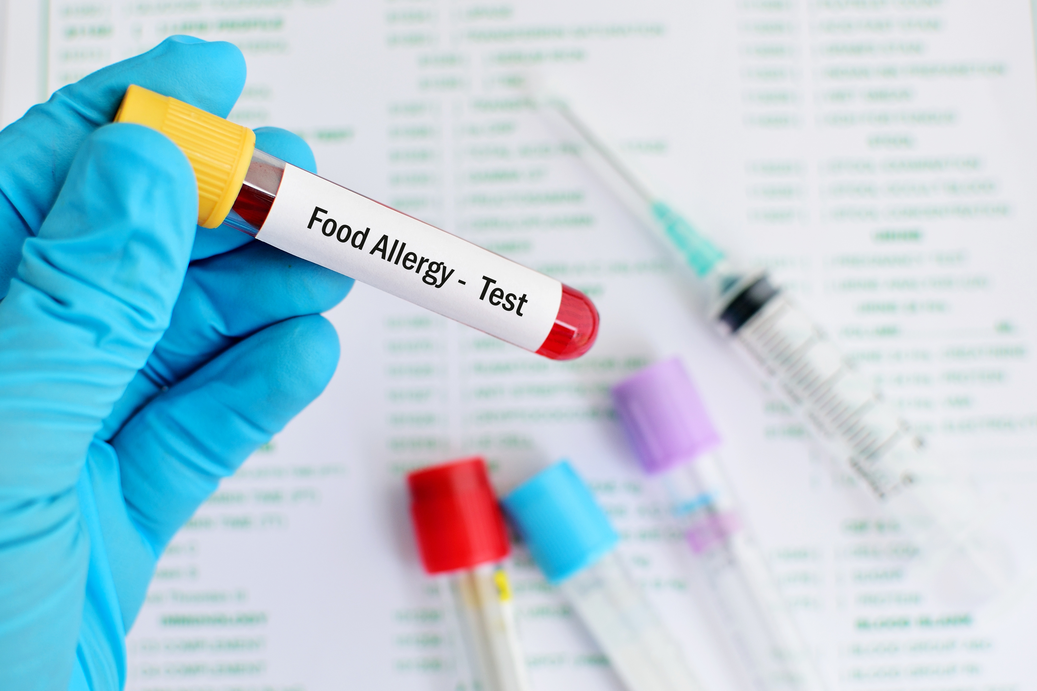
Unproven Tests for Food Allergy
These tests are not recommended in the evaluation of food allergy:
  Immunoglobulin G (IgG) testing
  Provocation-neutralization testing
  Antigen Leukocyte Antibody Test (ALCAT)
  Electrodermal testing
  Applied kinesiology
  Hair analysis
Kelso JM. J Allergy Clin Immunol Pract 2018;6:362-365.
Notes:
These tests are not proven or disproven for food allergy diagnosis. Given the lack of scientific support for these tests, patients should be counseled against pursuing these tests, as well as the potential risks of dietary modification based on these tests.

Slide 24
Management of Food Allergy
Notes:
No notes.

Slide 25
Current Therapeutic Options
Avoidance
Oral Immunotherapy
  Currently there is a single FDA-approved (approved in 2020) peanut oral immunotherapy product [Peanut (Arachis hypogaea) Allergen Powder-dnfp] for patients ages 1-17 years old. Approval was extended for patients 1-3 year old as well in 2024.
  Off-label immunotherapy to various foods is also practiced across the country.
Omalizumab
  An injectable monoclonal anti-IgE approved for the treatment of IgE-mediated food allergies in adult and pediatric patients aged 1 year and older (approved in 2024)
Investigational Therapies (Research studies)
  Many available across the country including:
    epicutaneous immunotherapy, sublingual immunotherapy, BTK inhibitors, peptide immunotherapy, and others.
ACAAI, Food Allergy eYardstick. Available at: https://education.acaai.org/faeyardstick
Notes:
There are multiple management options for food allergy patients currently, including avoidance and a variety of therapeutic approaches, mostly aiming to protect from accidental exposures and reduce the risk of resulting anaphylaxis.

Slide 26


Avoidance
Avoidance is still a reasonable management option for patients with food allergy.
Benefits include:
  Does not require any active therapy and no therapy-related side effects
  Low cost
Risks include:
  Risk of accidental ingestion could lead to reactions, including severe reactions
  Considered at risk of anaphylaxis and should carry epinephrine
  Possible anxiety/decreased quality of life for some patients
Boyce JA, et al. J Allergy Clin Immunol. 2010 Dec;126(6 Suppl):S1-58
ACAAI, Food Allergy eYardstick. Available at: https://education.acaai.org/faeyardstick
This Photo by Unknown Author is licensed under CC BY-SA
Notes:
These recommendations are in line with the current “Guidelines for the Diagnosis and Management of Food Allergy in the United States: Report of the NIAID-Sponsored Expert Panel”.
Education on avoidance measures can be found on the ACAAI website (acaai.org) for those wishing to know more information.

Slide 27



Oral Immunotherapy (OIT)
There is currently one FDA-approved OIT product for peanut allergy
OIT is commonly practiced ‘off-label’ for various foods
OIT involves giving the allergen in small doses over time, and slowly increasing the amount ingested.
Typically, a stable dose is taken daily, with ‘up-dosing’ done under physician supervision.
Sindher SB et al. Ann Allergy Asthma Immunol 2023;131:29-36.
Notes:
There is a variety of OIT protocols for use, including the FDA-approved product peanut OIT protocol. Some protocols include a rush phase, others go straight to the slow up dosing phase of therapy.
Low-does OIT protocols are currently under study.

Slide 28
Example of (OIT) Schedule
Rush
Build-Up
Maintenance
?
Initial dose
escalation
Home dosing
Maintenance
Build-Up
Notes:
This is meant to give an example of how the up-dosing is done in most studies.
The rush build up is rarely used, and only in small studies.
The therapy is considered long-term, possibly life-long as discontinuation for significant time periods results in loss of acquired desensitization (this varies from patient to patient).

Slide 29
Oral Immunotherapy (OIT): Benefits and Risks
Benefits include:
  Active treatment to raise threshold of reactivity
  Allows for protection from accidental ingestions leading to reactions
  Allows for decreased reaction severity
  May or may not improve quality of life
  Some reports suggest it can lead to sustained unresponsiveness in a subset of patients
Risks include:
  Side effects are common and occur in almost all patients, although they are usually mild/moderate
  Anaphylaxis can occur
  Cost can vary
  Should not be viewed as a cure
  Patients are still required to carry epinephrine
ACAAI, Food Allergy eYardstick. Available at: https://education.acaai.org/faeyardstick
This Photo by Unknown Author is licensed under CC BY-SA
Notes:
OIT is associated with both risks and benefits that should be discussed in detail and communicated clearly to patients prior to commencing treatment.

Slide 30

Omalizumab
An anti-IgE biologic that has been approved to treat asthma, chronic spontaneous urticaria, and chronic rhinosinusitis with nasal polyps
Approved in 2024 for the treatment of IgE-mediated food allergies in patients 1 year and older
It is dosed SubQ and given every 2 weeks or every 4 weeks depending on the patient’s body weight and total IgE level (obtained from a blood draw) .
ACAAI, Food Allergy eYardstick. Available at: https://education.acaai.org/faeyardstick
Notes:
A multi-center trial (OUtMATCH) investigated the use of omalizumab in food allergy in 177 children and adolescent and 3 adults.

Slide 31
Omalizumab: Benefits and Risks
Benefits include:
  Active treatment to raise threshold of reactivity
  Is allergen-naïve, so it would work for any food allergy the patient has including for multiple food allergies
  Allows for protection from accidental ingestions leading to reactions
  May or may not improve quality of life
  Can treat some co-morbid conditions that can be seen in patients with food allergies, such as asthma
Risks include:
  Requires regular (every 2 or 4 week) injections
  Side effects of injections (such as pain at sight of injection, and very rare risk of anaphylaxis to injection)
  Cost can vary
  Should not be viewed as a cure
  Patients are still required to carry epinephrine
ACAAI, Food Allergy eYardstick. Available at: https://education.acaai.org/faeyardstick
Notes:
Omalizumab is associated with both risks and benefits that should be discussed in detail and communicated clearly to patients prior to commencing treatment.

Slide 32

Goals and Roles of Therapy
Goals of immunotherapy may differ between physicians and families and from one patient to another
  Some families simply want a “safeguard” from accidental ingestions.¹
  Others may want a cure for the food allergy.
With OIT, a subset of participants who complete
the therapy achieve “sustained unresponsiveness”^{2,3}
  This has not been systematically assessed for Epicutaneous Immunotherapy (EPIT) and Sublingual Immunotherapy (SLIT)
Because the therapies differ and goals of patients/families differ, a shared decision-making approach will need to be used if multiple therapies become available.
¹Greenhawt M, et al. Ann Allergy Asthma Immunol. 2018 Nov;121(5):575-579.
²Burks AW, et al. N Engl J Med. 2012 Jul 19;367(3):233-43.
³Vickery BP et al. J Allergy Clin Immunol. 2014 Feb;133(2):468-75.
Notes:
The Greenhawt article interviewed families who enrolled in one of the EPIT or OIT studies. The Burks article was Egg OIT and published in NEJM. The Vickery article was peanut OIT.
Sustained unresponsiveness was defined by tolerating a set dose (greater than at baseline) after stopping therapy for up to 2 months.

Slide 33


Education
No matter the treatment option the patient and family select, they should still receive education on allergen avoidance and treatment of allergic reactions.
Notes:
Education remains the cornerstone of food allergy management.

Slide 34

Label Reading
Food Allergen Labeling and Consumer Protection Act (FALCPA)
  Passed by the US Congress in 2004
  Identified 8 major food allergens estimated to account for 90% of reactions
    Milk, egg, peanut, tree nuts, soy, wheat, fish, and shellfish
  Sesame was added to the list in April 2021 when the Food Allergy Safety, Treatment, Education, and Research (FASTER) Act was passed
  These 9 allergens must be clearly identified either in the ingredient list or in a ‘Contains’ statement
    Bold text is often used by companies to help consumers
  Food labeling laws differ around the world
FDA. Food Allergies. Available at: https://www.fda.gov/food/food-labeling-nutrition/food-allergies.
Notes:
The allergen must be clearly identified either in the ingredient list or in a 'Contains' statement following the list. For instance, even if the ingredient list uses a technical name like casein, the 'Contains' statement would still list 'milk' to be easily understood. Often times, companies will use bold text to highlight ingredients that pose an allergy risk.

Slide 35
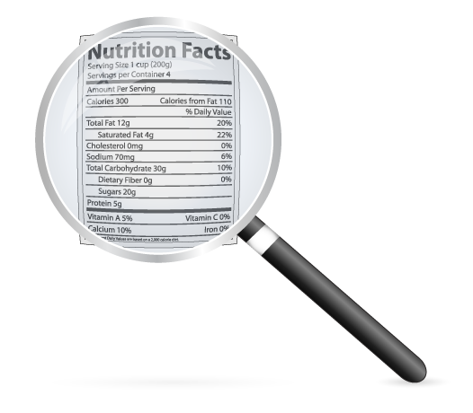
Precautionary Labeling
Precautionary labeling includes statements such as ‘‘may contain,” “produced in a facility,” “processed in a facility that also processes,” “manufactured on equipment that,” “made on equipment with,” etc.
Use of precautionary labeling is voluntary
FALCPA does not currently regulate precautionary labeling disclaimers
Whether avoidance of products with these disclaimers
is warranted is debatable
  While the risk of reaction to these products is likely low, there is some risk
Notes:
Some researchers have attempted to establish thresholds, such as the eliciting dose that would cause 10% of allergic patients to react, which could improve labeling practices. However, such thresholds have not been officially defined or regulated in the U.S. Currently, precautionary labeling (e.g., 'may contain') is voluntary and not standardized.

Slide 36

Even with avoidance, reactions can occur
  Reaction rate ~ 0.81 reaction/year in children ages 3-15 months in one multicenter study
Patients and Parents/Families should be provided with a written emergency action plan that should detail
  The patients’ allergies
  How to assess allergic reactions
  How to treat allergic reactions
Fleischer DM, et al. Pediatrics. 2012 Jul;130(1):e25-32
Notes:
The Fleischer study followed 512 children, ages 3-15 months, at enrollment with milk and/or egg allergy at 5 sites (New York, NY; Baltimore, MD; Little Rock, AR; Denver, CO; and Durham, NC).
2/3 were sensitized to peanut. They followed them on averaged 35 months. A total of 1171 reactions were reported by 367 (71.7%) subjects.

Slide 37
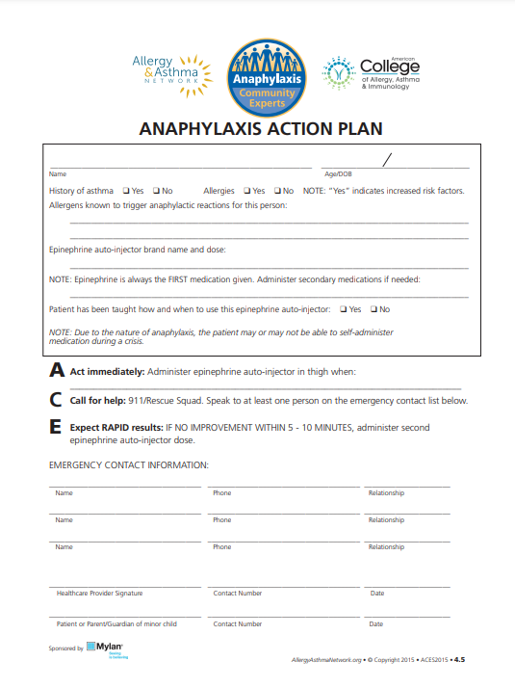
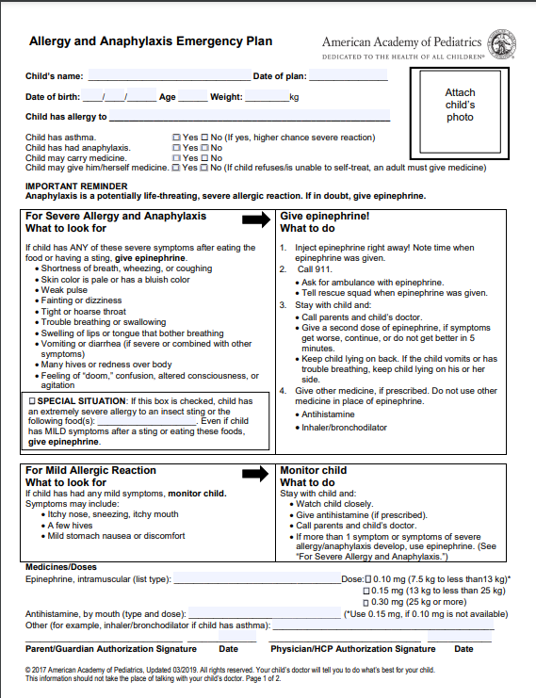
Examples of action plan or emergency plan can be downloaded from:
h
  https://college.acaai.org/sites/default/files/Resources/anaphylaxisactionplan.pdf
  https://www.aap.org/anaphylaxis
Notes:
Here are examples of an action plan and emergency plan that are available for download.

Slide 38
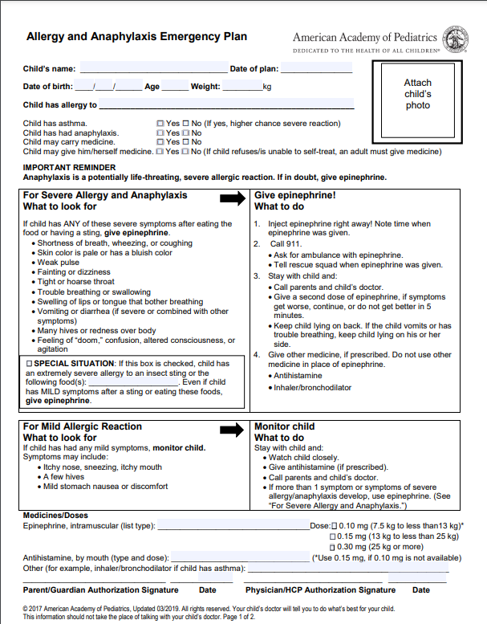
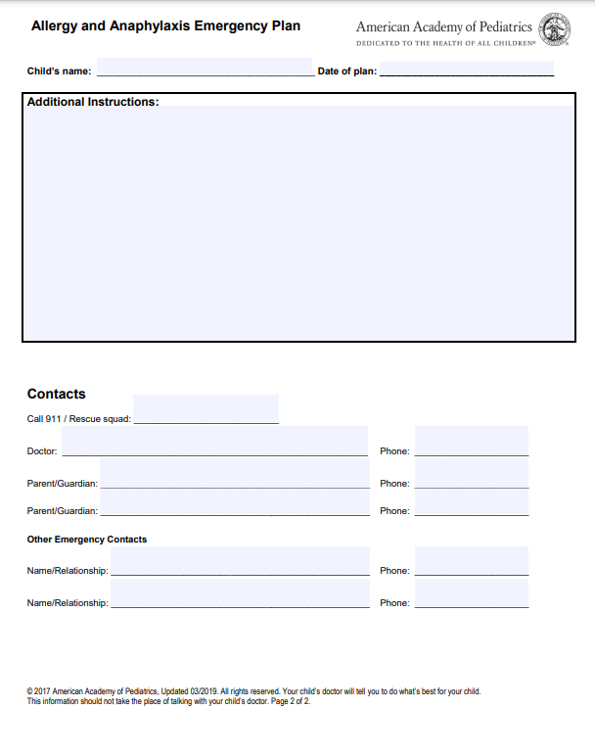
Notes:
Here is a close-up of the American Academy of Pediatrics' Allergy and Anaphylaxis Emergency Plan.

Slide 39
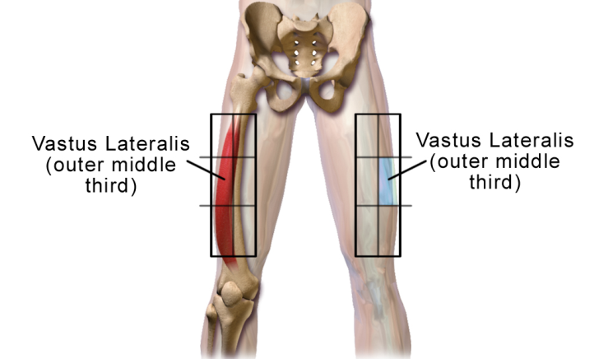

Treatment for Acute Reactions
Patients at risk for anaphylaxis should be prescribed epinephrine
  Epinephrine is the 1st line treatment for anaphylaxis
  In the United States, epinephrine is currently available to prescribe in 2 forms:
    Autoinjector
      0.1 mg (trade name only)
      0.15 mg (trade name and generic)
      0.3 mg (trade name and generic - for patients weighing >25 kg)
      Injectable epinephrine should ideally be injected into the outer thigh(vastus lateralis)
    Intranasal
      Currently available in a 2 mg spray for patients weighing >30 kg
Notes:
IM > SubQ in time-to-onset and peaks. Vastus lateralis > deltoid. Every guideline on this topic states that epinephrine is the first line treatment for anaphylaxis.

Slide 40
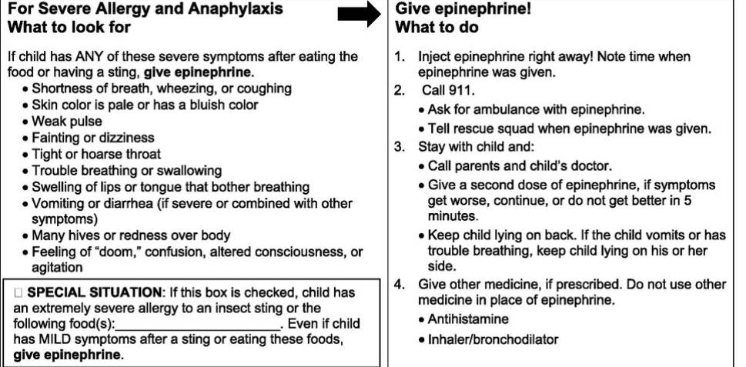
When to Consider Epinephrine?
For Severe Allergy and Anaphylaxis
What to look for
If child has ANY of these severe symptoms after eating the
food or having a sting, give epinephrine.
  Shortness of breath, wheezing, or coughing
  Skin color is pale or has a bluish color
  Weak pulse
  Fainting or dizziness
  Tight or hoarse throat
  Trouble breathing or swallowing
  Swelling of lips or tongue that bother breathing
  Vomiting or diarrhea (if severe or combined with other symptoms)
  Many hives or redness over body
  Feeling of “doom,” confusion, altered consciousness, or agitation
Give Epinephrine!
What to do
Inject epinephrine right away! Note time when epinephrine was given.
Call 911.
Ask for ambulance with epinephrine.
Tell rescue squad when epinephrine was given.
Stay with child and:
Call parents and child’s doctor.
Give a second dose of epinephrine, if symptoms get worse, continue, or do not get better in 5 minutes.
Keep child lying on back. If the child vomits or has trouble breathing, keep child lying on his or her side.
Give other medicine, if prescribed. Do not use other medicine in place of epinephrine.
Antihistamine
Inhaler/bronchodilator
Remember – There is NO contraindication to epinephrine
SPECIAL SITUATION: If this box is checked, child has an extremely severe allergy to an insect sting or the following food(s):____________________. Even if child
Has MILD symptoms after a sting or eating these foods, give epinephrine.
Notes:
Given that there is no contraindication to epinephrine, it is not unreasonable to state that any time that there is doubt or concern, it is better to give the epinephrine.
The reason to call 911 after giving epinephrine IS NOT because epinephrine can be dangerous. It is because if the reaction were that severe, the patient should be monitored for resolution or sequelae.
Newer guidelines do allow for home monitoring and not activating EMS after administration of epinephrine, as long as the reaction has resolved and the patient/family understand the risks/benefits of going to the ED or not going.

Slide 41
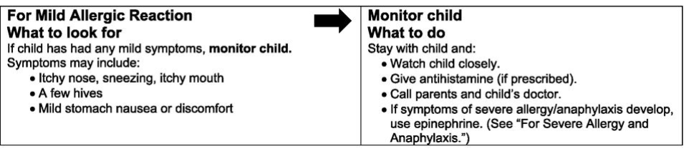
Mild Reaction Can Be Treated With Antihistamines
For Mild Allergic Reaction
What to look for
If child has had any mild symptoms, monitor child.
Symptoms may include:
  Itchy nose, sneezing, itchy mouth
  A few hives
  Mild stomach nausea or discomfort
Monitor Child
What to do
Stay with child and:
  Watch child closely.
  Give antihistamine (if prescribed).
  Call parents and child’s doctor.
  If more than 1 symptom or symptoms of severe allergy/anaphylaxis develop, use epinephrine. (See “For Severe Allergy and Anaphylaxis.”)
Example antihistamine doses:
cetirizine (0.25 mg/kg up to 10 mg)
diphenhydramine (1 mg/kg up to 50 mg)
Antihistamines should not be given in
lieu of epinephrine for anaphylaxis
Notes:
It is important to make families and patients aware of the fact that this is not to be used in place or before epinephrine for any concerning reaction.

Slide 42
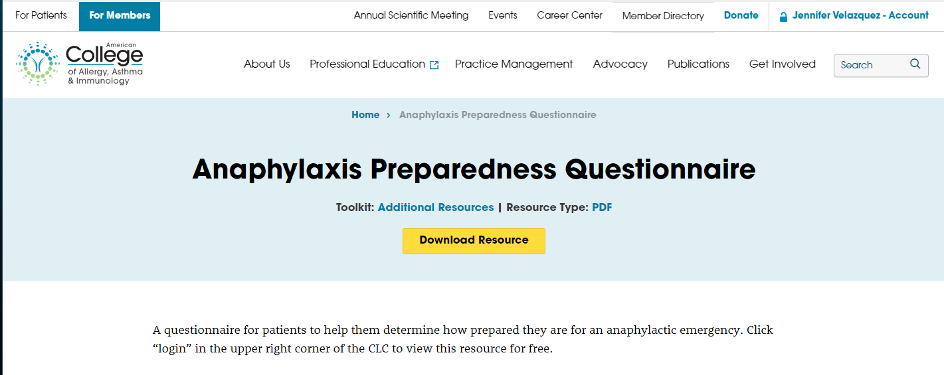

Anaphylaxis Preparedness Questionnaire
https://college.acaai.org/resource/anaphylaxis-preparedness-questionnaire/
Notes:
This is a tool that providers can use to assess how prepared their patients are to manage allergic reactions. This can be completed by patients/parents and then reviewed with the health care provider.

Slide 43


Management of Food Allergies in the School Setting
There are numerous resources to help educate patients and school personnel
  https://www.cdc.gov/healthyschools/foodallergies/index.htm
All 50 states have laws permitting or requiring schools to carry “stock epinephrine”
  To see your state’s status and law:
    https://www.foodallergy.org/education-awareness/advocacy-resources/advocacy-priorities/school-access-to-epinephrine-map
Notes:
Local practitioners can work with their states and school systems to better understand how it is being done locally.

Slide 44

How to Handle the Classroom and Cafeteria
There are no set guidelines for these situations
Current CDC “voluntary guidelines” provide tips for schools and parents
  Special seating arrangements can be considered when age and circumstance appropriate (e.g., during mealtimes, birthday parties)
  Staff and students should wash their hands and clean surfaces to reduce the risk of exposure to food allergens
  The importance of not sharing food
There is no
one-size-fits-all for all schools and all families
CDC, Available at: https://www.cdc.gov/HealthyYouth/foodallergies/pdf/13_243135_A_Food_Allergy_Web_508.pdf
Notes:
Different schools and school districts take different measures to decrease risk of allergen exposure for food allergic students in schools. There are no mandated guidelines for school management, but the CDC does provide some guidance.

Slide 45

Allergen Free Tables and Schools?
Very few studies so limited data available:
  Self-designated peanut-free schools and schools banning peanuts from being served in school or brought from home reported allergic reactions to nuts.
  Policies restricting peanuts from home, served in schools, or having peanut-free classrooms are not associated with lower epinephrine administration rates.
  Schools with peanut-free tables, compared to without, had lower rates of epinephrine administration
    incidence rate per 10,000 students 0.2 and 0.6, respectively
  One must consider the social stigma of isolation of “allergen free tables”
And remember, peanut is only one of the many allergens out there
Bartnikas LM, et al. J Allergy Clin Immunol. 2017 Aug;140(2):465-473.
Notes:
This is from one group of public schools in Massachusetts.
No actual intervention studies.
Unclear how it is in other states, school systems, private vs public, etc.

Slide 46

Airlines
Every airline has their own policy regarding travelers with food allergies
  Families should be counseled to understand these policies, that they differ amongst airlines and that policies can change
  https://www.allergicliving.com/2018/05/15/allergic-livings-airlines-and-allergies-policies-directory/
The only data on risk-mitigation come from self-reported, retrospective studies.
The following have been reported to lower risk in one study:
  Requesting a buffer zone, announcement to not eat peanut, or peanut-free meal
  Wiping tray table
  Bringing own food
  Avoiding use of airline blanket/pillow
Greenhawt M, et al. Ann Allergy Asthma Immunol. 2018 May;120(5)
Notes:
There are no intervention studies. All data is self-reported. There is no outcomes data on whether or not airline policies actually make a difference.

Slide 47

Risks and Route of Exposures
Route of exposure is an important concept for families and patients to understand
Severe reactions generally occur as a result of oral exposure to allergen
With the majority of allergens, risks of severe reaction to inhalation of vapors or casual skin contact are low.
  Studies have shown that even in severely allergic patients, peanut butter when near a patient, or even wiped on the skin, does not lead to concerning reactions.¹
  In addition, peanut allergen can only be detected in the air during active peanut shelling. It can not be detected immediately after shelling is stopped.²
  The one exception to this may be when the allergen is being cooked or fried, especially with fish or shellfish allergens
¹Simonte SJ, et al. J Allergy Clin Immunol. 2003 Jul;112(1):180-2.
²Johnson RM, et al. Allergy Asthma Proc. 2013 Jan-Feb;34(1):59-64.
Notes:
In the Simonte article, they masked peanut butter by smell and look, and applied peanut butter versus soy butter on the skin, and had children inhale the fumes. All had anaphylaxis by history or peanut IgE>50. None had respiratory or systemic reaction. Some had redness, itching, or wheal/flare locally with peanut butter.
Johnson article used ELISA to measure detectable peanut protein in air and ground with various scenarios. The air while shelling peanuts could detect very low levels in one sample, but the ground could not.

Slide 48
Prevention of Food Allergy
Notes:
No notes.

Slide 49
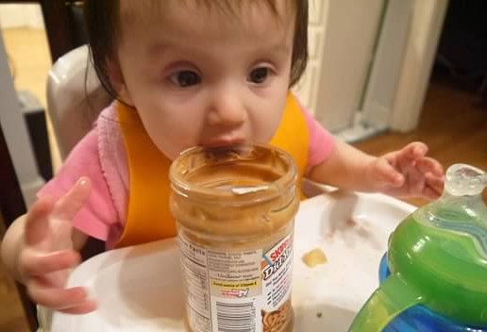
Prevention of Food Allergy
Past guidelines suggested delaying introduction of allergenic foods, often after 1 year of age
However, newer research has shown that early introduction of allergens from 4-6 months of age is safe and may decrease the incidence of food allergy.¹⁻³
Current guidelines and expert panel reports recommend early introduction of allergenic foods.¹⁻²
¹Fleischer DM, et al. J Allergy Clin Immunol Pract. 2021 Jan;9(1):22-43.e4
²Togias A, et al. Ann Allergy Asthma Immunol. 2017 Feb;118(2):166-173.
³Du Toit G, et al. N Engl J Med 2015;372:803-813
Notes:
The NIH guidelines and updates are specific to peanut allergy. The Du Toit article is the “LEAP” article.
In the LEAP article, the effect was much greater in those that actually ate peanut 3 times per week (the per-protocol analysis), than in all comers who were randomized (the intention-to-treat analysis).

Slide 50
Guidelines May Differ in the Approach
2017 National Institute of Allergy and Infectious Diseases-sponsored expert panel¹
Infant Criteria | Recommendations | Earliest Age of Peanut Introduction
Severe eczema, egg allergy, or both | Strongly consider evaluation by sIgE measurement and/or SPT and, if necessary, an OFC. Based on test results, introduce peanut-containing foods. | 4-6 months of age
Mild-to-moderate eczema | Introduce peanut containing foods | Around 6 months
No history of eczema or food allergy | Introduce peanut containing foods | Age appropriate and in accordance with family preferences and cultural practices
2021 North American Consensus Approach to Early Introduction²
Introduce peanut-containing products to all infants, irrespective of their relative risk of developing peanut allergy, starting around 6 months of life, though not before 4 months of life.
Once peanut is introduced, regular ingestion should be maintained.
¹Togias A, et al. Ann Allergy Asthma Immunol. 2017 Feb;118(2):166-173.
²Fleischer DM, et al. J Allergy Clin Immunol Pract.
Notes:
The NIAID guidelines suggest a more cautious approach with screening based upon risk. This method has been difficult to employ and screening has not been shown to be helpful.
The North American Consensus is not a guideline per se, but offers options based on patient and provider preference and allows for a non-screening based introduction approach.

Slide 51
Take-Home Points
Notes:
No notes.

Slide 52
Summary
Food allergy is reported to affect up to 10% of the US population
Diagnosis relies mostly on history, with testing providing supportive information
Therapies for food allergy can include avoidance, OIT, omalizumab; and a shared-decision making approach should be undertaken
Newer therapies (EPIT, SLIT, biologics) are also currently being investigated.
Notes:
No notes.

Slide 53
Approach to Patients Presenting with Concern for Food Allergy
If history & time course is highly suspicious for a food allergy, recommend avoidance of identified triggers.
Targeted testing can be performed to only suspected foods (panel testing should NOT be done).
Provide guidance for allergen avoidance, prescribe epinephrine device and educate on recognition and management of allergic reactions
Refer to an allergist for assistance in confirming the diagnosis, evaluation and counseling, and discussion of therapeutic options.
Notes:
Take home points:
A detailed history of allergen exposure and reaction is important.
A dietary history is necessary as well - if the patient is eating the food without reactions, he/she is by definition not allergic to that food, so do not test tolerated food.
Indiscriminate testing results in false positives and results in unnecessary food avoidance and burden/stress on the patient/family.

Slide 54
Additional Resources
For Patients: https://acaai.org/allergies/anaphylaxis
Patient Video: Introducing peanut-containing foods to prevent peanut allergy
Early Peanut Introduction Partnership Website
COLA: Update on Food Allergy
Notes:
No notes.

Slide 55
References
American College of Allergy, Asthma & Immunology. (2024, October) Food Allergy eYardstick.
NIAID-Sponsored Expert Panel; Boyce JA, Assa'ad A, Burks AW, Jones SM, Sampson HA, Wood RA, Plaut M, Cooper SF, Fenton MJ, Arshad SH, Bahna SL, Beck LA, Byrd-Bredbenner C, Camargo CA Jr, Eichenfield L, Furuta GT, Hanifin JM, Jones C, Kraft M, Levy BD, Lieberman P, Luccioli S, McCall KM, Schneider LC, Simon RA, Simons FE, Teach SJ, Yawn BP, Schwaninger JM. Guidelines for the diagnosis and management of food allergy in the United States: report of the NIAID-sponsored expert panel. J Allergy Clin Immunol. 2010 Dec;126(6 Suppl):S1-58. doi: 10.1016/j.jaci.2010.10.007. PMID: 21134576; PMCID: PMC4241964.
Sampson HA. Update on food allergy. J Allergy Clin Immunol. 2004 May;113(5):805-19; quiz 820. doi: 10.1016/j.jaci.2004.03.014. PMID: 15131561.
Chapman, Jean A. et al. Food allergy: a practice parameter. Annals of Allergy, Asthma & Immunology. 2006 March; 96:S51-S68
Sicherer SH. Clinical implications of cross-reactive food allergens. J Allergy Clin Immunol. 2001 Dec;108(6):881-90. doi: 10.1067/mai.2001.118515. PMID: 11742262.
Ortolani C, Pastorello EA, Farioli L, Ispano M, Pravettoni V, Berti C, Incorvaia C, Zanussi C. IgE-mediated allergy from vegetable allergens. Ann Allergy. 1993 Nov;71(5):470-6. PMID: 8250353.
Gupta RS, Springston EE, Warrier MR, Smith B, Kumar R, Pongracic J, Holl JL. The prevalence, severity, and distribution of childhood food allergy in the United States. Pediatrics. 2011 Jul;128(1):e9-17. doi: 10.1542/peds.2011-0204. Epub 2011 Jun 20. PMID: 21690110.
Notes:
No notes.

Slide 56
References
Gupta RS, Warren CM, Smith BM, Jiang J, Blumenstock JA, Davis MM, Schleimer RP, Nadeau KC. Prevalence and Severity of Food Allergies Among US Adults. JAMA Netw Open. 2019 Jan 4;2(1):e185630. doi: 10.1001/jamanetworkopen.2018.5630. PMID: 30646188; PMCID: PMC6324316.
Branum AM, Lukacs SL. Food allergy among U.S. children: trends in prevalence and hospitalizations. NCHS Data Brief. 2008 Oct;(10):1-8. PMID: 19389315.
Gupta RS, Warren CM, Smith BM, Blumenstock JA, Jiang J, Davis MM, Nadeau KC. The Public Health Impact of Parent-Reported Childhood Food Allergies in the United States. Pediatrics. 2018 Dec;142(6):e20181235. doi: 10.1542/peds.2018-1235. Epub 2018 Nov 19. Erratum in: Pediatrics. 2019 Mar;143(3):e20183835. doi: 10.1542/peds.2018-3835. PMID: 30455345; PMCID: PMC6317772.
Gupta R, Holdford D, Bilaver L, Dyer A, Holl JL, Meltzer D. The economic impact of childhood food allergy in the United States. JAMA Pediatr. 2013 Nov;167(11):1026-31. doi: 10.1001/jamapediatrics.2013.2376. Erratum in: JAMA Pediatr. 2013 Nov;167(11):1083. PMID: 24042236.
Savage J, Sicherer S, Wood R. The Natural History of Food Allergy. J Allergy Clin Immunol Pract. 2016 Mar-Apr;4(2):196-203; quiz 204. doi: 10.1016/j.jaip.2015.11.024. PMID: 26968958.
Nowak-Wegrzyn A, Assa'ad AH, Bahna SL, Bock SA, Sicherer SH, Teuber SS; Adverse Reactions to Food Committee of American Academy of Allergy, Asthma & Immunology. Work Group report: oral food challenge testing. J Allergy Clin Immunol. 2009 Jun;123(6 Suppl):S365-83. doi: 10.1016/j.jaci.2009.03.042. PMID: 19500710.
Perry TT et al. Risk of oral food challenges. J Allergy Clin Immunol 2004;114:144-149.
Notes:
No notes.

Slide 57
References
Kelso JM. Unproven Diagnostic Tests for Adverse Reactions to Foods. J Allergy Clin Immunol Pract. 2018 Mar-Apr;6(2):362-365. doi: 10.1016/j.jaip.2017.08.021. PMID: 29524991.
Sindher SB, Hillier C, Anderson B, Long A, Chinthrajah RS. Treatment of food allergy: Oral immunotherapy, biologics, and beyond. Ann Allergy Asthma Immunol. 2023 Jul;131(1):29-36. doi: 10.1016/j.anai.2023.04.023. Epub 2023 Apr 25. PMID: 37100276; PMCID: PMC10330596.
Greenhawt M, Marsh R, Gilbert H, Sicherer S, DunnGalvin A, Matlock D. Understanding caregiver goals, benefits, and acceptable risks of peanut allergy therapies. Ann Allergy Asthma Immunol. 2018 Nov;121(5):575-579. doi: 10.1016/j.anai.2018.06.018. Epub 2018 Jun 27. PMID: 29940310.
Burks AW, Jones SM, Wood RA, Fleischer DM, Sicherer SH, Lindblad RW, Stablein D, Henning AK, Vickery BP, Liu AH, Scurlock AM, Shreffler WG, Plaut M, Sampson HA; Consortium of Food Allergy Research (CoFAR). Oral immunotherapy for treatment of egg allergy in children. N Engl J Med. 2012 Jul 19;367(3):233-43. doi: 10.1056/NEJMoa1200435. PMID: 22808958; PMCID: PMC3424505.
Vickery BP, Scurlock AM, Kulis M, Steele PH, Kamilaris J, Berglund JP, Burk C, Hiegel A, Carlisle S, Christie L, Perry TT, Pesek RD, Sheikh S, Virkud Y, Smith PB, Shamji MH, Durham SR, Jones SM, Burks AW. Sustained unresponsiveness to peanut in subjects who have completed peanut oral immunotherapy. J Allergy Clin Immunol. 2014 Feb;133(2):468-75. doi: 10.1016/j.jaci.2013.11.007. Epub 2013 Dec 19. PMID: 24361082; PMCID: PMC3960331.
U.S. Food and Drug Administration. (2024, April). Food Allergies. U.S. Department of Health and Human Services.
Notes:
No notes.

Slide 58
References
Fleischer DM, Perry TT, Atkins D, Wood RA, Burks AW, Jones SM, Henning AK, Stablein D, Sampson HA, Sicherer SH. Allergic reactions to foods in preschool-aged children in a prospective observational food allergy study. Pediatrics. 2012 Jul;130(1):e25-32. doi: 10.1542/peds.2011-1762. Epub 2012 Jun 25. PMID: 22732173; PMCID: PMC3382915.
Centers for Disease Control and Prevention. August 2022. Voluntary guidelines for managing food allergies in schools and early care and education programs.
Bartnikas LM, Huffaker MF, Sheehan WJ, Kanchongkittiphon W, Petty CR, Leibowitz R, Hauptman M, Young MC, Phipatanakul W. Impact of school peanut-free policies on epinephrine administration. J Allergy Clin Immunol. 2017 Aug;140(2):465-473. doi: 10.1016/j.jaci.2017.01.040. Epub 2017 Mar 25. PMID: 28347736; PMCID: PMC5546995.
Greenhawt M. Environmental exposure to peanut and the risk of an allergic reaction. Ann Allergy Asthma Immunol. 2018 May;120(5):476-481.e3. doi: 10.1016/j.anai.2018.03.011. Epub 2018 Mar 16. PMID: 29555352.
Simonte SJ, Ma S, Mofidi S, Sicherer SH. Relevance of casual contact with peanut butter in children with peanut allergy. J Allergy Clin Immunol. 2003 Jul;112(1):180-2. doi: 10.1067/mai.2003.1486. PMID: 12847496.
Johnson RM, Barnes CS. Airborne concentrations of peanut protein. Allergy Asthma Proc. 2013 Jan-Feb;34(1):59-64. doi: 10.2500/aap.2013.34.3622. PMID: 23406937.
Fleischer DM, Chan ES, Venter C, Spergel JM, Abrams EM, Stukus D, Groetch M, Shaker M, Greenhawt M. A Consensus Approach to the Primary Prevention of Food Allergy Through Nutrition: Guidance from the American Academy of Allergy, Asthma, and Immunology; American College of Allergy, Asthma, and Immunology; and the Canadian Society for Allergy and Clinical Immunology. J Allergy Clin Immunol Pract. 2021 Jan;9(1):22-43.e4. doi: 10.1016/j.jaip.2020.11.002. Epub 2020 Nov 26. PMID: 33250376.
Notes:
No notes.

Slide 59
References
Togias A, Cooper SF, Acebal ML, Assa'ad A, Baker JR Jr, Beck LA, Block J, Byrd-Bredbenner C, Chan ES, Eichenfield LF, Fleischer DM, Fuchs GJ 3rd, Furuta GT, Greenhawt MJ, Gupta RS, Habich M, Jones SM, Keaton K, Muraro A, Plaut M, Rosenwasser LJ, Rotrosen D, Sampson HA, Schneider LC, Sicherer SH, Sidbury R, Spergel J, Stukus DR, Venter C, Boyce JA. Addendum guidelines for the prevention of peanut allergy in the United States: Report of the National Institute of Allergy and Infectious Diseases-sponsored expert panel. Ann Allergy Asthma Immunol. 2017 Feb;118(2):166-173.e7. doi: 10.1016/j.anai.2016.10.004. Epub 2017 Jan 5. PMID: 28065802.
Du Toit G, Roberts G, Sayre PH, Bahnson HT, Radulovic S, Santos AF, Brough HA, Phippard D, Basting M, Feeney M, Turcanu V, Sever ML, Gomez Lorenzo M, Plaut M, Lack G; LEAP Study Team. Randomized trial of peanut consumption in infants at risk for peanut allergy. N Engl J Med. 2015 Feb 26;372(9):803-13. doi: 10.1056/NEJMoa1414850. Epub 2015 Feb 23. Erratum in: N Engl J Med. 2016 Jul 28;375(4):398. doi: 10.1056/NEJMx150044. PMID: 25705822; PMCID: PMC4416404.
Notes:
No notes.

