Slide 1
Food Allergy Diagnosis and Management
This program was developed by American College of Allergy, Asthma & Immunology with grant support from DBV Technologies
Notes:
No notes.

Slide 2
Presented by
Insert presenter name here
Authors
Jay Lieberman, MD, FACAAI, Associate Professor of Pediatrics, University of Tennessee Health Science Center and LeBonheur Children’s Hospital
Daniel Petroni, MD, PhD, Executive Director Seattle Allergy & Asthma Research Institute and the Northwest Food Allergy Treatment & Research Center
Julie Wang, MD, FACAAI, Professor of Pediatrics, Jaffe Food Allergy Institute Icahn School of Medicine at Mount Sinai
Notes:
Note: Speaker can insert their name above.

Slide 3
Learning objectives
Identify patients who should be evaluated for food allergy
Select appropriate tests to diagnose food allergy
Formulate a food allergy management plan
Discuss potential treatments for food allergy
Notes:
No notes.

Slide 4

What is a food allergy?
Food allergy is an adverse health effect arising from a specific immune response that occurs reproducibly on exposure to a given food.
This reaction can be IgE-mediated, non IgE-mediated or mixture of both that results in clinical symptomatology.
Notes:
Food allergies are adverse immune reactions to food proteins that can lead to a range of symptoms.
The exposure with clinical reaction is the key point here. Food Allergy Testing determines sensitivity, and does not diagnose food allergy.

Slide 5
Immunologic food reactions
IgE-Mediated
Non IgE-Mediated
Systemic allergic reaction (Anaphylaxis)
Oral Allergy Syndrome
Eosinophilic esophagitis (EoE)
Eosinophilic gastritis
Eosinophilic gastroenteritis
Atopic dermatitis
Food Protein-Induced Enterocolitis (FPIES)
Protein-Induced Enteropathy
Eosinophilic proctocolitis
Dermatitis herpetiformis
Contact dermatitis
Sampson H. J Allergy Clin Immunol 2004;113:805-9
Chapman J et al. Ann Allergy Asthma & Immunol 2006;96:S51-68.
Notes:
The key disorders to point out are:
FPIES – Generally presents in infancy and is characterized by delayed vomiting 2-3 hours post ingestion.
Milk is the most common trigger in children, followed by soy.
FPIES can also be triggered by solid foods – rice and oat are the most common triggers for solid food FPIES.
EoE – Chronic, immune/antigen-mediated esophageal disease.
Characterized clinically by symptoms related to esophageal dysfunction
and histologically by eosinophil-predominant inflammation.
Most common trigger in children is milk.
Younger children most often present with vomiting, growth failure
and food refusal.
For older patients, dysphagia, impaction and heartburn are more often reported.

Slide 6
IgE-mediated food allergy
IgE-mediated food allergy reaction often occurs within minutes to 2 hours of
ingesting a food
Reactions can range from mild to severe (anaphylaxis)
Symptoms include:
Cutaneous | urticaria, angioedema, pruritus, flushing, rash
Respiratory | upper airway → rhinitis, stridor, hoarseness, sneezing lower airway → cough, wheeze, dyspnea, cyanosis
Cardiovascular | vasodilation, tachycardia, arrhythmia, hypotension, shock
Gastrointestinal | swelling of lips/tongue, palatal itch, nausea, vomiting, abdominal cramps, diarrhea
Neurologic | anxiety, headache, seizure, LOC
Notes:
This talk will focus on IgE-mediated food allergies.

Slide 7
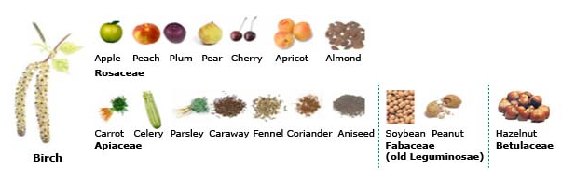










Oral Allergy Syndrome or
Pollen-Food Allergy Syndrome
The reaction is due to cross reactivity with the fruit, vegetable, seed or nut with a corresponding pollen
Symptoms are generally mild and limited to the oropharynx
In rare cases, systemic reactions can occur
Management: avoidance of the raw food, but cooked versions are well-tolerated
Apple
Peach
Plum
Pear
Cherry
Apricot
Almond
Peanut
Hazelnut
Rosaceae
Fabaceae
(old Leguminosae)
Betulaceae
Birch
Sicherer SH. Clinical implications of cross-reactive food allergens. J Allergy Clin Immunol 2001; 108:881.
Notes:
Oral allergy syndrome is also an IgE-mediated allergy that is due to cross-reacting, homologous proteins between pollens and food proteins. Symptoms are triggered by fresh fruits and vegetables. Commonly associated foods with birch tree pollen are shown in the figure.
Symptoms are mild, and localized to the oropharynx; typical symptoms include lip/mouth itching, and swelling. However, systemic reactions can occur. In a study of 706 patients with OAS, 2.1% of individuals experienced anaphylaxis. [Ortolani C, Pastorello EA, Farioli L, et al. IgE-mediated allergy from vegetable allergens. Ann Allergy 1993 Nov;71(5):470-6.]
Management
Patients are advised to avoid the raw fruits and/or vegetables that trigger symptoms. Heating the food allergens that trigger OAS denatures the relevant protein, therefore cooked forms of the foods are generally well tolerated. The degree of clinical reactivity can have seasonal variations.

Slide 8
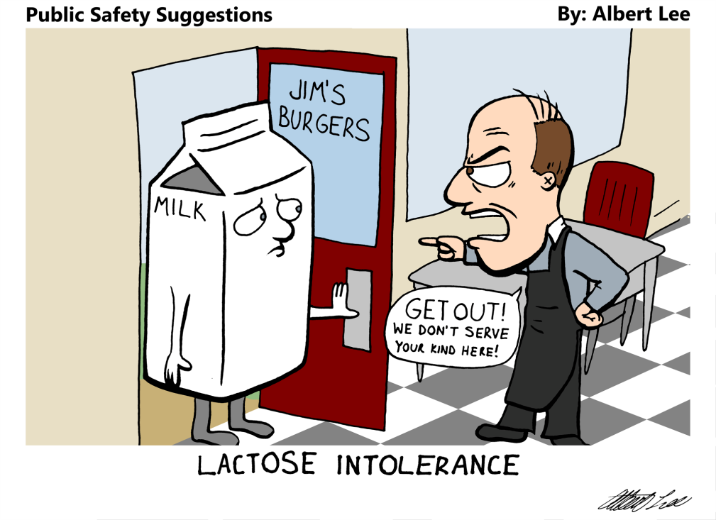
“Food Intolerance”
Term that encompasses non-Immune food reactions.
Complaints variable and can include fatigue, brain fog, GI complaints.
Often delayed symptoms hours to days post consumption
Example: lactose intolerance is due to inability of the body to break down lactose milk sugar leading to increase bloating and GI pain.
Notes:
No notes.

Slide 9
Epidemiology of Food Allergy
Notes:
Going forward, this presentation will focus on IgE-mediated food allergies that are not oral allergy syndrome.

Slide 10
Epidemiology of Food Allergy
Estimated 8% of children and 10% of adults in the US are food allergic
Food allergy prevalence is increasing among children (18% increase from 1997-2007).
Food allergy reactions are common
  42% of children with food allergy report at least 1 lifetime food allergy-related visit to the ED
  19% of children with food allergy report at least 1 food allergy-related ED visit in the last year.
Estimated cost of food allergy is ~$25 billion annually
Similar trends are seen in other countries across the world
Gupta RS, Springston EE, Warrier MR, Smith B, Kumar R, Pongracic J, Holl JL. The prevalence, severity, and distribution of childhood food allergy in the United States. Pediatrics. 2011 Jul;128(1):e9-17.
Gupta RS, Warren CM, Smith BM, Jiang J, Blumenstock JA, Davis MM, Schleimer RP, Nadeau KC. Prevalence and Severity of Food Allergies Among US Adults. JAMA Netw Open. 2019 Jan 4;2(1):e185630.
Branum A, Lukacs S. Food allergy among U.S. children: Trends in prevalence and hospitalizations. National Center for Health Statistics Data Brief. 2008.
Retrieved from http://www.cdc.gov/nchs/data/databriefs/db10.htm 2
Gupta RS et al.The Public Health Impact of Parent-Reported Childhood Food Allergies in the United States. Pediatrics. 2018 Dec;142(6). pii: e20181235. doi: 10.1542/peds.2018-1235. Epub 2018 Nov 19.
Gupta R, Holdford D, Bilaver L, Dyer A, Holl JL, Meltzer D. The economic impact of childhood food allergy in the United States. JAMA Pediatr. 2013 Nov;167(11):1026-31.
Notes:
Surveys of the US population suggest that 8% of children and 10% of adults in the US are food allergic. Prevalence of food allergy appears to be increasing over time.
Food allergic individuals are at risk for allergic reactions – many children with food allergies have needed emergency medical attention to treat food-related allergic reactions. Similar data exists for adults with food allergy.
Food allergy carries a significant financial burden on patients, families and society, with the estimated cost of food allergy nearing $25 billion per year in the US.
Similar trends for food allergy are reported by other countries as well.

Slide 11
Figure 4. Average number of hospital discharges per year among children under age 18 years with any diagnosis related to food allergy: United States, 1998-2006
10,000
¹9,537
8,000
6,000
Average number of discharges per year
4,135
4,000
2,615
2,000
0
1998–2000
2001–2003
2004–2006
Years
¹Statistically significant trend.
SOURCE: CDC/NCHS, National Health Interview Survey
Branum A, Lukacs S. Food allergy among U.S. children: Trends in prevalence and hospitalizations. National Center for Health Statistics Data Brief. 2008. Retrieved from http://www.cdc.gov/nchs/data/databriefs/db10.htm 2
Notes:
Similar to data on ED visits for food allergic reactions, increased hospitalizations for food allergy have been reported in recent years.
This bar graph shows the prevalence of hospital discharges with diagnosis of food allergy from late 1990’s to mid 2000’s.

Slide 12
Estimated Prevalence in US Children
Any Food Allergy | 7.6%
Peanut | 2.2%
Tree nut | 1.2%
Milk | 1.9%
Shellfish | 1.3%
Egg | 0.9%
Fin fish | 0.6%
Wheat | 0.5%
Soy | 0.5%
Sesame | 0.2%
An estimated 39.9% of food allergic children have multiple food allergies.
Gupta RS et al.The Public Health Impact of Parent-Reported Childhood Food Allergies in the United States.
Pediatrics. 2018 Dec;142(6). pii: e20181235. doi: 10.1542/peds.2018-1235. Epub 2018 Nov 19.
Notes:
The most common food allergens causing reactions in children include:
milk
egg
peanuts
tree nuts
wheat
soy
fish, and
shellfish
Sesame is increasingly an issue as well.
In this study, the prevalence in children of peanut allergy has increased in 2018 to 2.2%. The same group in 2011 was 2.0%, and in 2008 Sicherer et al.’s had an estimated 1.4%.

Slide 13
Natural History of Food Allergy
Allergen | Age of Diagnosis | Outgrowth? | Notes
Milk | Infant/toddler | Early to late childhood ~50% by age 5 yrs | Exposure to extensively heated milk may be safely tolerated before uncooked milk and may hasten development of tolerance to milk.
Egg | Infant/toddler | Early to late childhood ~50% by age 6 yrs | Exposure to extensively heated egg may be safely tolerated before cooked egg and may hasten development of tolerance to cooked egg
Peanut | Infant/toddler | Uncommon, ~20%
Tree nuts | Toddler/early childhood | Uncommon, ~10%
Wheat | Infant/toddler | Early to late childhood, ~50% by age 7 yrs
Savage J1, Sicherer S2, Wood R3. The Natural History of Food Allergy. J Allergy Clin Immunol Pract. 2016 Mar-Apr;4(2):196-203; quiz 204.
doi: 10.1016/j.jaip.2015.11.024.
Notes:
The majority of children outgrow their allergy to milk, egg, wheat and soy. However, allergies to peanut, tree nuts, fish and shellfish often persist into adulthood.
Therefore, the most common food allergens for adults are peanut, tree nuts, fish and shellfish.
For some individuals, food allergies do not develop until adulthood.

Slide 14
Diagnosis of IgE-Mediated Food Allergy
Notes:
No notes.

Slide 15

Diagnosis of Food Allergy begins with the History
Symptoms within minutes to a few hours of ingesting a food, especially if it is reproducible
Symptoms can include
  Skin – itching, hives, flushing, swelling (Most common)
  Mouth – itching, swelling lips and/or tongue
  Throat – itching, tightness/closure, hoarseness
  GI – immediate vomiting, diarrhea, cramps
  Lung – wheezing, cough, shortness of breath
  CV – hypotension, tachycardia
Boyce J, Assa'ad A, Burks AW, et al. Guidelines for the diagnosis and management of food allergy in the United States: report of the NIAID-sponsored expert panel. J Allergy Clin Immunol 2010;125(6Suppl):S1-58.
Notes:
History is the most important factor in the diagnosis of food allergy. Symptoms of IgE-mediated food allergy generally develop quickly, within minutes to 2 hours after ingestion. If a specific allergen has triggered symptoms on multiple occasions, then the suspicion for allergy to that food is high.
Allergy symptoms are variable and can affect any body system. Skin symptoms are most commonly seen, though are not seen with every allergic reaction. Symptoms can also affect the mouth, throat, gastrointestinal tract, lung and cardiovascular system.

Slide 16
Associating allergen exposure and symptoms
Timing of ingestion and onset of symptoms
Type and quantity of food that triggered the reaction
Prior exposures to the trigger or related foods
Association of additional factors such as exercise and concurrent medications
EXPOSURE
SYMPTOMS
Boyce J, Assa'ad A, Burks AW, et al. Guidelines for the diagnosis and management of food allergy in the United States: report of the NIAID-sponsored expert panel. J Allergy Clin Immunol 2010;125(6Suppl):S1-58.
Notes:
Information regarding timing of ingestion to the onset of symptoms, types of signs and symptoms, type and quantity of food that triggered the reaction, prior exposures to the trigger or related foods, and association of additional factors such as exercise and concurrent medications should be obtained.
A history of symptoms with exposures to the triggering food and lack of symptoms with exclusion of the food is highly suggestive of allergy. Based on the history, selected foods are evaluated by skin prick testing or serum specific IgE testing.

Slide 17
Unlikely to be Food Allergy
Hives that last more than a few hours (especially over 24 hours) or recurrent over several days
Reactions that occur only sporadically when the patient eats the food (not every exposure)
Headaches (migraines), hyperactivity, mood changes
Chronic nasal congestion or rhinorrhea
Notes:
Approximately 20% of people believe they have food allergy, but only about half have true allergies.
Here are some examples of concerns that are unlikely to be food allergy.
Food allergy reactions generally do not manifest as hives that persist for many hours or multiple days, without repeat allergen exposure.
Food allergies are reproducible such that every exposure to the allergen trigger should trigger symptoms, though the exact symptoms or severity of symptoms may vary with each exposure.
Headaches, hyperactivity, mood changes, chronic nasal congestion or rhinorrhea are unlikely to be signs of food allergy.

Slide 18
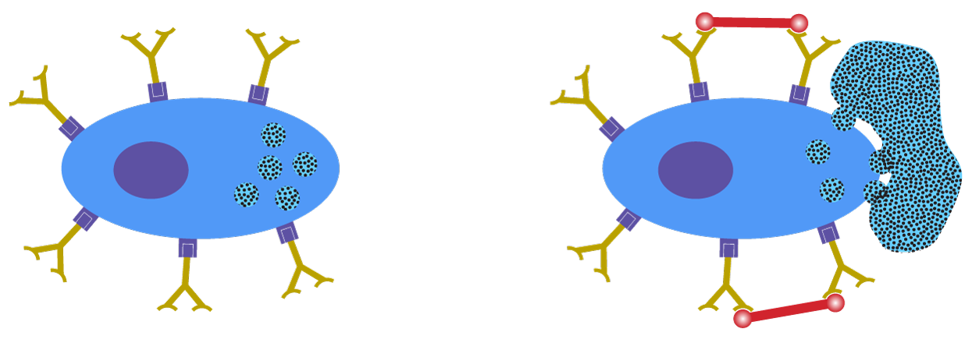
Pathophysiology: Definition
allergen
IgE antibody
effector cell
allergen
Pathophysiology: IgE production in response to allergen exposure, allergen cross-links IgE on surface of mast cells and basophils leading to release of mediators
allergen
effector cell
igE Antibody
allergen
Notes:
Binding of food allergens by specific IgE on effector cells, such as basophils and mast cells, leads to degranulation and mediator release (i.e. histamine, tryptase, cysteinyl leukotrienes, prostaglandin D₂), causing a variety of symptoms seen in allergic reactions.

Slide 19
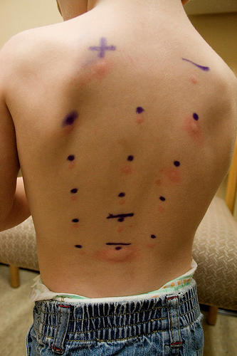
Diagnostic Testing
Both skin prick testing and specific allergen IgE are tools to show IgE mediated sensitivity to a particular food.
They do not predict severity of reactions or the dose of allergen that could trigger reactions
Notes:
If the history and physical examination are consistent with IgE-mediated food allergy, skin prick testing and/or serum allergen-specific IgE testing can be performed to support the diagnosis.
Both tests provide an indication of the likelihood of allergic reaction with exposure to the food allergen. The results of these tests do not predict the severity of reactions that may occur as a result of allergen exposures.
These tests have high negative predictive values (NPV >95%), so negative tests largely exclude a specific IgE-mediated food allergy.

Slide 20
NIAID Guidelines for the diagnosis of food allergy
Guideline 4: The EP recommends performing an skin prick test to assist in the identification of foods that may be provoking IgE-mediated food-induced allergic reactions, but the skin prick test alone cannot be considered diagnostic of food allergy.
Guideline 7: The EP recommends specific IgE tests for identifying foods that potentially provoke IgE-mediated food-induced allergic reactions, but alone these tests are not diagnostic of food allergy.
Boyce et al. J Allergy Clin Immunol 2010
Notes:
While these are useful tests, we know that they are not perfect. The positive predictive value (PPV) is <50% for these tests, therefore a positive test in isolation without a clinical history is not diagnostic for food allergy. Test results need to be taken in the context of history, as cross-reactivity between proteins can give positive IgE test results that may not be clinically relevant.

Slide 21
Oral Food Challenge
The current gold standard for the diagnosis of food allergy is a Double Blind Placebo Controlled Food Challenge
These must be performed at centers that comfortable with handling anaphylaxis.
Reasons for food challenges
  1. Determine whether the wrong food is suspected as the cause of symptoms.
  2. Prove that a food is NOT the cause of symptoms.
  3. Verify whether a patient has outgrown food allergies.
  4. Discover the degree of sensitivity.
The decision to undergo food challenge is a combination of history and diagnostic testing (SPT/immunoCAP)**
Nowak-Wegrzyn A, Assa'ad AH, Bahna SL, Bock SA, Sicherer SH, Teuber SS; Adverse Reactions to Food Committee of American Academy of Allergy, Asthma & Immunology. Work Group report: oral food challenge testing. J Allergy Clin Immunol. 2009 Jun;123(6 Suppl):S365-83.
Perry T.T., Matsui E.C., Kay Conover-Walker M., and Wood R.A.: The relationship of allergen-specific IgE levels and oral food challenge outcome. J Allergy Clin Immunol 2004; 114: pp. 144-149
Notes:
When history and skin prick/IgE testing do not provide a diagnosis with high certainty, a food challenge should be performed. Because of the risk for severe allergic reaction (anaphyalxis) during food challenges, this procedure should be performed in settings where medical staff and equipment are readily available.
The gold standard for the diagnosis of food allergy is a double-blind, placebo-controlled oral food challenge – the allergen in question is gradually fed in increasing doses under medical supervision.
**Among children with peanut-specific IgE levels of less than 5kUA/L, 77% tolerated peanut at food challenge if their peanut allergy diagnosis was made on the basis of sensitization only, whereas none of the patients who had confirmed history of reacting to peanut with similar peanut-specific IgE levels passed a food challenge.

Slide 22
Additional diagnostic tests:
Component testing
Assess IgE binding to individual proteins within a food
May increase diagnostic accuracy
May provide indicators for severity or persistence of allergy
Example: peanut components
Allergen | Protein characteristics
Ara h 1 | Seed storage protein, stable to heating, major allergen
Ara h 2 | Seed storage protein, stable to heating, major allergen
Ara h 3 | Seed storage protein, stable to heating, major allergen
Ara h 6 | Ara h 2 homologue
Ara h 8 | Bet v 1 (birch tree pollen) homologue; heat labile
Ara h 9 | Lipid transfer protein, associated with more severe symptoms as well as oral symptoms in the Mediterranean area
Notes:
Recent advances in the identification of relevant allergens, and the development of recombinant proteins now allow us to assess IgE binding to individual proteins within a food. This is known as component testing.
The hope is that this testing may have increased sensitivity and specificity, and thus diagnostic accuracy. This may assist in the decision-making process to decrease the need for food challenges. And, perhaps provide prognostic information regarding the severity or persistence of the food allergy.
Peanut protein components that are currently available for testing by diagnostic laboratories are listed. Some studies suggest that having elevated IgE levels to specific components are more predictive of allergy, however, there is no consensus at this time for how these tests should be interpreted or cutoff levels.

Slide 23
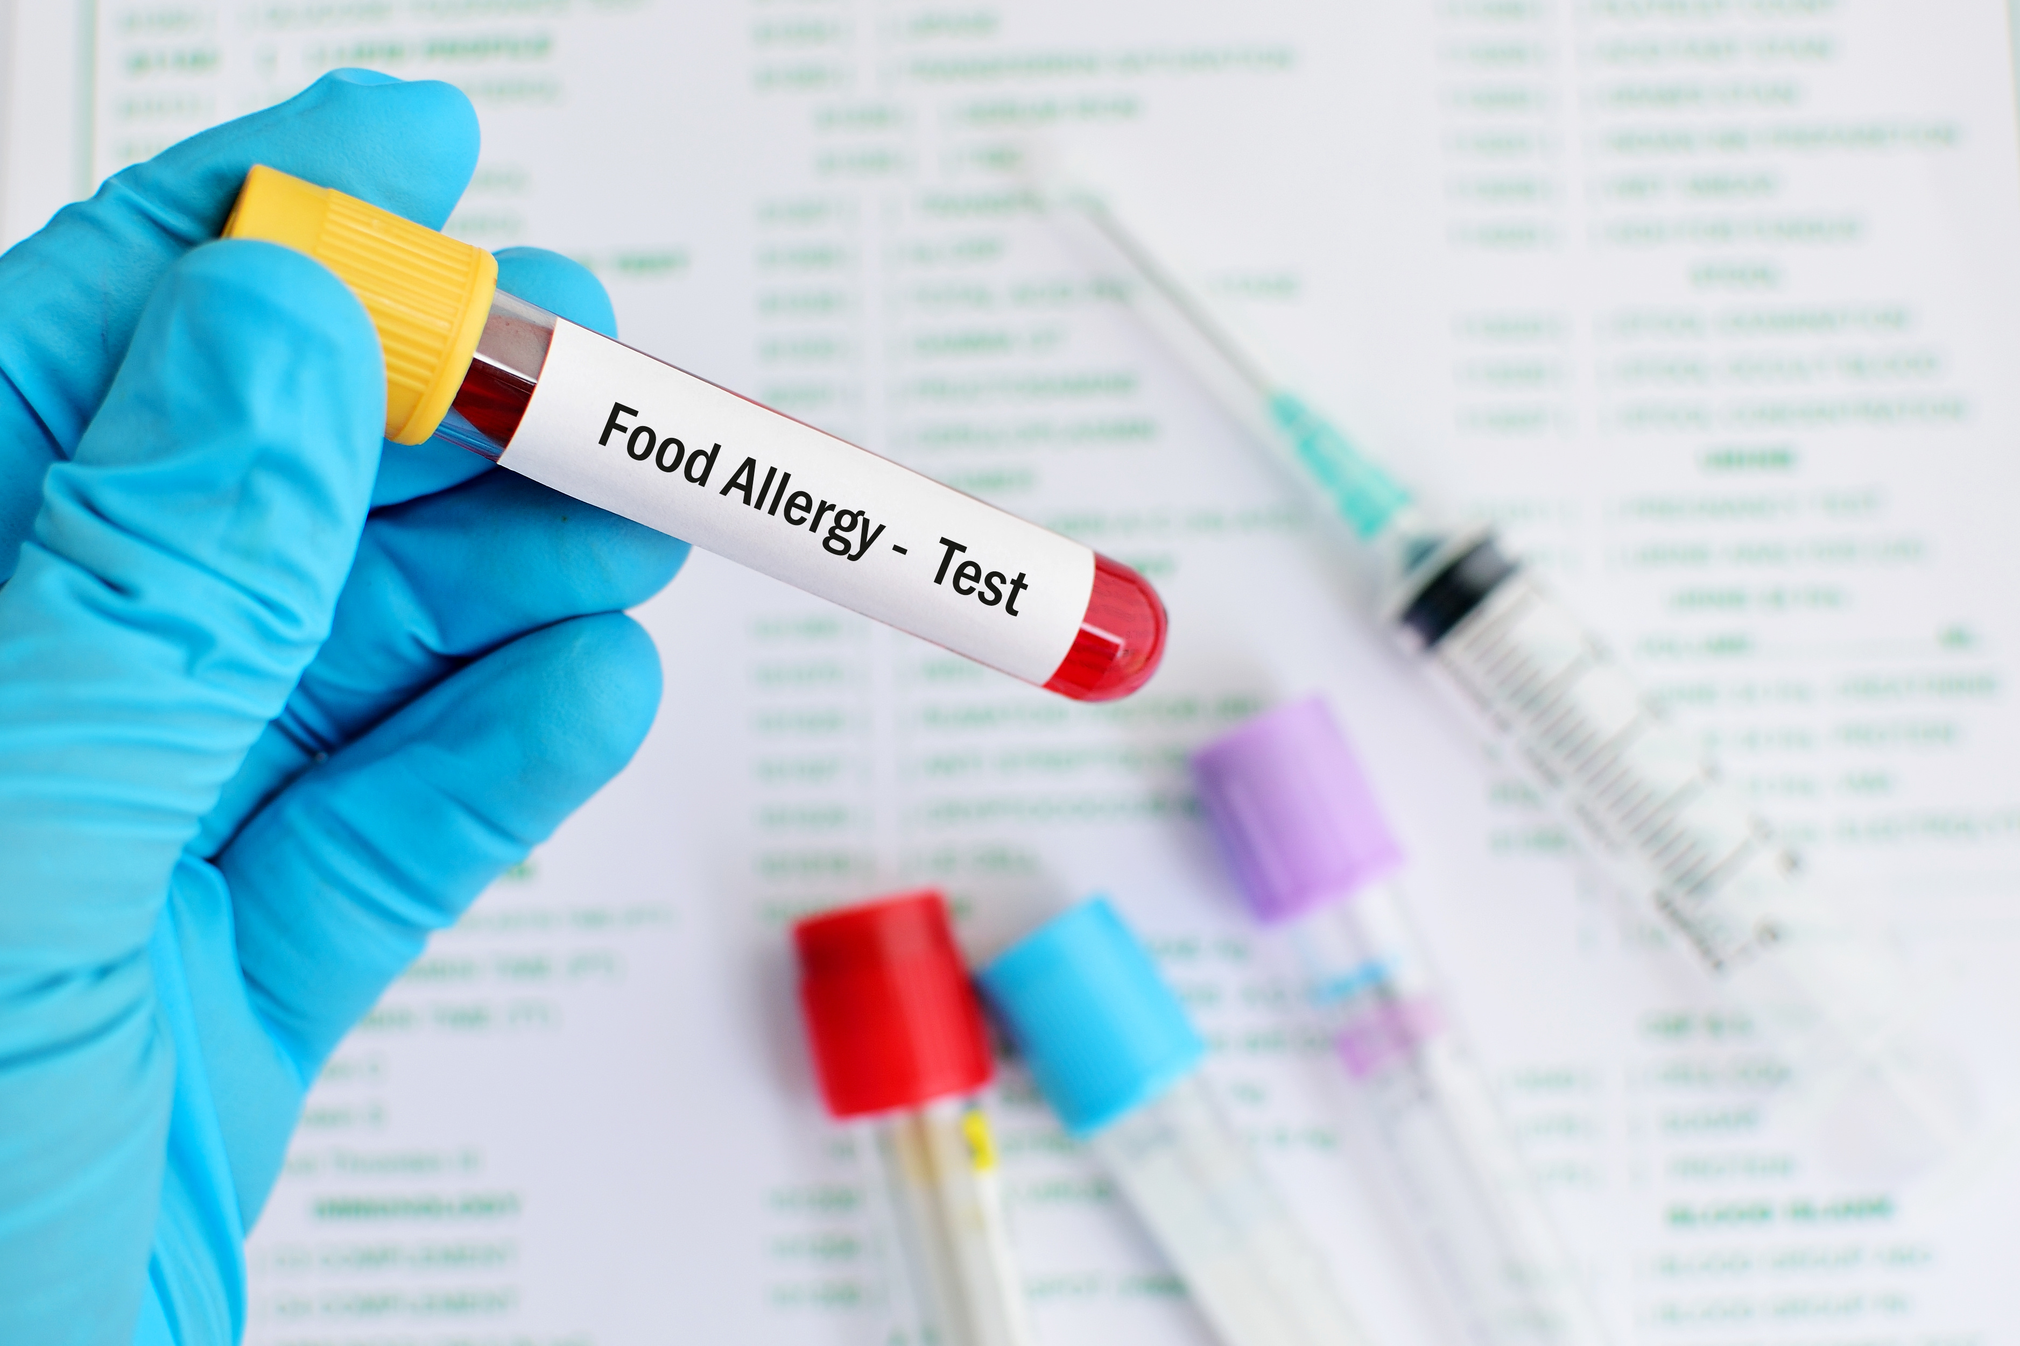
Unproven tests for Food Allergy
These are not recommended in the evaluation of food allergy.
  IgG testing
  Provocation-neutralization testing
  ALCAT
  Electrodermal testing
  Applied kinesiology
Kelso JM. Unproven Diagnostic Tests for Adverse Reactions to Foods. J Allergy Clin Immunol Pract. 2018 Mar - Apr;6(2):362-365.
doi: 10.1016/j.jaip.2017.08.021.
Notes:
These tests are not proven or disproven for food allergy diagnosis. Given the lack of scientific support for these tests, patients should be counseled against pursuing these tests, as well as the potential risks of dietary modification based on these tests.

Slide 24
Management of Food Allergy
Notes:
No notes.

Slide 25


Avoidance
Currently, there are no FDA approved therapies for the treatment of food allergies
Guidelines recommend avoidance of allergens and treatment for any suspected allergic reactions.
Patients and Parents/Families of patients should be provided education and resources to aid in avoidance.
  Education and resources on supplementation may be needed depending on the types and numbers of foods to be avoided
    e.g. vitamin D and calcium in milk allergic infants
Boyce JA, et al. J Allergy Clin Immunol. 2010 Dec;126(6 Suppl):S1-58.
This Photo by Unknown Author is licensed under CC BY-SA
Notes:
These recommendations are in line with the current “Guidelines for the Diagnosis and Management of Food Allergy in the United States: Report of the NIAID-Sponsored Expert Panel”.
Education on avoidance measures can be found on the ACAAI website (acaai.org) for those wishing to know more information.

Slide 26
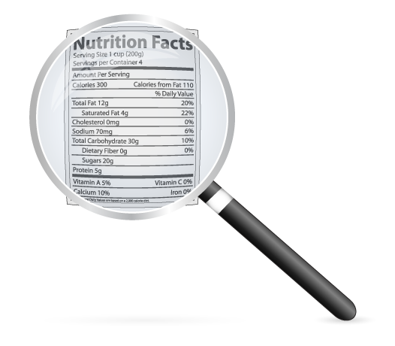
Label reading
Food Allergen Labeling and Consumer Protection Act (FALCPA)
  Passed by the US Congress in 2004
  Identifies 8 major food allergens estimated to account for 90%
  of reactions
    Milk, egg, peanut, tree nuts, soy, wheat, fish, and shellfish
    Sesame is under consideration for being added
  These allergens must be listed in bold letters underneath
  the ingredient list
  Food labeling laws differ around the globe:
    EU includes top 8 allergens + sesame, celery, mustard, lupine,
    and mollusks
    Canada includes top 8 allergens + sesame, mustard, and mollusks
Notes:
Currently, the FDA is seeking input on sesame allergy (prevalence and severity) in order to decide whether this should be included as the 9th.
The food allergen should also be listed in the ingredients, however the name may be different (such as casein instead of “milk”). Thus, the labeling in bold letters below the ingredients is meant to be as clear as possible.

Slide 27
Precautionary Labeling
Precautionary labeling includes statements such as ‘‘may contain”, “processed in a facility with”, “made on equipment with”, etc.
Use of precautionary labeling is voluntary
FALCPA does not currently regulate precautionary labeling disclaimers
Whether avoidance of products with these disclaimers
is warranted is debatable
  While the risk of reaction to these products is likely low, there is
  some risk
Notes:
Some researchers have tried to established thresholds, such as the eliciting dose that would cause 10% of allergic patients to react. This would help to better define how to label these products. However, thresholds have not yet been defined.

Slide 28
Precautionary Labeling
Studies have examined protein content in packages with these labels and found detectable levels of allergen in packaged products that contain precautionary labels.
Allergens were also detectable in some products that did not have allergen labeling or precautionary labeling on the package.
 | Precautionary Label | No allergen declared
Milk | 10.2% | 3.0%
Egg | 1.8% | 2.6%
Peanut | 4.5% | 0.0%
Ford LS, et al. J Allergy Clin Immunol. 2010 Aug;126(2):384-5
Notes:
Understand that the levels of detection of allergen in these products is arguably lower than the threshold of reaction for >95% of patients. Thus, a discussion of the risks and benefits of avoiding these foods is good to have with patients and families so that they can understand their risks.

Slide 29
Cross-contact/Cross-contamination
Can occur anywhere along the food preparation chain
Can occur at home or at outside eating establishments
  Allergen can be transferred by shared cooking equipment such as cutting boards, knives, pans, grills, fryers
  When eating out, patients should communicate their allergies to relevant staff and co-diners
    Request tables to be cleaned with soap and water or commercial wipes
Higher risk areas
  Buffets or self-serve
  Asian restaurants, bakeries, ice cream shops for nut-allergic patients
  Seafood restaurants for patients allergic to fish and shellfish
Notes:
Cross-contamination can occur on farm equipment, in processing facilities, inside the restaurant, at home, etc. There are no studies that examine each of these situations specifically.

Slide 30

Even with avoidance, reactions occur
  Reaction rate ~ 0.81 reaction/year in children ages 3-15 months in one multicenter study
Patients and Parents/Families should be provided with a written emergency action plan that should detail
  The patients’ allergies
  How to assess allergic reactions
  How to treat allergic reactions
Fleischer DM, et al. Pediatrics. 2012 Jul;130(1):e25-32
Notes:
The Fleischer study followed 512 children, ages 3-15 months, at enrollment with milk and/or egg allergy at 5 sites (New York, NY; Baltimore, MD; Little Rock, AR; Denver, CO; and Durham, NC).
2/3 were sensitized to peanut. They followed them on averaged 35 months. A total of 1171 reactions were reported by 367 (71.7%) subjects.

Slide 31
Examples of action plans can be found and downloaded freely
  https://college.acaai.org/sites/default/files/Resources/anaphylaxisactionplan.pdf
  https://www.aap.org/anaphylaxis
Notes:
Here are examples of action plans that are available for download.

Slide 32

Allergy and Anaphylaxis Emergency Plan
Child’s name: __________________________________ Date of plan: _______________
Date of birth: ____/____/______ Age: ______Weight: _________kg
Child has allergy to: _______________________________________________________
Child has asthma. Yes No (If yes, higher chance severe reaction)
Child has had anaphylaxis. Yes No
Child may carry medicine. Yes No
Child may give him/herself medicine. Yes No (If child refuses/is unable to self-treat, an adult must give medicine)
IMPORTANT REMINDER
Anaphylaxis is a potentially life-threatening, severe allergic reaction. If in doubt, give epinephrine.
Attach
child’s
photo
For Severe Allergy and Anaphylaxis
What to look for
If child has ANY of these severe symptoms after eating the
food or having a sting, give epinephrine.
  Shortness of breath, wheezing, or coughing
  Skin color is pale or has a bluish color
  Weak pulse
  Fainting or dizziness
  Tight or hoarse throat
  Trouble breathing or swallowing
  Swelling of lips or tongue that bother breathing
  Vomiting or diarrhea (if severe or combined with other symptoms)
  Many hives or redness over body
  Feeling of “doom,” confusion, altered consciousness, or agitation
Give Epinephrine!
What to do
Inject epinephrine right away! Note time when epinephrine was given.
Call 911.
  Ask for ambulance with epinephrine.
  Tell rescue squad when epinephrine was given.
Stay with child and:
Call parents and child’s doctor.
Give a second dose of epinephrine, if symptoms get worse, continue, or do not get better in 5 minutes.
Keep child lying on back. If the child vomits or has trouble breathing, keep child lying on his or her side.
Give other medicine, if prescribed. Do not use other medicine in place of epinephrine.
Antihistamine
Inhaler/bronchodilator
SPECIAL SITUATION: If this box is checked, child has an extremely severe allergy to an insect sting or the following food(s):____________________. Even if child
Has MILD symptoms after a sting or eating these foods, give epinephrine.
For Mild Allergic Reaction
What to look for
If child has had any mild symptoms, monitor child.
Symptoms may include:
  Itchy nose, sneezing, itchy mouth
  A few hives
  Mild stomach nausea or discomfort
Monitor Child
What to do
Stay with child and:
  Watch child closely.
  Give antihistamine (if prescribed).
  Call parents and child’s doctor.
  If more than 1 symptom or symptoms of severe allergy/anaphylaxis develop, use epinephrine. (See
  “For Severe Allergy and Anaphylaxis.”)
Medicine/Doses
Epinephrine, intramuscular (list type):________________________________Dose: 0.10 mg (7.5 kg to less than 13 kg)*
0.15 mg (13 kg to less than 25 kg)
0.30 mg (25 kg or more)
Antihistamine, by mouth (type and dose):______________________________ (*Use 0.15 mg, if 0.10 mg is not available)
Other (for example, inhaler/bronchodilator if child has asthma): __________________________________________
_______________________________ ______________ ______________________________ _____________
Parent/Guardian Authorization Signature Date Physician/HCP Authorization Signature Date
© 2017 American academy of Pediatrics, Updated 03/2019. All rights reserved. Your child’s doctor will tell you to do what’s best for your child.
This information should not take the place of talking with your child’s doctor. Page 1 of 2.
Notes:
Here is one example of an emergency plan. This one is from the American Academy of Pediatrics.

Slide 33
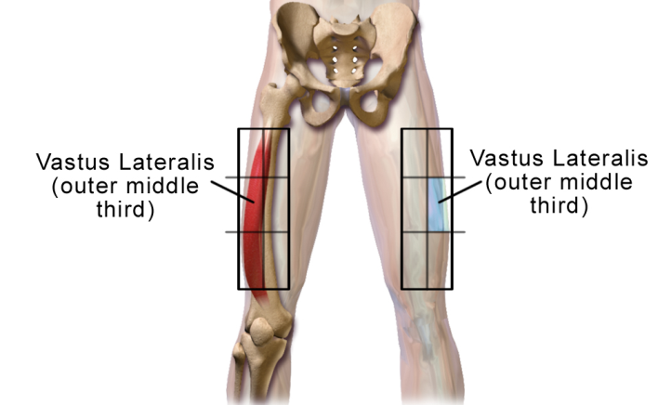
Treatment for Acute Reactions
Patients at risk for anaphylaxis should be prescribed auto-injectable epinephrine
  Epinephrine is the 1st line treatment for anaphylaxis
  In the United States, auto-injectable epinephrine is available in:
    0.1 mg (trade name only)
    0.15 mg (trade name and generic)
    0.3 mg (trade name and generic)
      Patients weighing > 25 kg should be switched to the 0.3 mg dose
  Epinephrine should be injected IM
  into the outer thigh (vastus lateralis)
  Most retrospective studies suggest that
  early administration is key
Notes:
IM > SubQ in time-to-onset and peaks. Vastus lateralis > deltoid. Every guideline on this topic states that epinephrine is the first line treatment for anaphylaxis.

Slide 34
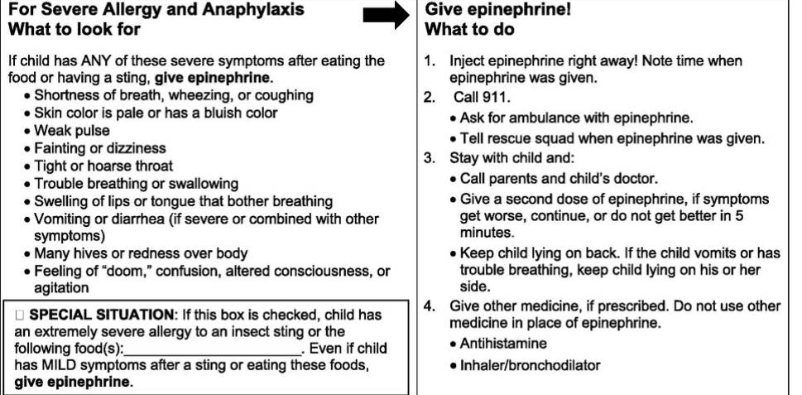
When to Consider Epinephrine?
For Severe Allergy and Anaphylaxis
What to look for
If child has ANY of these severe symptoms after eating the
food or having a sting, give epinephrine.
  Shortness of breath, wheezing, or coughing
  Skin color is pale or has a bluish color
  Weak pulse
  Fainting or dizziness
  Tight or hoarse throat
  Trouble breathing or swallowing
  Swelling of lips or tongue that bother breathing
  Vomiting or diarrhea (if severe or combined with other symptoms)
  Many hives or redness over body
  Feeling of “doom,” confusion, altered consciousness, or agitation
Give Epinephrine!
What to do
Inject epinephrine right away! Note time when epinephrine was given.
Call 911.
Ask for ambulance with epinephrine.
Tell rescue squad when epinephrine was given.
Stay with child and:
Call parents and child’s doctor.
Give a second dose of epinephrine, if symptoms get worse, continue, or do not get better in 5 minutes.
Keep child lying on back. If the child vomits or has trouble breathing, keep child lying on his or her side.
Give other medicine, if prescribed. Do not use other medicine in place of epinephrine.
Antihistamine
Inhaler/bronchodilator
SPECIAL SITUATION: If this box is checked, child has an extremely severe allergy to an insect sting or the following food(s):____________________. Even if child
Has MILD symptoms after a sting or eating these foods, give epinephrine.
***Remember – There is NO contraindication to IM epinephrine***
Notes:
Given that there is no contraindication to epinephrine, it is not unreasonable to state that any time that there is doubt or concern, it is better to give the epinephrine.
The reason to call 911 after giving epinephrine IS NOT because epinephrine can be dangerous. It is because if the reaction were that severe, the patient should be monitored for resolution or sequelae.

Slide 35
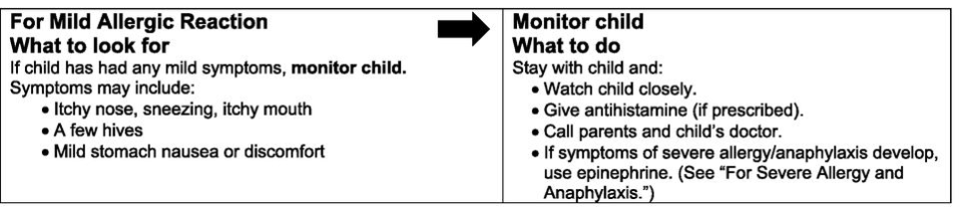
Mild Reaction can be Treated with Antihistamines
For Mild Allergic Reaction
What to look for
If child has had any mild symptoms, monitor child.
Symptoms may include:
  Itchy nose, sneezing, itchy mouth
  A few hives
  Mild stomach nausea or discomfort
Monitor Child
What to do
Stay with child and:
  Watch child closely.
  Give antihistamine (if prescribed).
  Call parents and child’s doctor.
  If more than 1 symptom or symptoms of severe allergy/anaphylaxis develop, use epinephrine. (See “For Severe Allergy and Anaphylaxis.”)
Example antihistamine doses:
  cetirizine (0.25 mg/kg up to 10 mg)
  diphenhydramine (1 mg/kg up to 50 mg)
**Antihistamines should not be given in lieu
of epinephrine for anaphylaxis
Notes:
It is important to make families and patients aware of the fact that this is not to be used in place or before epinephrine for any concerning reaction.

Slide 36
Anaphylaxis Preparedness Questionnaire
http://college.acaai.org/anapylaxisprep
Notes:
This is a tool that providers can use to assess how prepared their patients are to manage allergic reactions. This can be completed by patients/parents and then reviewed with the health care provider.

Slide 37


Management of Food Allergies in the School Setting
There are numerous resources to help educate patients and school personnel
  https://www.cdc.gov/healthyschools/foodallergies/index.htm
All 50 state have a law in place to either allow or require schools to have “stock epinephrine”
  To see your state’s status and law:
    https://www.foodallergy.org/education-awareness/advocacy-resources/advocacy-priorities/school-access-to-epinephrine-map
Notes:
Local practitioners can work with their states and school systems to better understand how it is being done locally.

Slide 38

How to Handle the Classroom and Cafeteria
There are no set guidelines for these situations
Current CDC “voluntary guidelines” provide tips for schools and parents
  Special seating arrangements can be considered when age and circumstance appropriate (e.g., during meal times, birthday parties)
  Staff and students should wash their hands and clean surfaces to reduce the risk of exposure to food allergens
  The importance of not sharing food
  *There is no one size fits all for all schools and all families
CDC Voluntary Guidelines for Managing Food Allergies in Schools and Early Care and Education Programs - https://www.cdc.gov/HealthyYouth/foodallergies/pdf/13_243135_A_Food_Allergy_Web_508.pdf
Notes:
Different schools and school districts take different measures to decrease risk of allergen exposure for food allergic students in schools. There are no mandated guidelines for school management, but the CDC does provide some guidance.

Slide 39

Allergen Free Tables and Schools?
Very few studies so limited data available:
  Self-designated peanut-free schools and schools banning peanuts from being served in school or brought from home reported allergic reactions to nuts.
  Policies restricting peanuts from home, served in schools, or having peanut-free classrooms are not associated with lower epinephrine administration rates.
  Schools with peanut-free tables, compared to without, had lower rates of epinephrine administration
    incidence rate per 10,000 students 0.2 and 0.6, respectively
  One must consider the social stigma of isolation of “allergen free tables”
  *And remember, peanut is only one of the many allergens out there.
Bartnikas LM, et al. J Allergy Clin Immunol. 2017 Aug;140(2):465-473.
Notes:
This is from one group of public schools in Massachusetts.
No actual intervention studies.
Unclear how it is in other states, school systems, private vs public, etc.

Slide 40

Airlines
Every airline has their own policy regarding travelers with food allergies
  Families should be counseled to understand these policies, that they differ amongst airlines and that policies can change
  https://www.allergicliving.com/2018/05/15/allergic-livings-airlines-and-allergies-policies-directory/
The only data on risk-mitigation come from self-reported, retrospective studies.
The following have been reported to lower risk in one study:
  Requesting a buffer zone, announcement to not eat peanut, or peanut-free meal
  Wiping tray table
  Bringing own food
  Avoiding use of airline blanket/pillow
Greenhawt M, et al. Ann Allergy Asthma Immunol. 2018 May;120(5)
Notes:
There are no intervention studies. All data is self-reported. There is no outcomes data on whether or not airline policies actually make a difference.

Slide 41

Risks and Route of Exposures
Route of exposure is an important concept for families and patients to understand
Severe reactions generally occur as a result of oral exposure to allergen
With the majority of allergens, risks of severe reaction to inhalation of vapors or casual skin contact are low.
  Studies have shown that even in severely allergic patients, peanut butter when near a patient, or even wiped on the skin, does not lead to concerning reactions.¹
  In addition, peanut allergen can only be detected in the air during active peanut shelling. It can not be detected immediately after shelling is stopped.²
  The one exception to this may be when the allergen is being cooked or fried, especially with fish or shellfish allergens
Simonte SJ, et al. J Allergy Clin Immunol. 2003 Jul;112(1):180-2.
Johnson RM, et al. Allergy Asthma Proc. 2013 Jan-Feb;34(1):59-64
Notes:
In the Simonte article, they masked peanut butter by smell and look, and applied peanut butter versus soy butter on the skin, and had children inhale the fumes. All had anaphylaxis by history or peanut IgE>50. None had respiratory or systemic reaction. Some had redness, itching, or wheal/flare locally with peanut butter.
Johnson article used ELISA to measure detectable peanut protein in air and ground with various scenarios. The air while shelling peanuts could detect very low levels in one sample, but the ground could not.

Slide 42
Prevention of Food Allergy
Notes:
No notes.

Slide 43
Prevention of Food Allergy
New guidelines on timing of peanut introduction have been put out by the National Institutes of Health¹
  Guidelines are based on the first randomized controlled study of early introduction of allergen for the prevention of food allergy
  The Learning Early about Peanut Allergy (LEAP) trial²
    Peanut introduced to high-risk infants at 4-11 months of age
    Consumption group continued ingestion of peanut at least 3 times/week for 60 months
 | Peanut Consumption Group | Peanut Avoidance Group | P value
Peanut Allergy at 60 months of age | 1.9% | 13.7% | <0.001
Togias A, et al. Ann Allergy Asthma Immunol. 2017 Feb;118(2):166-173.
Du Toit G, et al. N Engl J Med 2015;372:803-813
Notes:
The NIH guidelines and updates are specific to peanut allergy. The Du Toit article is the “LEAP” article.
In the LEAP article, the effect was much greater in those that actually ate peanut 3 times per week (the per-protocol analysis), than in all comers who were randomized (the intention-to-treat analysis).

Slide 44
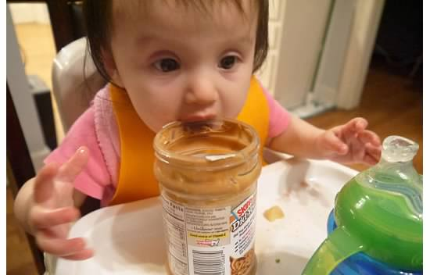
Current Infant Feeding Guidelines
Current guidelines are ONLY for peanut:
Guideline | Infant Criteria | Recommendations | Earliest Age of Peanut Introduction
1 | Severe eczema, egg allergy, or both | Strongly consider evaluation by sIgE measurement and/or SPT and, if necessary, an OFC. Based on test results, introduce peanut-containing foods. | 4-6 months of age
2 | Mild-to-moderate eczema | Introduce peanut containing foods | Around 6 months
3 | No history of eczema or food allergy | Introduce peanut containing foods | Age appropriate and in accordance with family preferences and cultural practices
Togias A, et al. Ann Allergy Asthma Immunol. 2017 Feb;118(2):166-173.
Notes:
The current infant feeding guidelines address 3 groups of infants:
For infants with severe eczema and/or egg allergy, the recommend is to strongly consider evaluation of peanut allergy.
For infants with mild-moderate eczema, recommendation is to introduce peanut containing foods around 6 months of age in age-appropriate forms.
For infants with no history of eczema or food allergy, peanut containing foods can be introduced in an age-appropriate manner and in accordance with family preferences and cultural practices.

Slide 45
For Infants with Severe Eczema and/or Egg Allergy
Severe eczema
or egg allergy or both
Peanut sIgE*
Peanut Skin Prick Test
<0.35
≥0.35
0-2 mm
3-7 mm
≥8 mm
Risk of reaction low.
Over 90% will have (-) SPT to peanut.
Options:
Introduce peanut
at home
Supervised feeding
in the office
(based on provider/parental preference)
Refer to specialist for
consultation/SPT protocol
Risk of reaction low.
(95% will not have peanut allergy).
Options:
Introduce peanut
at home
Supervised feeding
in the office
(based on provider/parental preference)
Risk of reaction varies from moderate to high.
Options:
Supervised feeding in the office
Graded OFC in a specialized facility
Infant probably
allergic to peanut.
Continue evaluation and management by a specialist
Togias A, et al. Ann Allergy Asthma Immunol. 2017 Feb;118(2):166-173.
Notes:
This is meant to help primary care providers. They can order the peanut-specific serum IgE in their patients if they feel comfortable doing this. This should be done as early as possible (ideally 4-6 months of age) so that if negative, they can start the introduction, and if positive, they can be referred to an allergist.

Slide 46
Early Introduction Notes
A practical guide on how to introduce peanut can be found on the ACAAI website
  https://acaai.org/news/new-guidelines-show-how-introduce-peanut-containing-foods-reduce-allergy-risk
ACAAI joint venture with the National Peanut Board: https://preventpeanutallergies.org
Early introduction may also be of benefit for egg
More studies are needed to determine whether early introduction of other allergens could be of benefit in high-risk populations
Or if early introduction in the general population is beneficial
Perkins ML, et al. N Engl J Med 2016;374:1733-43, Al-Saub B et al. Int Arch Allergy Immunol. 2018;177(4):350-359
Notes:
There are more than 1 egg intro studies, and meta-analysis suggest it to be beneficial.
The EAT trial (Perkins et al.) suggested that early intro of foods was not beneficial in general/breastfed population (although it may have decreased allergy rates to peanut and egg in the per-protocol analysis).

Slide 47
Food Allergy Treatment
Notes:
No notes.

Slide 48

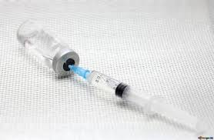

Treatment for Food Allergy
While there are no approved therapies for food allergy, current research is showing efficacy of immunotherapy for food allergies
  Immunotherapy for food allergy works similar to “allergy shots”
  Current research has shown immunotherapy can be effective for different foods using various routes of exposure
Notes:
Older studies suggest that allergy shots could actually work for food allergies (specifically peanut), but the adverse effects were too great to continue as a primary treatment option.

Slide 49
Routes of Immunotherapy for Food Allergy
Oral immunotherapy (OIT)
  Ingesting increasing amounts of the food over time until a target “maintenance dose”
  Daily oral dosing, dose increases occur under medical supervision
Epicutaneous immunotherapy (EPIT)
  Patch containing the food protein is placed on the skin daily
  Fixed amount of allergen on the patches
Sublingual immunotherapy (SLIT)
  Holding a small volume of liquid with the allergen under the tongue
  Daily dosing
Burks AW, et al. J Allergy Clin Immunol. 2018 Jan;141(1):1-9
Notes:
For EPIT, there is only one company that has a device for this that is currently being studied. Realize that OIT is currently being practiced off label by allergists around the country.
SLIT has not progressed to the point of having a product that is being tested for the goal of an FDA approved product.

Slide 50
Example of Oral Immunotherapy Schedule
Rush
Build-Up
Maintenance
?
Initial dose
escalation
Home dosing
Maintenance
Build-Up
Notes:
This is meant to give an example of how the up-dosing is done in most studies.
The rush build up is rarely used, and only in small studies.
For now, maintenance is likely to be life-long.

Slide 51
Efficacy of Immunotherapy
Data to date suggest that the efficacy of OIT > SLIT > EPIT
  No studies have directly compared treatment approaches
These effects are likely due to dose differences:
EPIT (250mcg) < SLIT (2.5mg) < OIT (300mg)
There have been randomized, double-blind, placebo-controlled Phase 3 studies examining EPIT and OIT for peanut immunotherapy
Burks AW, et al. J Allergy Clin Immunol. 2018 Jan;141(1):1-9
Notes:
There is some thought that EPIT efficacy increases with time on therapy as well.

Slide 52

Adverse Events
Data suggests that safety of EPIT > SLIT > OIT
Oral immunotherapy¹
  GI symptoms the most common (abdominal pain, vomiting)
  Followed by oral itching
  11.6% from the active group withdrew due to adverse events
Epicutaneous immunotherapy²
  Local skin reactions the most common
  1.7% from the active group withdrew due to adverse events
¹Vickery PB, et al. N Engl J Med. 2018 Nov 22;379(21):1991-2001. ²Fleischer DM, et al. JAMA. 2019 Feb [epub].
Notes:
This is Phase III data for OIT and EPIT. It is important to note that there are no studies that directly compare OIT and EPIT.

Slide 53

Goals and Roles of Therapy
Goals of immunotherapy may differ between physicians and families and from one patient to another
  Some families simply want a “safeguard” from accidental ingestions.¹
  Others may want a cure for the food allergy.
With OIT, a small portion of subject who complete
the therapy achieve “sustained unresponsiveness”^{2,3}
  However, this has not been assessed for EPIT and SLIT
Because the therapies differ and goals of patients/families differ, a shared decision making approach will need to be used if multiple therapies become available.
¹Greenhawt M, et al. Ann Allergy Asthma Immunol. 2018 Nov;121(5):575-579.
²Burks AW, et al. N Engl J Med. 2012 Jul 19;367(3):233-43.
³Vickery BP et al. J Allergy Clin Immunol. 2014 Feb;133(2):468-75.
Notes:
The Greenhawt article interviewed families who enrolled in one of the EPIT or OIT studies. The Burks article was Egg OIT and published in NEJM. The Vickery article was peanut OIT.
Sustained unresponsiveness was defined by tolerating a set dose (greater than at baseline) after stopping therapy for up to 2 months.
As of 1/10/19, EPIT removed their FDA application and peanut OIT has not filed application.

Slide 54
Other Therapies Under Investigation
Adjuvants to immunotherapy are being tested in hopes of improving efficacy
and/or safety
  Examples include anti-IgE therapy and probiotics
Anti-IgE therapy has also been studied as a mono-therapy for peanut allergy
Other approaches include vaccines using modified peanut proteins, anti-cytokine therapy, Chinese herbal therapy, combination therapies
Wood RA, et al. J Allergy Clin Immunol. 2016;137(4):1103-10. Tang ML, et al. J Allergy Clin Immunol. 2015;135(3):737-44. Leung DY, et al.
N Engl J Med. 2003;348(11):986-93
Begin P, et al. Allergy Asthma Clin Immunol. 2014 Jan 15;10(1):1.
Notes:
The Wood article examined omalizumab given prior to, and at the first part of an OIT protocol.
The Tang article compared OIT plus probiotics to placebo OIT and placebo probiotics. It did NOT compare OIT to OIT+probiotics
The Leung article examined an anti-IgE monotherapy which was an older drug (not omalizumab), however omalizumab will be studied as a monotherapy in the future.
The Begin article was on multi-food OIT, which has only been reported out of a single center. There are no good data on multi-food OIT to date.

Slide 55
Take-home points
Notes:
No notes.

Slide 56
Summary
Food allergy affects up to 10% of the US population
Diagnosis relies on history, with testing providing supportive information
Allergen avoidance, education, and preparation for emergencies are the mainstays of current management
Several new therapies are in clinical trials
Notes:
No notes.

Slide 57
Approach to patients presenting with concern for food allergy
If history & time course is highly suspicious for a food allergy, recommend avoidance of identified triggers.
Targeted testing can be performed to only suspected foods
(panel testing should NOT be done).
Provide guidance for allergen avoidance, prescribe epinephrine auto-injector and educate on management of allergic reactions
Refer to Allergy for assistance in confirming the diagnosis and counseling
Notes:
Take home points:
A detailed history of allergen exposure and reaction is important.
A dietary history is necessary as well - if the patient is eating the food without reactions, he/she is by definition not allergic to that food, so do not test tolerated food.
Indiscriminate testing results in false positives and results in unnecessary food avoidance and burden/stress on the patient/family.

Slide 58
Additional Resources
For Patients: https://acaai.org/allergies/anaphylaxis
Patient Video: Introducing peanut-containing foods to prevent peanut allergy
Early Peanut Introduction Partnership Website
COLA: Update on Food Allergy
References
Addendum guidelines for the prevention of peanut allergy in the United States: Report of the National Institute of Allergy and Infectious Diseases-sponsored expert panel. Togias A, Cooper SF, Acebal ML, et al. Ann Allergy Asthma Immunol. 2017 Feb;118(2):166-173.e7.
Food allergy: a practice parameter update-2014. Sampson HA, Aceves S, Bock SA, et al. J Allergy Clin Immunol. 2014 Nov;134(5):1016-25.e43.
New treatment directions in food allergy. Sampath V, Sindher SB, Zhang W, Nadeau KC. Ann Allergy Asthma Immunol. 2018 Mar;120(3):254-262.
Notes:
No notes.

