Slide 1
Relative Value Units
Wednesday,
March 16, 2022
7:30 pm CT

Slide 2
M. Razi Rafeeq, MD, FACAAI Andrew Nickels, MD, FACAAI
Advocacy Council’s
Billing and Coding Committee

Slide 3
Objectives
Learn the historical development of the RVU system.
Understand how RVUs, particularly work RVUs, affect day-to-day practice habits.
Appreciate how RVUs fit into practice management, job searches, practice valuation.

Slide 4
Polling Question 1
Does your practice track RVUs annually?
Yes
No
Unsure

Slide 5
History of Reimbursement
Customary, Prevailing, and Reasonable Charges
Resource-Based Relative Value Scale or RBRVS
CMS contracted with researchers at Harvard University (1985)
RBRVS took many years with guidance from over 200 physicians in 33 specialty groups
Omnibus Budget Reconciliation Act of 1989
Physician payment system established by CMS – Implemented in January 1992
Established “Resource-Based Relative Value Scale” or RBRVS
THREE major component concepts:
Relative value units
Geographic adjustments
Conversion factor
Limits on balance billing

Slide 6
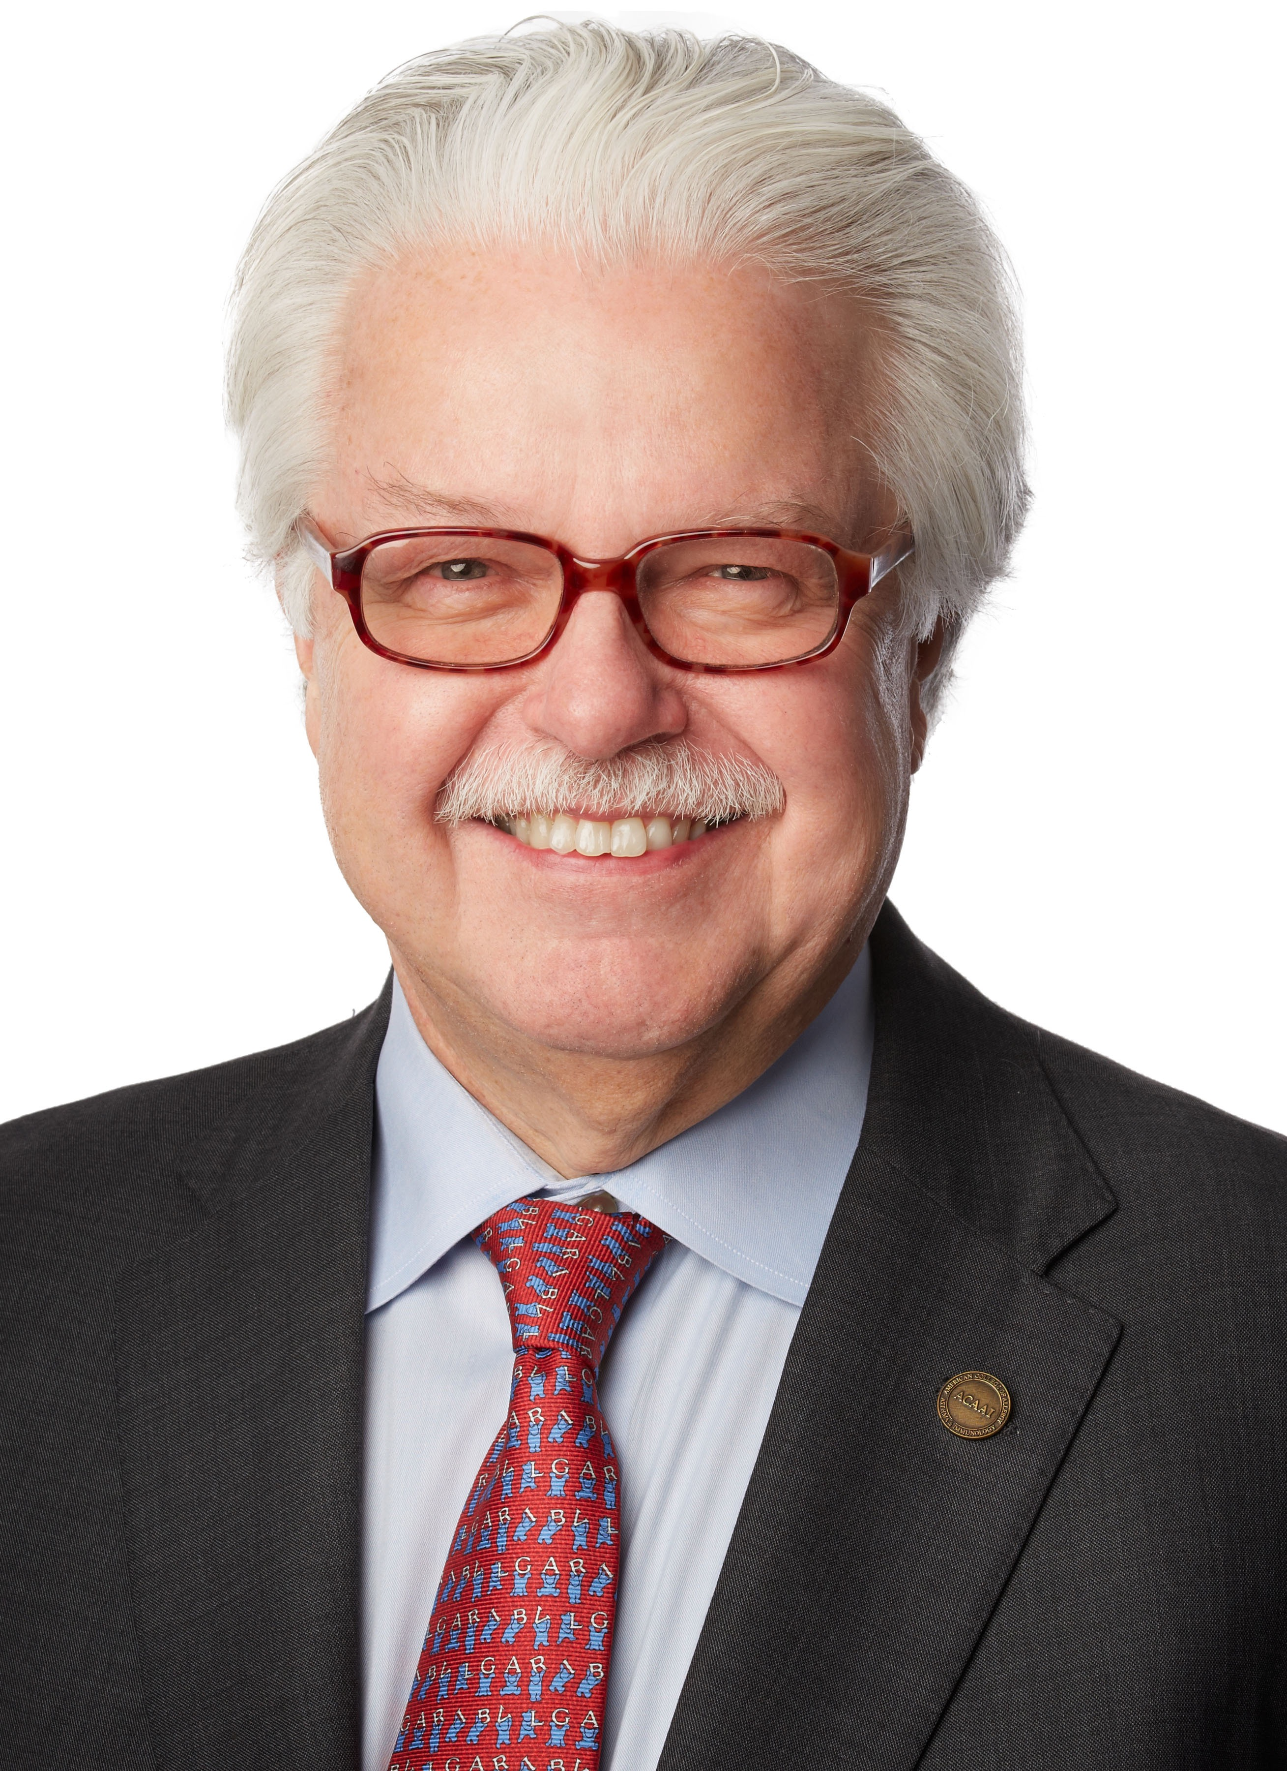
ACAAI Influence on RBRVS
Engagement with AMA/Specialty Society RVS Update Committee (RUC)
Dr. Donald Aaronson, FACAAI
Dr. Gary Gross, FACAAI
Dr. James Sublett, FACAAI

Slide 7
RVUs and Allergists: What you need to know.
Numerical values that model healthcare assigned to each CPT and E/M code
https://www.cms.gov/medicare/physician-fee-schedule/search
CMS sets values based on input from AMA
Current Procedural Terminology panel
Relative Value Update Committee (RUC)
RBRVS Overview. American Medical Association.
Notes:
History of RVUs
Customary, Prevailing and Reasonable charges
Medicare reimbursement in mid 1970s and early 1980s
Based on CPR charges
RBVRS – Resources Based Relative Value Scale implemented in 1992
CMS contracted with Harvard Group to develop RBRVS
Continues to be industry’s standard for physician reimbursement
Based on System of CPT codes and RVUs
Determined by two AMA panels
CPT Current Procedural Terminology
RUC Relative Value Update Committee
Used by CMS to set Medicare payment
Used by nearly all commercial payers
NOT just part of the Medicare payment formula
Private insurers set fees

Slide 8
Nuts & Bolts of RVUs
Three Components:
Physician work (wRVUs)
Practice expense (peRVU)
Professional liability insurance (pliRVU)
Total RVU = wRVU + peRVU + pliRVU
Notes:
Physician work component
The physician work component accounts for an average of 51% of the total relative value for each service. The factors used to determine physician work include the time it takes to perform the service, the technical skill and physical effort, the required mental effort and judgment and stress due to the potential risk to the patient. The physician work relative values are updated each year to account for changes in medical practice. Also, CMS must review the whole scale at least every 5 years.
Practice expense component
The practice expense component accounts for an average of 45% of the total relative value for each service. The values were based on a formula using average Medicare-approved charges from 1991 (the year before the RBRVS was implemented) and the proportion of each specialty's revenues attributable to practice expenses. In January 1999, CMS began a transition to resource-based practice expense relative values for each CPT code, which differ based on the site of service.
Professional liability insurance (PLI)
On Jan. 1, 2000, CMS implemented the PLI relative value units. The PLI component of the RBRVS accounts for an average of 4% of the total relative value for each service. With this implementation and the final transition of the resource-based practice expense relative units on Jan. 1, 2002, all components of the RBRVS are resource-based.

Slide 9
Work RVU (wRVU)
Harvard RBRVS study
Time requested to perform the service
Technical skill and physical effort
Mental effort and judgement
Psychological stress associated with the Physician's concern about iatrogenic risk to the patient
Not based only on time
Divided into work before, during, and after a service
Some codes have NO associated physician work

Slide 10
Practice Expense RVU (peRVU)
Costs of maintaining a practice
Rent, equipment, supplies and non-physician staff costs
Direct costs (costs assigned to a specific service)
Staff time, supplies and equipment
Indirect costs
Maintaining a waiting room
Billing service

Slide 11
Malpractice RVU (pliRVU)
Professional liability expenses
Usually the smallest component of the RVU values
“Resource-Based”
Calculated based on formula taking into account the following
National average professional liability premiums
Risk factors (nonsurgical and surgical)
Each code give a PLI RVU based on percentage of specific specialty using code

Slide 12
Geographic Variation in Payment Schedule
Geographic Practice Cost Index (GPCIs; “gypsies”)
Cost-of-Living GPCI
0.949 (Montana)
1.50 (Alaska)
Practice Expense GPCI
0.842 (Mississippi)
1.383 (Santa Clara Country, California)
Malpractice (PLI) GPCI
0.235 (Nebraska)
2.702 (NYC Suburbs/Long Island)
Facility vs. Non-facility

Slide 13
Conversion Factor
Scaling factor that converts the geographically adjusted number of relative value units for each service into a dollar payment amount.
Adjusted (typically annually)
2022 Conversion Factor = $34.6062

Slide 14
Putting it all together…
[(wRVU x wGPCI) + (peRVU x peGPCI) + (pliRVU x pliGPCI)] = Total RVU
Total RVU x $ Conversion Factor = Total Payment
95165 - Example using GPCI for Chicago, Illinois
[(.06 x 1.008)+(.39 x 1.034)+(.01 x 1.925)] x $34.6062 = $16.71 Total Payment

Slide 15
Polling Question 2
How many work RVUs (wRVUs) are associated with percutaneous allergy skin tests (95004)?
A. 0.36
B. 0.01
C. 1.54

Slide 16
Compensation Models
Employed, Non-Owner/Non-Partner
Salary
Salary + Productive bonus
Productivity Based
Private Practice, Owner/Partner
Total collections – Cost= Profit/Pay
How is productivity measured?
Billing
Collections
Total RVUs
wRVUs

Slide 17
Common Allergy Codes: What they mean for YOU?
HCPCS Code | Short Description | Work RVU | Non-FAC PE RVU | MP RVU
95004 | Percut allergy skin tests | 0.01 | 0.1 | 0.01
94010 | Breathing capacity test | 0.17 | 0.6 | 0.02
95017 | Perq & icut allg test venoms | 0.07 | 0.18 | 0.01
95018 | Perq&ic allg test drugs/biol | 0.14 | 0.46 | 0.01
95024 | ID allergy test | 0.01 | 0.23 | 0.01
95076 | Ingest challenge ini 120 min | 1.5 | 1.94 | 0.07
95079 | Ingest challenge addl 60 min | 1.38 | 1.04 | 0.05
95115 | Immunotherapy one injection | 0 | 0.27 | 0.01
95117 | Immunotherapy injections | 0 | 0.33 | 0.01
95145 | Antigen therapy services (1 venom) | 0.06 | 0.95 | 0.01
95146 | Antigen therapy services (2 venom) | 0.06 | 1.8 | 0.01
95147 | Antigen therapy services (3 venom) | 0.06 | 1.73 | 0.01
95148 | Antigen therapy services (4 venom) | 0.06 | 2.6 | 0.01
95149 | Antigen therapy services (5 venom) | 0.06 | 3.48 | 0.01
95165 | Antigen therapy services | 0.06 | 0.39 | 0.01
95180 | Rapid desensitization | 2.01 | 1.89 | 0.09
Each CPT code has variable amounts of wRVU assigned
Some common Allergy codes have LOW or NO wRVU value
Notes:
REMIND audience that the numbers for skin test are per unit and should be multiplied by the number of tests done.

Slide 18
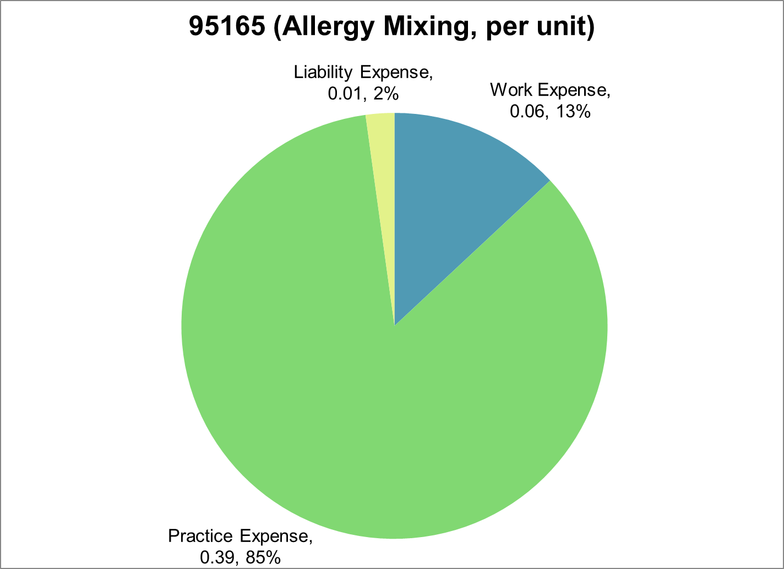
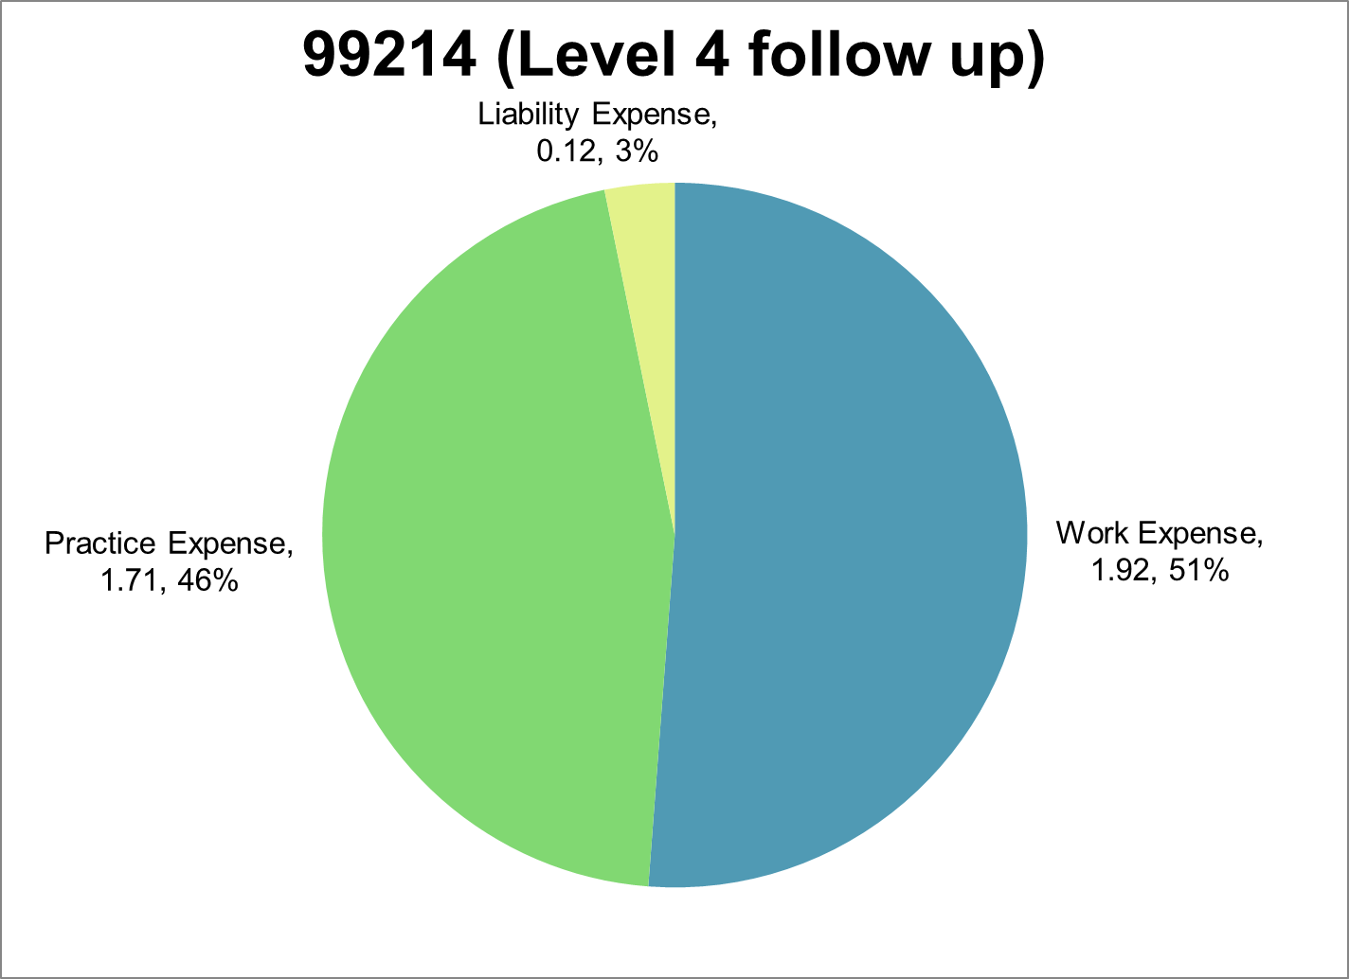
RVU variation by code - keys to the bottom line
Total Non-Facility RVU | Work Expense | Practice Expense | Professional Liability Exp.
0.46 | 0.06 | 0.39 | 0.01
Total Non-Facility RVU | Work Expense | Practice Expense | Professional Liability Exp.
3.75 | 1.92 | 1.71 | 0.12

Slide 19
RVU – Compare 2021 vs. 2022
CPT | Description | 2021 RVUs | CF 2021 = $34.8931 | Revised % change 2021 to 2022 | 2022 RVUs | CF 2022 = $34.6062
94010 | Spirometry | 0.86 | $30.01 | -8.1% | 0.79 | $27.34
95018 | Drug skin testing | 0.62 | $21.63 | -2.4% | 0.61 | $21.11
95076 | Ing. Challenge | 3.44 | $120.03 | 1.2% | 3.51 | $121.47
95117 | 2+ Injections | 0.33 | $11.51 | 2.3% | 0.34 | $11.77
95165 | Antigen /dose | 0.46 | $16.05 | 0.8% | 0.46 | $15.92
99214 | E/M | 3.76 | $131.20 | -1.1% | 3.75 | $129.77

Slide 20
Compensation Data- MGMA

Slide 21
Compensation Data- MGMA
Source: 2021 MGMA Data Dive Provider Compensation, based on 2020 data. Used with permission from MGMA Copyright 2021. https://www.mgma.com/data. Data is protected by MGMA copyright and is prohibited to be shared or re-published without MGMA’s consent.

Slide 22
Polling Question 3
What is your current compensation model?
A. Owner
B. Salary only
C. Salary + Productivity (Billings or Collections)
D. Salary + Productivity (RVU-based)
E. Productivity only (Billings or Collections)
F. Productivity only (RVU-based)

Slide 23
Why you need to know RVUs… Employed Practice
Compensation/Contract negotiation
Straight salary model (employer tracks RVUs)
Pure productivity/RVU-based compensation
Base salary + bonus (annual RVU base plus bonus + quality measures)

Slide 24
Why you need to know RVUs… Employed Practice
Tracking Productivity
wRVU
Total RVU
Patient volume
Detailed report by CPT codes
Dollar for wRVU rate

Slide 25
Why you need to know RVUs… Independent Practice
Financial health of practice
Forecast and address changes to impact bottom lines
Gross charges/RVUs – how productive is your practice (more work = more RVUs)
Compare and evaluate payers – negotiate contracts
Review fee schedule
Benchmarking - compare provider’s productivity against other providers

Slide 26
Why you need to know RVUs… Independent Practice
Maximize billing RVUs – increase revenues
Make sure coding is done accurately
Total patients – New patients and Est patients
Check your E/M coding – avoid under coding
Do not trust your coding to anybody
New hire negotiations
Selling your practice – understand offers for purchase/merger/employment

Slide 27
Summary
Relative Value Units (RVUs) are an important metric to understand
Measurement of clinical activity
Used as a reference between practices and within practices
Important for compensation models/considerations

Slide 28
Polling Question 4
What will help you negotiate better contracts?
A. Understanding wRVUs
B. Knowing the different compensation models
C. Having a plan
D. All of the above

Slide 29
Resources and References
At the ACAAI -
Advocacy Council – AdvocacyCouncil@acaai.org
Billing and Coding Committee – suegrupe@acaai.org
Practice Management Committee – jenniferpfeifer@acaai.org
Center for Medicare & Medicaid Services - https://www.cms.gov
RBRVS overview. American Medical Association. Accessed 2/5/2022. https://www.ama-assn.org/about/rvs-update-committee-ruc/rbrvs-overview
American Medical Association. (2021) Medicare RBRVS 2021 The Physician’s Guide. (book)

Slide 30
Questions?

